Slide 1
A Disability Justice Approach To Humanitarian Action
Reimagining How We Prepare for, Respond to
and Recover from Global Conflicts, Humanitarian Crises
& Climate Change
Facilitated by
Justice Shorter
& Valerie Novack
Notes:
Take a few moments:
What feels uncertain to you in your organization now and over the next two years?
What have you, your team and the organization as a whole done to manage it?

Slide 2
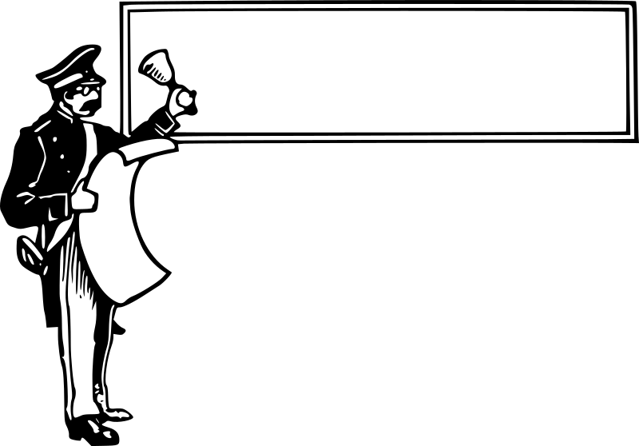
Announcements & Accommodations
Access Needs
Session Flow
Q&A/Adobe Connect Features

Slide 3
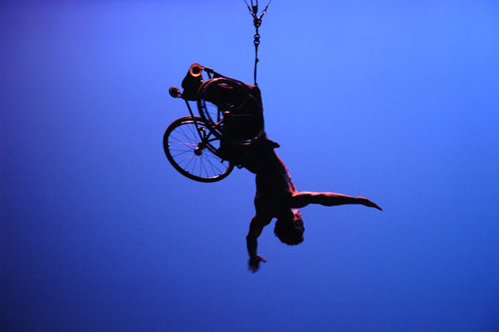
Sins Invalid
Disability justice is a framework coined by a group of queer, disabled women of color that were connected through Sins Invalid, a US-based performance project that incubates and celebrates artists with disabilities, centralizing artists of color and queer and gender-variant artists as communities who have been historically marginalized.
Disability justice recognizes the complexities of multiply marginalized disabled people and aims to be holistic in by recognizing these complexities.
Sins Invalid has created 10 Principles of Disability Justice that, when applied to your work, can help to create a more inclusive, and aware, justice-based response.

Slide 4
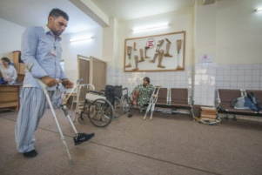
Starter Stats
2013 UN Survey on Disability & Disaster
Only 20% say that they are able to evacuate immediately without difficulty in the event of a sudden disaster, the rest could only do so with a certain degree of difficulty, and 6% would not be able to do so at all;
71% of respondents do not have an individual preparedness plan for natural disasters;
Only 31% always have someone to help them to evacuate, whereas 13% have no one to help them;
Only 17% of respondents are aware of the their community’s disaster preparedness plan;
Only 14% are consulted during the preparation of these disaster preparedness plans

Slide 5
Starter Stats (Continued)
Violence & Sexual Assaults:
In the six weeks after the 2010 Haiti earthquake, 10,813 people were sexually assaulted, the vast majority of whom were female. In the same period, 4,645 individuals were physically assaulted.
Nepalese sources show anywhere from a 50% increase in the first month after the 2015 earthquake to 20-30% increase in the following three months
Climate Change Migration:
Current migration estimates say roughly 200 million environmental migrants by 2050 with some estimates up to 1 billion people.

Slide 6
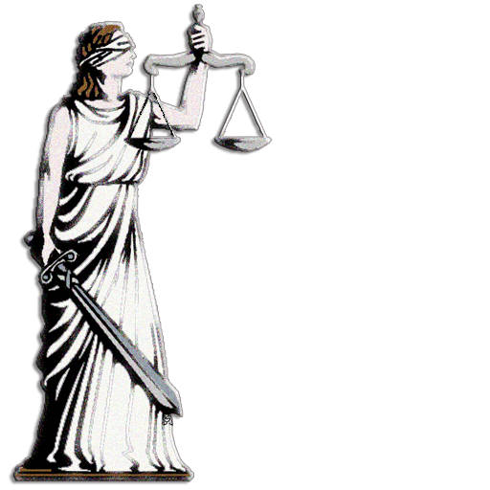
The Legal Lens
2016 Charter on Inclusion of Persons with Disabilities in Humanitarian Action
Convention on the Rights of People with Disabilities
Article 11 – Situations of risk and humanitarian emergencies
Sustainable Development Goals
Goals 4, 8, 11 & 17
Sendai Framework 2015-2030

Slide 7
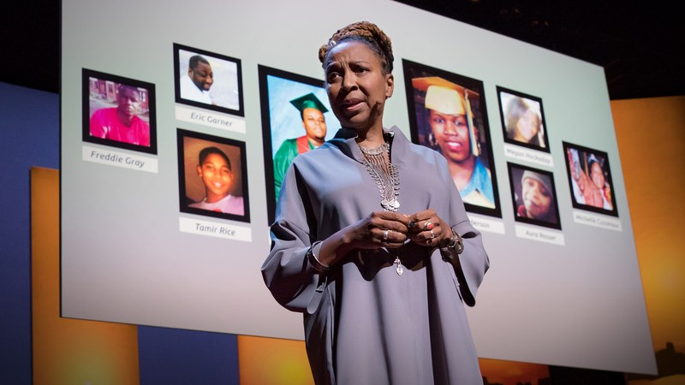
Principle #1 | Intersectionality
Multiple forms of discrimination, experienced by historically marginalized groups in particular, often overlap or intersect in ways that:
Interfere with effective humanitarian interventions
Inhibit equitable response
Impede sustainable development/recovery

Slide 8
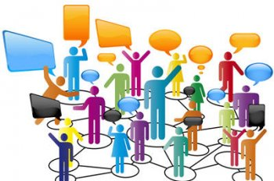
Questions To Consider
How are individuals impacted by ableism, racism, sexism, classism, ageism, religion, homophobia, xenophobia etc., throughout disasters/emergencies?
Do our programs recognize the contributions and access needs of women/girls with disabilities, refugees with disabilities, LGBTQ people with disabilities, religious minorities with disabilities, ethnic minorities with disabilities, climate migrants with disabilities, conflict survivors with disabilities, elders with disabilities, etc.?

Slide 9
Questions To Consider (Continued)
Have we considered how a singular issue can affect several communities differently? For this very reason, truly inclusive international coalitions are elevated via their acknowledgement of the many intersecting ways a specific issue can affect those served.
Do we intervene when the intersectional experiences of survivors with disabilities are dismissed or deemed invalid by those providing humanitarian assistance? Are these behaviors acknowledged as gas lighting and micro aggressions with detrimental impact on a survivor’s ability to prepare, respond and recover?

Slide 10
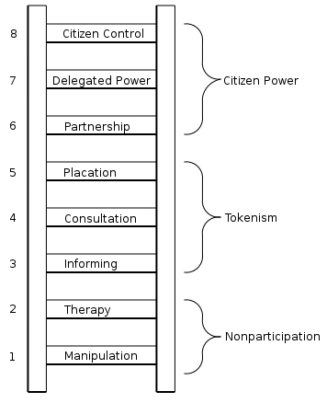
Principle #2 | Leadership By The Most Impacted
Individuals from communities most impacted by conflicts, crises and climate change serving in decision making positions that shape programs, plans/policies, resources and services.

Slide 11
Questions To Consider
Who are in our appointed positions and on our boards? Are impacted individuals given professional development opportunities to become not only in-country staff but global leaders for our organizations as well? Who do we invite to the planning table as equal partners/contributors?
Who is at the table? Who is leading?
In what ways do we value work experience over lived experience when determining which people should be included around decision making tables?
How can we conduct consistent check ins around privilege in our effort to equalize power dynamics as a measure of real empowerment?

Slide 12
Principle #3 | Anti-Capitalist Politic
The application of Capitalism has contributed to histories of harm towards people and Earth. We must rethink the use and distribution of resources recognizing the potential damage to people during large disasters, due to the interdependent nature of global economies, which requires a rethinking of our specific economic systems.
Resources, services and other preparedness and response efforts are often linked to wealth and is disproportionately harmful to lower income citizens, including many with disabilities and people of color.
Distribution and use of resources is often disproportionate between country and the demand for resources is often the root cause of conflict among peoples and depletion of Earth’s resources.

Slide 13
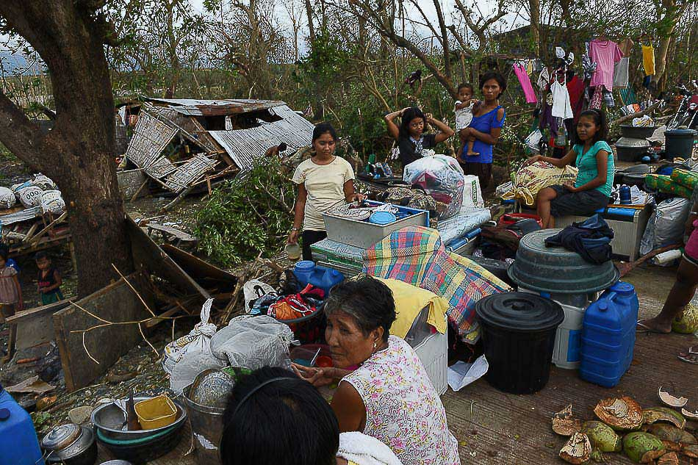
Questions To Consider
How is economic development and global trade contributing to extreme weather and disaster events such as oil spills, water pollutants, flooding, etc.?
Post/Pre disaster contracting- what is the focus in rebuilding destructed communities? Who are we rebuilding for?
Are we addressing the cost prohibitive nature of personal preparedness?
Who is receiving the financial benefits of grants and assistance?
How does disaster capitalism and the “Blank Slate” mentality lead to erasure and further marginalization of people with disabilities?

Slide 14
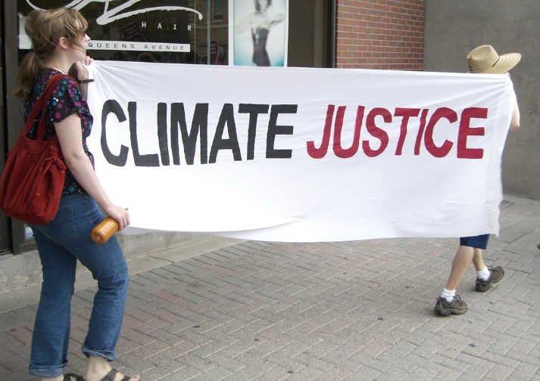
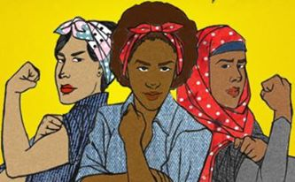
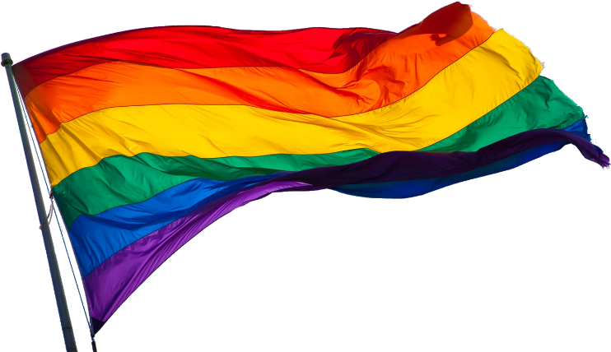
Principle #4 | Commitment to Cross Movement Organizing
Recognizing the whole identities of disaster impacted people is essential in global humanitarian work. Being familiar with the culture and customs, faith, etc. of impacted people with disabilities also connects you to other overlapping issue areas and will allow you to provide movement support and growth in a culturally relevant way.

Slide 15
Principle #4 (Continued) | Commitment to Cross Movement Organizing
Cross movement organizing helps to make sure organizations that may not traditionally be doing emergency preparedness work, are made aware of certain necessary aspects of inclusive disaster planning, making their movements more educated. Likewise, your organization might not focus on other social movement work, but will gain a better understanding of the needs of diverse groups of individuals from work being done in other spheres.

Slide 16
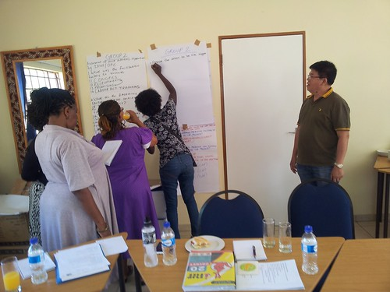
Questions To Consider
Who is in your continuity plans? How are you sharing the load and what problems are you trying to prevent and for who?
Disasters don’t discriminate but environmental barriers and attitudinal biases do create systemic inequality that disproportionately affect individuals with disabilities. How are we planning and preparing regionally and across historically underserved groups?
Do we understand disability as a cross-cutting issue with intersectional relevance to other movements/focus areas?

Slide 17
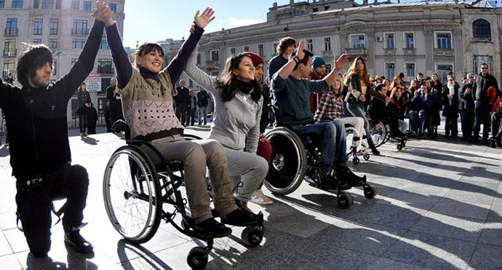
Principle #5 | Recognizing Wholeness
If we can agree that people have inherent worth, then all disaster assistance activities should prioritize safety, dignity, meaningful access, accountability, participation and do no harm.

Slide 18
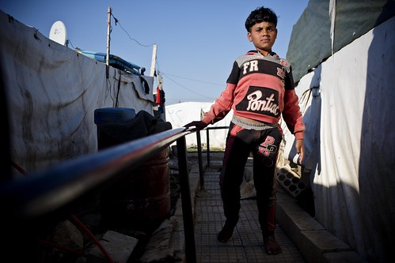
Questions To Consider
How are we creating space throughout humanitarian interventions for survivors to show up as their whole selves without fear of mistreatment?
Do we consider that people with disabilities are also first responders, emergency managers, part of families, in the community, etc.?
How do we recognize the people who can provide assistants and are we fully utilizing the experiential expertise of people with disabilities throughout humanitarian action?

Slide 19
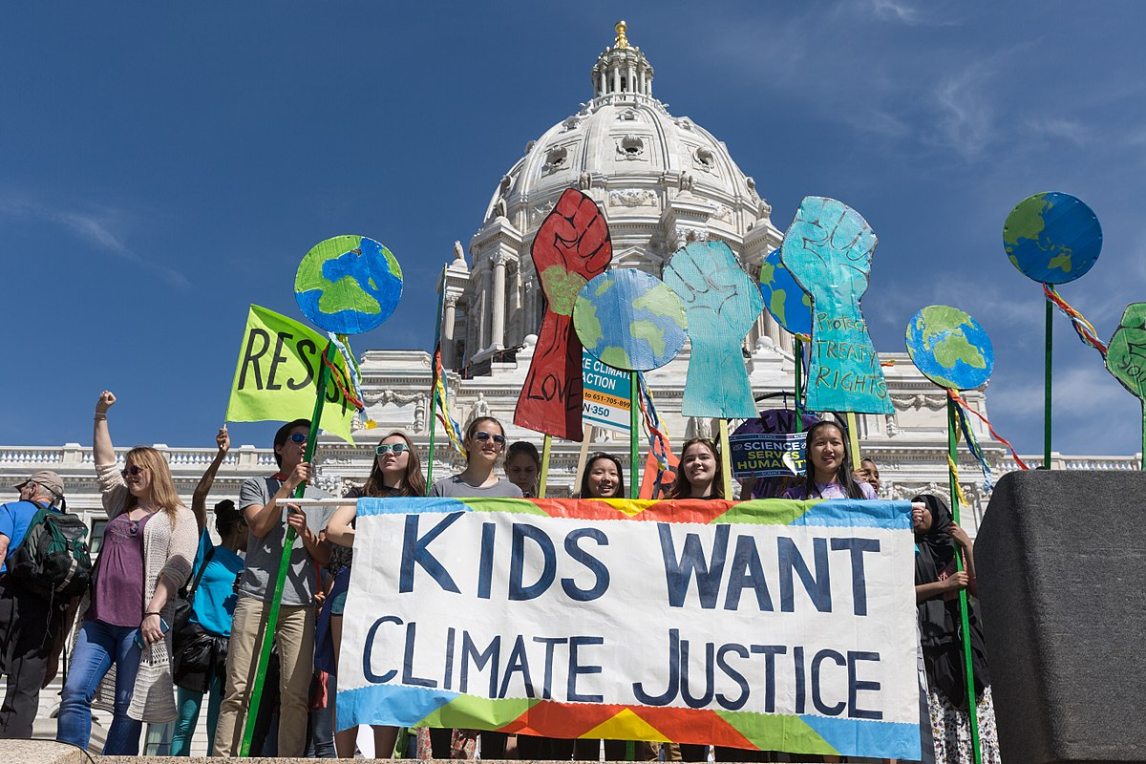
Principle #6 | Sustainability
Sustaining the move towards recovery and resilience in a way that centers bodymind needs in proximity to political, environmental, economic and social challenges.
Climate change is rapidly reshaping the world around us. Climate migrants with disabilities are thus forced to contend with the compound affects environmental barriers can have on access to food/water, shelter/safety, travel/transportation, communal support systems/continuance of care and governmental services/resources.

Slide 20
Questions To Consider
How can we shape sustainability plans to better address the physical, mental and emotional impact disasters have on individuals/communities?
What type of mitigation activities allow us to make connections between Climate Justice and Disability Justice? Has environmental racism or globalization caused physical or mental harm to effected communities?
Are we approaching this as a one off? How are we embedding change throughout processes, programs and policies?
Are we integrating disability justice approaches into all phases of humanitarian action?

Slide 21
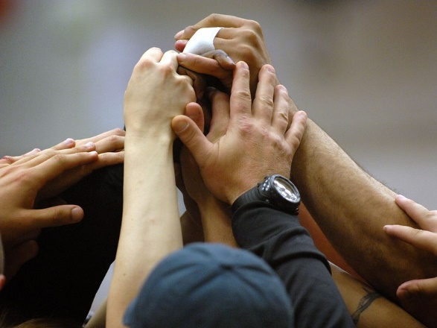
Principle #7 | Commitment to Cross Disability Solidarity
Disability is not a monolith. You may work with a single population, or the loudest voices might primarily be coming from one group, organization, or subset of the disabled population. People have different needs as well as multiple disabilities, working across disability types helps to ensure inclusion in response both for your consumers, and at large.

Slide 22
Questions To Consider
How are we showing up for and creating spaces alongside individuals with different types of disabilities?
Does our work reflect solidarity strategies that help us all survive disasters and receive equal access to emergency resources/services?
How are we addressing inequities that effect some people in the disability community and not others?

Slide 23
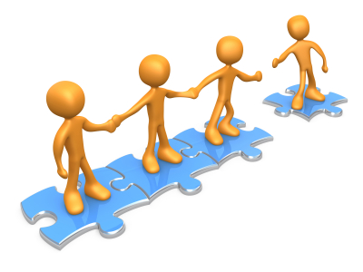
Principle #8 | Interdependence
No one person, organization, or outcome is independent. We are dependent on others whether that is personally or in business. Recognizing this interdependence and pushing against the myth of independence, brings further dignity to those that are openly dependent for certain things.
Interdependence is critical in preparedness and response. Making partnerships, planning as communities and regions, and leveraging strengths and resources are ways to create community driven preparedness that benefits everyone.

Slide 24
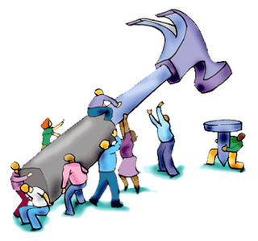
Questions To Consider
How are we understanding the collective/individual needs of those around us including community, non-profit, government and charity? Are we best utilizing these partnerships to best assist everyone?
How do we preserve the dignity of survivors with disabilities by recognizing the value of interdependence during response/recovery?
Do we understand interdependence as a viable strategy for strengthening community living options outside of/free from institutions?

Slide 25
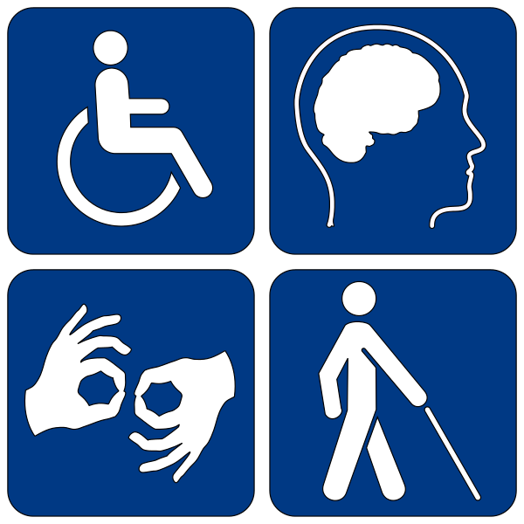
Principle #9 | Collective Access
Collectively meeting access needs while simultaneously respecting independence and self-determination when planning humanitarian interventions.
Examine all aspects of a country’s infrastructure when implementing resettlement strategies to ensure that people with disabilities will be granted access to physical/environmental, judicial/legal, political/democratic, economic/employment/educational and social/community support.

Slide 26
Questions To Consider
How often do we build in access rather than retrofitting changes in after construction/project completion? Can this prolonged process lead to discrimination by delay?
Who or what do we allow to define "average/normal" standards of physical, communication and programmatic access? How do these standards further marginalize people with disabilities?
Have we invited disabled people to partner in creating space useable by all (i.e. refugee camps, temporary shelters, distribution sites, hygiene areas etc.)?
Are we going to a variety of disability centric groups to determine what type of access is lacking?
Do we seek out access suggestions prior to finalizing humanitarian oriented events/activities?
Do we expressly mention which accessibility considerations/accommodations are readily available when publicizing events/programs to prospective attendees?

Slide 27
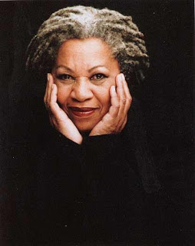
Principle #10 | Collective Liberation
Nothing about us without ALL of us.
“The function of freedom is to free someone else, and if you are no longer wracked or in bondage to a person or a way of life, tell your story. Risk freeing someone else.”
– Toni Morrison
“None of us are free until we are all free.”
– Dr. Martin Luther King

Slide 28
Questions To Consider
Are we advocating for adequate humanitarian action plans for human trafficking survivors, torture survivors, prisoners and detainees with disabilities?
How are we proactively working to prevent and monitor/track asylum/immigration denials of people with disabilities based on claims such as public charge and societal burdens ?
Are we remaining mindful of how displacement after disaster may increase rates of human trafficking? What does this mean in relation to women and children with disabilities? Which type of protection and prevention measures can we collectively implement to address this issue?
Do our teams understand how the lingering effects of colonialism and/or historical trauma can influence a community’s willingness to fully disclose critical needs or work with certain organizations throughout disasters?

Slide 29
Contact Us
Justine “Justice” Shorter
Disaster Protection Advisor
National Disability Rights Network
Justine.Shorter@ndrn.org
Phone: 202-880-2435
Valerie Novack
2019 Portlight Fellow
Center for American Progress
vnovack@americanprogress.org
Phone: 206-707-3754

Slide 30
Thank You

