Slide 1
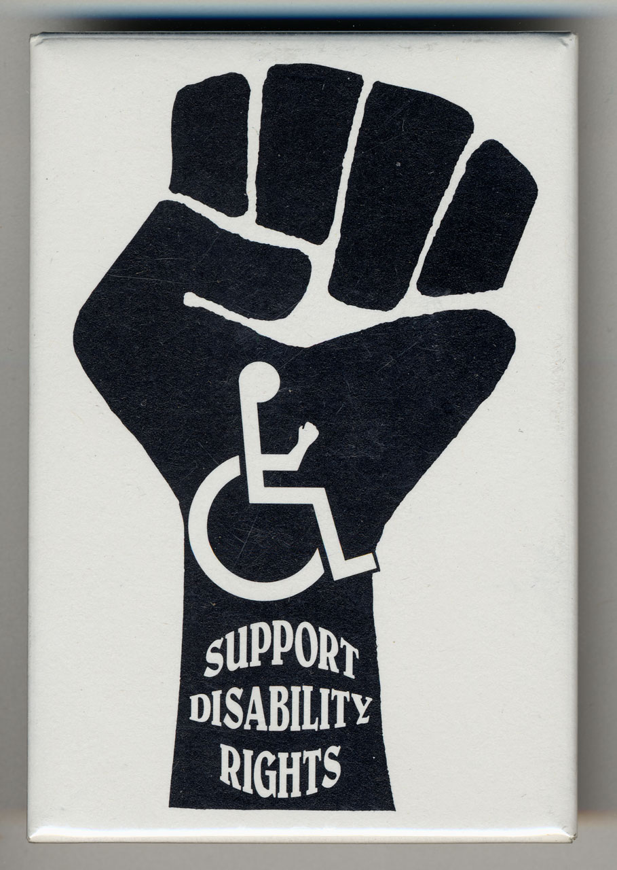
National Disability Rights Network Findings based on focus groups and a national mixed-mode survey of the disability community September 2019
Celinda Lake
Alysia Snell
Jesse Kline
Emily Caramelli

Slide 2
Methodology – Survey
Lake Research Partners designed and administered this survey that was conducted both online and by phone from August 12 – August 20th, 2019. The survey reached a total of 1,000 adults nationwide with a disability, or who have an immediate family member or close friend with a disability. There were 500 completes by phone and 500 completes online. The sample was drawn from a file of listed adults.
The sample was weighted by gender, race, race by gender, party identification, region, and educational attainment to reflect attributes of the actual population.
The margin of error for the total sample is +/-3.1%. The margin of error for people with disabilities in this survey is +/- 4.7%. The margin of error for people with a family member or close friend with a disability in this survey is +/- 3.7%.
This report is among the disability community only, that is, people who self-identify as having a disability and people who have a family member or close friend with a disability.

Slide 3
Methodology – Focus Groups
Lake Research Partners conducted three in-person focus groups on June 10th 2019 among the following groups of registered voters in Baltimore, Maryland:
White people with disabilities
People of color with disabilities
Parents of children with disabilities under 18
Participants were recruited to reflect a mix of ages, party identification, education levels, marital status, and parental status. Groups did not include those who said they were definitely not going to vote in the 2020 election and people with strong partisanship were limited.

Slide 4
Qualitative Research Statement of Limitations
In opinion research, qualitative research seeks to develop insight and direction rather than quantitate precise or absolute measures. Because of the limited number of respondents and the restrictions of recruiting, this research must be considered in a qualitative frame of reference.
The reader may find that some of the information seems inconsistent in character upon first reading this report. These inconsistencies should be considered as valid data from the participant’s point of view. That is, the participant may be misinformed or simply wrong in his or her knowledge or judgment, and we should interpret this as useful information about their level of understanding.
This study cannot be considered reliable or valid in the statistical sense. This type of research is intended to provide knowledge, awareness, attitudes, and opinions about issues and concerns.
The following limitations are inherent in qualitative research and are stated here to remind the reader that the qualitative data presented here cannot be projected to any universe of individuals.
Statement 1. Participants who respond to the invitation of a stranger to participate in this research show themselves to be risk takers and may be somewhat more assertive than non-participants.
Statement 2. Some participants speak more often and more forcefully in focus group sessions than other participants, so their opinions tend to carry more weight in the findings.
Statement 3. Participants “self-select” themselves.
Statement 4. Participants were not selected randomly; as a result each person in the pool of possible participants did not have an equal chance to be selected.

Slide 5
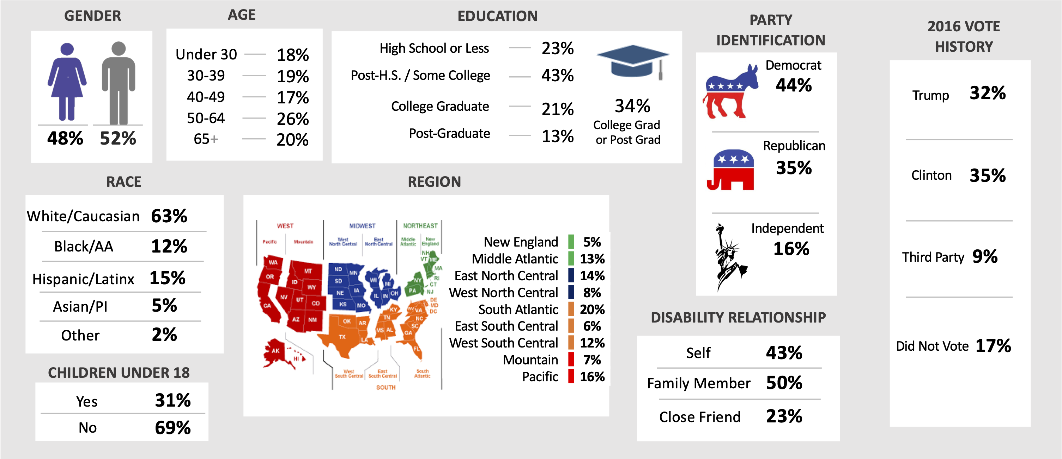
Demographics of the Disability Community - people who self-identify as having a disability and people who have a family member or close friend with a disability

Slide 6
In October 2018, Lake Research Partners conducted a nationwide survey of adults commissioned by the Coelho Center. LRP found the disability community reflective of the overall population as a voting bloc - similar to voters overall, the disability community is more likely to vote in a presidential election (2020) compared to an off-year election (2018).
2018
2019
 | Probably
 | Almost Certain
NDRN: How likely are you to vote in the election in November 2020 for President, Senate, Congress, and other offices…?
2018: How likely are you to vote in the election this November for Senate, Congress, and other offices?

Slide 7
The NDRN data this year shows the disability community closely aligned demographically with the overall adult population surveyed in 2018. In comparison, the total disability community surveyed for NDRN is younger and lower income than adults nationwide in 2018.
Demographics | NDRN 2019 |  | Coehlo Center 2018
 | Total Disability Community | PWD | Adults Nationwide | PWD
Men | 48 | 48 | 49 | 48
Women | 52 | 52 | 51 | 52
Under 50 | 54 | 48 | 49 | 34
Over 50 | 46 | 52 | 46 | 62
White | 63 | 66 | 63 | 63
Black/African American | 12 | 13 | 12 | 15
Latinx | 15 | 11 | 11 | 8
Asian | 5 | 4 | 2 | 0
Northeast | 18 | 19 | 18 | 12
Midwest | 22 | 23 | 21 | 22
South | 38 | 37 | 38 | 45
West | 23 | 21 | 23 | 21
Democrat ID | 44 | 41 | 43 | 41
Independent ID | 16 | 17 | 16 | 16
Republican ID | 35 | 37 | 37 | 37
College | 34 | 24 | 36 | 76
Noncollege | 65 | 75 | 61 | 22
HH income < $50k | 49 | 64 | 36 | 57
HH income $50k + | 44 | 31 | 43 | 22
Likely Voter | 87 | 84 | 74 | 69
Not Likely Voter | 12 | 15 | 25 | 30
Parent of child <18 | 31 | 23 | 27 | 21
Not parent of child <18 | 69 | 77 | 73 | 79
NDRN: Do you, a family member, or a close friend have a disability, such as a physical, mental health,
sensory, learning, cognitive or other disability that impacts daily living? If yes, then please let me know which applies.
Coehlo Center: According to the Americans with Disabilities Act, a "person with a disability" is someone who has a physical or
mental impairment that substantially limits a major life activity; has a record of such impairment; or is regarded as having such
an impairment. Now I am going to read you some statements. For each statement please tell me whether it applies to you or not.

Slide 8
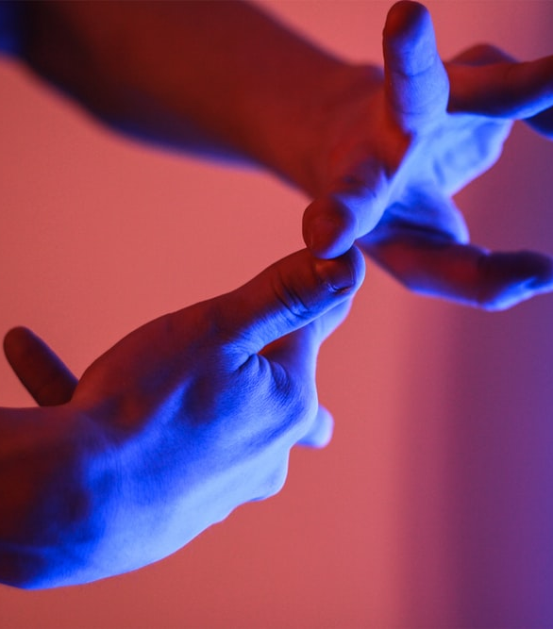
Key Findings

Slide 9
Summary of Key Findings – Context
In focus groups, we learned that people with disabilities and parents of children with disabilities identify with their/their child’s disability in a variety of ways.
The broadest point focus group participants made was that they want it to be understood by other people and political actors that every day life for people with disabilities poses more challenges than everyday life for people without disabilities.
Members of the disability community would feel motivated if politicians addressed the realities they face and fought for solutions to make social and government programs fair and accessible to people with disabilities.
Another strong theme throughout the focus groups was that people with disabilities deserve to be treated like everyone else, though they may have unique struggles.
People with disabilities said they wished other people would simply ask to understand them, instead of assuming their needs.
The focus groups showed a significant difference between the thoughts and opinions of those with disabilities and the parents of children with disabilities. The two audiences approach politics through a first-person lens, resulting in the people with disabilities voicing their opinions from their lived experiences while the parents of children with disabilities did the same – not necessarily thinking about their child’s needs when it came to voting for politicians or policies that would benefit their child most.

Slide 10
Summary of Key Findings – Context
Among the disability community surveyed, 43% identify as a person with a disability, 50% say they have a family member with a disability, and 23% say they have a close friend with a disability.
Among parents of children with a disability (17% of the sample), mental health, learning, and physical disabilities are the most common types of disabilities their children have. A little less than one-quarter have sensory disability and a little less than one in five have a cognitive disability.
People with disabilities are significantly more likely than people with a family member or friend to say they are part of the disability community – 57% vs. 29% strongly agree. Forty-nine (49) percent of parents of a child with a disability strongly agree.
The views of parents of a child with disabilities surveyed are similar to those shared by the total disability community.

Slide 11
Summary of Key Findings – Issues
In focus groups, we heard that parents of children with a disability are concerned about a variety of social and political issues, such as healthcare, the environment, minimum wage, and human rights. There is also concern about division in the country and many feel there is no room for people who are more “in the middle” of the political spectrum these days.
We also heard from people with disabilities that they are concerned about healthcare, Medicare and Social Security, civil rights, education, having a support structure, and being able to get the kind of care that they need, especially mental healthcare.

Slide 12
Summary of Key Findings – Issues
Healthcare is the top concern among the disability community, and each of the subgroups that compose it. People with a family member with a disability are the most concerned about healthcare.
Twenty-one percent (21%) of the disability community and people with disabilities say that healthcare is their top issue.
Nineteen percent (19%) of people with disabilities say that Social Security and Medicare is their top issue.
A strong majority of the disability community is concerned that social programs that benefit them may be eliminated, including Social Security and Medicare, followed by nearly half who are very concerned about the elimination of the ADA.
Both parents of children with disabilities and people with disabilities in the focus groups were more concerned about the Affordable Care Act. They said that while it has benefitted them and people with disabilities broadly, they also see it as a divisive topic because healthcare has become too partisan.

Slide 13
Summary of Key Findings – Political Engagement
A plurality (43%) of the disability community says that there is a movement among people with disabilities today. Those most likely to think so include those under 50, African Americans, and younger people with disabilities.
Focus group participants also talk about personal political action taken around the ACA and healthcare by people with disabilities that makes them feel like there is a powerful movement among people with disabilities today.
In focus groups, participants share examples of the communities and groups they are part of that make them feel like there is a movement.
Parents of children with disabilities discuss finding commonalities with other parents from their child’s schools, support groups, and the internet as sources of “community” for them.

Slide 14
Summary of Key Findings – Political Engagement
The disability community believes it is important to be engaged in their communities and they feel motivated to take action on issues that are important to them with intensity on the side of being engaged in their community. The importance and motivation is similar among the full disability community and people with disabilities themselves.
A full 82% of the disability community says it is important to be engaged in their community (41% very important); parents of children with disabilities are just as likely to say it is important (83% important, 41% very important).
A full 87% of the disability community says they are motivated to take action on issues they care about (34% very motivated); parents of children with disabilities are just as likely to say they are motivated (86% motivated, 34% very motivated).
Politicians delivering on their promises is the top reason the full disability community (51%), people with disabilities, and people with a family member or friend with a disability would become more interested in voting. This finding reflects what we heard in the focus groups.
People with disabilities are more likely than the full disability community and people with a family member or friend to say that candidates focused on issues facing people with disabilities would make them more interested in voting.

Slide 15
Summary of Key Findings – Voting
The disability community’s connection to voting is strong. The following statements are core values among the disability community and people with disabilities:
Voting is necessary to make our voices heard.
With the way things are going now, voting is more important now than ever.
Voting is power.
However, people of color in this community and people of color with disabilities are less likely to agree that voting is power.
Focus group participants also saw voting as a core value, and believe it is a key way to make their voices heard. However, some were concerned about voter suppression and accessibility. They see barriers to voting ranging from accessibility to racism.
Additionally, a strong majority also agrees that it takes too long to see political change happen, but levels of agreement are less intense than they are about voting. This finding is echoed in the focus groups as many participants expressed frustration with the political system, especially at the federal level, because meaningful political change is an extremely slow moving process.

Slide 16
Summary of Key Findings – Voting
People with disabilities agree that issues around disability influence how motivated I feel to vote, especially those under age 50, Independents, and people of color with disabilities are the most likely to strongly agree with this.
The disability community is more likely to disagree that being politically active is not one of my priorities and me or people I know have skipped voting because it is a difficult or inconvenient process.
A strong majority of the disability community agrees that voting on the issues that matter to the disability community can make change. Focus group participants also touched on this, saying they wished there was a more cohesive disability voting bloc that could advocate and vote for issues that affect them directly.
The disability community is more likely to vote for a candidate that votes for legislation that supports people with disabilities. They are less likely to vote against a candidate that votes against legislation that supports people with disabilities. The disability community WILL vote these issues. They want to reward more than punish.

Slide 17
Summary of Key Findings – Treatment of the Disability Community
A strong majority of the disability community is concerned about the treatment of people with disabilities in the U.S. People with disabilities are about 7-points more likely to be very concerned than the full disability community overall.
Democrats with disabilities, women with disabilities, people of color with disabilities, and those with disabilities under age 50 are the most concerned among key demographic subgroups.
Similarly, half of the disability community believes that the rights of people with disabilities are under attack or threatened today, and the same demographic subgroups as above are more likely to believe this.

Slide 18
Summary of Key Findings – Messages
The messages focused on education, voting as a fundamental right, and healthcare are the strongest messages among the disability community.
Focusing on critical protections for people with disabilities that are at stake, the impact of voting, and the gains this community has made over history fall into a second tier but are still very strong for this group.
% Very Convincing | Total | People with Disabilities | People with a Family Member or Friend | Parents of Child with a Disability
[EDUCATION] The future of our nation rests on education today. All children, including children with disabilities, must have access to the best education we can offer. This means our schools must be equipped with the correct resources and the most capable and carefully trained teachers. For this to be possible, we must vote for representatives who will allocate the proper funding to our schools to best serve all students and give special needs students a fair shot at a great education. | 61 | 65 | 60 | 61
[FUNDAMENTAL RIGHT] Voting is a fundamental right. It’s our way to contribute to the future of the country, but just 56% of voting-age Americans voted in 2016. That means for every friend of yours that voted, another one didn’t. Voting gives everyone the opportunity to amplify the voices of those who desperately want and need to be heard. Often, those in the disability community need social change even more. As members of the disability community, we should strive to beat that statistic – ALL of us should vote. | 57 | 56 | 57 | 61
[HEALTHCARE] Healthcare should be one of the top reasons you vote in every election. You never know when an injury or illness will occur for you or a loved one, and your future health may be impacted by how people vote on this issue today. With the future of the Affordable Care Act and coverage for people with pre-existing conditions in doubt, and the cost of insurance and prescription drugs on the rise, we need to vote today. | 57 | 58 | 55 | 60

Slide 19
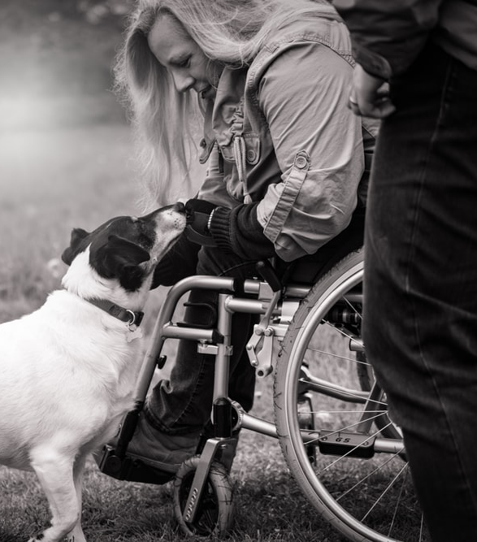
Context

Slide 20
Getting to know the disability community surveyed: A plurality have a disability, half have an immediate family member with a disability, and nearly a quarter have a close friend with a disability. There is some overlap.
Do you, a family member, or a close friend have a disability, such as a physical, mental health, sensory, learning, cognitive or other disability that impacts daily living? If yes, then please let me know which applies.

Slide 21
Demographics of Sample
Demographics | Total | PWD | Family | Friend
Men | 48 | 48 | 43 | 55
Women | 52 | 52 | 57 | 45
Under 30 | 18 | 17 | 17 | 21
30-39 | 19 | 14 | 19 | 29
40-49 | 17 | 17 | 20 | 12
50-64 | 26 | 27 | 26 | 23
Over 65 | 20 | 26 | 17 | 14
White | 63 | 66 | 63 | 58
Black/African American | 12 | 13 | 11 | 8
Latinx | 15 | 11 | 15 | 22
Asian | 5 | 4 | 5 | 7
Northeast | 18 | 19 | 18 | 15
Midwest | 22 | 23 | 23 | 22
South | 38 | 37 | 37 | 37
West | 23 | 21 | 22 | 26
Democrat ID | 44 | 41 | 43 | 48
Independent ID | 16 | 17 | 16 | 18
Republican ID | 35 | 37 | 35 | 28
College | 34 | 24 | 37 | 43
Noncollege | 65 | 75 | 61 | 57
HH income < $50k | 49 | 64 | 43 | 35
HH income $50k + | 44 | 31 | 52 | 54
Likely Voter | 87 | 84 | 87 | 88
Not Likely Voter | 12 | 15 | 11 | 11
Parent of child <18 | 31 | 23 | 37 | 34
Not parent of child <18 | 69 | 77 | 63 | 66
People with Disabilities – 43%
People with disabilities make up 43% of this survey universe.
They are more likely to be over 50 years of age, have a household income of under $50k annually, be non-college educated, and non-parents of children under 18.
Family Member – 50%
Demographics of those with a family member with a disability closely match that of the overall population.
They are slightly more likely to be women, have household income over $50k, and to have a child under age 18 than adults overall.
Close Friend – 23%
Demographics of those with a friend with a disability show this subgroups being more likely to be male, under 40 years old, Latinx, college educated, and to have a household income over $50k than adults overall.
They are less likely to be Republican.
Do you, a family member, or a close friend have a disability, such as a physical, mental health, sensory, learning, cognitive or other disability that impacts
daily living? If yes, then please let me know which applies.

Slide 22
In focus groups, participants highlighted that while they identify as a person with a disability, it is not their primary identity and they want to be treated like everyone else.
“It is not necessarily the first thing that I will say, but absolutely.” – White person with disability, Baltimore
“I just go I am a person with a disability because I want to be established as a person first and disability second.” – Person of color with disability, Baltimore
“So, this is like…as someone with a disability, I just want to be treated like everybody else. I don’t want to be treated any different. I am young and people look at me like I have the plague.” – White person with disability, Baltimore
“I wish [other people] knew what a huge adjustment it is in all areas of your life.” – White person with disability, Baltimore
Do you identify as a person with a disability? (Probe: what does that mean to you?)
What do you wish other people understood about disabilities and people with disabilities?

Slide 23
Participants discussed words they never want to hear in reference to a person with a disability or their child with a disability.
White people with disability | People of color with disability | Parents of child with disability
“Don’t make assumptions, especially if you saw something on TV or something.” “I will get people from other places come in and talk to me and they will be like how do you deal with these crazy people. I am like I am one of them. I hate that.” | “You are handicapped.” “Useless.” “Lazy.” “A waste.” “Spoiled” “Special.” “Retarded.” | “Don’t say retard.” “Don’t call him dumb or stupid or bad. Because it is a disorder and it’s not their fault.” “Kind of along the lines of what she said, not bad or labeling the child is a problem or a behavioral nightmare sometimes.” “I agree – be open minded and give them as many opportunities and believe in them and love them and respect them because they are just like you.”
What words or phrases should people never use when referring to a person with a disability?

Slide 24
Parents of children with disabilities say they wish people could understand that their child’s behavior is different from other children and that it isn’t a bad thing.
“Or even understanding that just because they are chronologically this age does not mean that they are functioning at that age.” – Parent of child with disability, Baltimore
“That sometimes some of the things that they may do is not malicious. They are acting out sometimes and they can’t control it. You know sometimes people get upset.” – Parent of child with disability, Baltimore
“So, I think people just don’t understand it. They try to, but you will never know what it is like until you experience it, and that is your child.” – Parent of child with disability, Baltimore
What do you wish other people understood about disabilities and people with disabilities?

Slide 25
People with disabilities and parents of children with disabilities overwhelmingly want other people to be able to understand what they go through. They are human, not their disability.
White people with disability | People of Color with disability | Parents of children with disability
“I was just going to say that I always say I just wish you could step in my shoes and live (you know what I mean) what I live for a day or a week or whatever and see.” | “We could accomplish a lot more and even get back to work if we had the resources, but if you have developmental disabilities, there is no real support system, because the rehab services really help you get a job or a good job.” | “That they are human beings like anyone else and that despite he might have a learning disability and that it is hard for them to express, they still have the same feelings as everybody else does.”
“That you are constantly wishing for me to get better is awful.” | “Even with a disability. I can probably do as much as you, if not more.” | “It’s just knowing that they can hear and they do understand.”
“I wish too that they knew what a huge adjustment it is in all areas of your life.” | “Well for me in particular, I want to be included and I am not standoffish, and pretty much notice that there might be something going on, and even when you do say it, they want to kind of…you get shunned in a way sometimes.” | “That they are not unintelligent. It is just that they might take a different route to get there and it may take them longer. It’s just a different way of thinking for them.”
“I wish that people would understand that we are not lazy.”
What do you wish other people understood about disabilities and people with disabilities?

Slide 26
Nearly a third of the overall disability community are parents of children under 18 (31%). Of the 17% who are parents of children with a disability, mental health, learning, and physical disabilities are the most common types of disabilities their children have. A little less than one-quarter have a sensory disability and a little less than one in five have a cognitive disability.
[AMONG THOSE WITH A CHILD WITH A DISABILITY] Do any of your children have a disability, such as a physical, mental health, sensory, learning, cognitive or other disability that impacts daily living? [multiple response question]
Parent of Child with a Disability
Parent of Child with no Disability
No Child in Household

Slide 27
Parents of children with disabilities are comfortable calling their child’s disability by name as a descriptor.
Parents of Child with Disability
“Anxiety”
“Slow processing”
“Cognitive disability”
“Autism”
“ADHD”
“A genetic disorder”
Thinking about your child with a disability, what are the words or phrases you feel most comfortable using when talking about their disability?

Slide 28
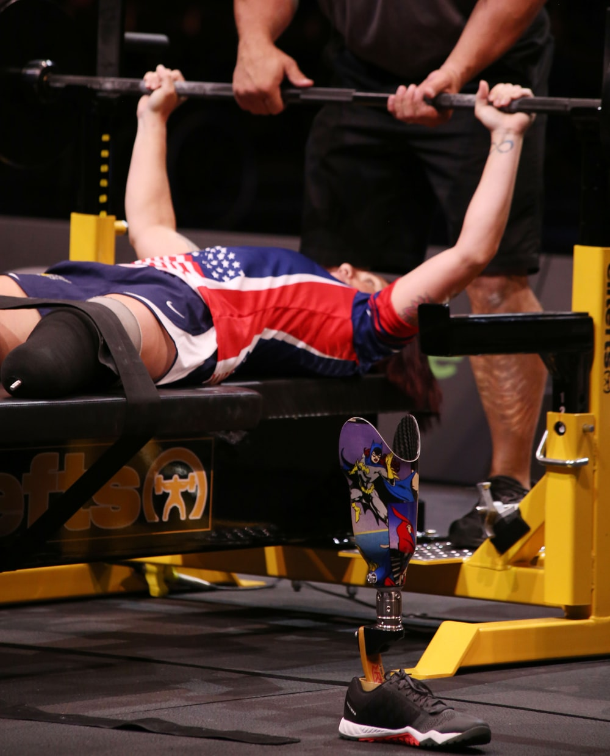
Issues

Slide 29
Healthcare is the top issue among the entire disability community and each of the subgroups that compose it. People with a family member with a disability are most likely to say healthcare is an important issue. People with disabilities are more likely to say Social Security and Medicare are important than those with a family member or close friend.
Now, I am going to read you a list of concerns that some people in this area have mentioned. Please tell me which one you think is the most important issue for you and your family?
TOP TIER OF ISSUES
Most likely to say healthcare:
Women <50 with disability (29%)
College educated <50 (27%)
Women with disability (26%)
Family/friend <50 (26%)
Latinx family/friend (25%)
PWD <50 (24%)
Most likely to say Social Security and Medicare:
PWD 50+ (27%)
Noncollege 50+ (26%)
Black PWD (25%)
 | Disability Community
 | People with Disabilities
 | Family Member
 | Close Friend

Slide 30
National security and crime, education, the environment, taxes, and the federal budget deficit fall into the bottom tier of issues of greatest importance across subgroups within the disability community.
Now, I am going to read you a list of concerns that some people in this area have mentioned. Please tell me which one you think is the most important issue for you and your family?
BOTTOM TIER OF ISSUES
 | Disability Community
 | People with Disabilities
 | Family Member
 | Close Friend

Slide 31
People with disabilities are concerned about healthcare, Medicare and Social Security, civil rights, education, having a support structure, and being able to get the kind of care that they need, especially mental healthcare.
“Education and healthcare.” – White person with disability, Baltimore
“Social Security.” – Person of color with disability, Baltimore
“I haven’t had a support structure and I don’t know what to do about it, and I know the way that the Medicare administration is run that it is as much medical as it is political, but the changes that could be made for what the average person thinks and understands as far as like how they can go out to the polls and vote has a lot to do with your delegates and your representatives.” – Person of color with disability, Baltimore
“When I was on medical assistance, I had a wonderful therapist. And then as soon as I started getting money, they made me switch to Medicare and I lost her. And it is frustrating because what’s wrong with me is a military problem as well as a mental health problem, but there is no real treatment for the average person for what’s wrong with me.” – Person of color with disability, Baltimore
“The waiting list on housing.” – Person of color with disability, Baltimore
“Housing and homelessness.” – White person with disability, Baltimore
“The election coming up.” – White person with disability, Baltimore
“It sounds like it was taught. Take care of others. Civil liberties is not a huge issue with me. But it really bothers me and it takes a toll when I see other stuff.” – White person with disability, Baltimore
What social and political issues do you care about most?

Slide 32
Parents of children with a disability are concerned about a wider variety of social and political issues, such as healthcare, the environment, minimum wage, safety, and human rights. There is also concern about division in the country and many feel there is no room for people who are more “in the middle” of the political spectrum these days. Most parents were not thinking of their child when answering this question
“Health care.” – Parent of child with disability, Baltimore
“And it seems like people aren’t allowed to be just okay or criticize anything anymore. It’s like you have to fall into one of two groups. It’s like you have to 100% support ObamaCare or you have to be anti-ObamaCare. It’s not like you can say well this part of it works well, but we’ve got to take a look at this part and this might need to be redone. It’s like you have to be on either side of the isle. There is no more in the middle.” – Parent of child with disability, Baltimore
“Because it is up in turmoil. We don’t know if we are going to go Single Payer or we don’t know if ObamaCare or the ACA is going to be around. Premiums are skyrocketed. You can’t afford to get sick. You have these balloon payments coming out of nowhere.” – Parent of child with disability, Baltimore
“Just the safety like school shootings and safety and stuff.” – Parent of child with disability, Baltimore
“Gun control.” – Parent of child with disability, Baltimore
“Domestic terrorism.” – Parent of child with disability, Baltimore
“Yeah, just like protecting ourselves and being safe.” – Parent of child with disability, Baltimore
“The environment.” – Parent of child with disability, Baltimore
“[Minimum wage] hasn’t been increased in years or decades, possibly.” – Parent of child with disability, Baltimore
“Like the whole thing for Baltimore County is college and career ready, college and career ready, and like I get it, but if he is not going to college …or if he is not going into a career, what are the options for him.” – Parent of child with disability, Baltimore
What social and political issues do you care about most?

Slide 33
The cost of healthcare is very concerning to people with disabilities and parents of children with a disability.
“Too much money.” – Person of color with disability, Baltimore
“They prescribe medications for you and you have to get like an approval if the insurance company doesn’t cover it.” – Person of color with disability, Baltimore
“Our copays will be too much money.” – Person of color with disability, Baltimore
“I am concerned that I don’t know a lot about it, but as far as like the coverage. I know like my employer will cover my children until they are 26, but I think about my [son] who may not be employed full-time or know how to make his own decisions for healthcare, and let’s say if he has to use Medicaid or some kind of state assistance, will it cover what he may need at a certain time. That is very concerning to me.” – Parent of child with disability, Baltimore
“So, there are certain healthcare that aren’t even. Everyone doesn’t get the same kind of coverage.”– Person of color with disability, Baltimore
What about healthcare concerns you?

Slide 34
A strong majority of the disability community is concerned about the elimination of Social Security and Medicare, followed by Medicaid, and the ADA. The disability community is concerned about the elimination of all key programs and laws related to healthcare, education, and protections.
How concerned are you that the following government programs or laws will be eliminated and no longer benefit you?

Slide 35
Overall, those with a household income below $50k are more concerned about the elimination of these programs than people with a household income above $50k. Boomers, those over 50, and Latinx are more likely to be concerned about Social Security and Medicare, and African Americans are more concerned about Medicare.
Shown Among Disability Community
% Very Concerned | Total | PWD | Family or Friend | M | W | Mill. | Gen X | Boo-mer | <50 | 50+ | Father | Mother | Parent of child with disability | No child | Dem | Ind | Rep | White | AA | Lat | C | NC | Likely Voter | Not LV | HH <$50k | HH $50k +
Social Security | 67 | 70 | 65 | 64 | 70 | 55 | 71 | 77 | 60 | 75 | 57 | 63 | 57 | 70 | 71 | 63 | 64 | 65 | 68 | 74 | 62 | 69 | 68 | 57 | 73 | 61
Medicare | 61 | 64 | 60 | 58 | 64 | 47 | 63 | 74 | 52 | 73 | 51 | 54 | 54 | 65 | 67 | 63 | 53 | 60 | 71 | 69 | 58 | 63 | 62 | 55 | 69 | 55
Medicaid | 53 | 54 | 53 | 52 | 54 | 47 | 61 | 54 | 52 | 54 | 54 | 49 | 58 | 54 | 63 | 57 | 40 | 50 | 67 | 62 | 49 | 55 | 53 | 56 | 61 | 45
ADA | 49 | 50 | 49 | 47 | 51 | 43 | 53 | 51 | 47 | 51 | 50 | 48 | 61 | 49 | 56 | 49 | 40 | 47 | 55 | 57 | 47 | 50 | 50 | 37 | 54 | 43
The Ticket to Work program… | 44 | 44 | 45 | 41 | 47 | 38 | 48 | 48 | 41 | 48 | 40 | 43 | 46 | 45 | 51 | 44 | 35 | 42 | 50 | 55 | 40 | 46 | 44 | 42 | 51 | 38
Special Education programs | 43 | 40 | 44 | 39 | 47 | 39 | 47 | 43 | 44 | 42 | 46 | 49 | 55 | 41 | 49 | 49 | 33 | 40 | 52 | 54 | 41 | 44 | 43 | 42 | 48 | 37
ACA | 41 | 41 | 40 | 38 | 43 | 37 | 45 | 44 | 41 | 41 | 36 | 44 | 42 | 41 | 56 | 37 | 23 | 36 | 57 | 45 | 43 | 39 | 42 | 32 | 44 | 39

Slide 36
Among people with disabilities, those over 50 are more concerned about the elimination of Social Security and Medicare. Those with a household income below $50k are more likely to be concerned about the elimination of all of the programs than those with higher household incomes.
 |  | Shown among People with Disabilities Only
% Very Concerned | Total | PWD | Have Family or Friend | M | W | <50 | 50+ | Parent | No child | Dem | Ind | Rep | White | POC | C | NC | Likely Voter | Not LV^ | HH <$50k | HH $50k +
Social Security | 67 | 70 | 71 | 67 | 72 | 59 | 79 | 64 | 71 | 73 | 74 | 65 | 68 | 71 | 64 | 71 | 72 | 58 | 73 | 64
Medicare | 61 | 64 | 64 | 59 | 67 | 50 | 76 | 59 | 65 | 71 | 69 | 54 | 61 | 69 | 63 | 63 | 65 | 56 | 68 | 56
Medicaid | 53 | 54 | 54 | 50 | 57 | 54 | 53 | 57 | 52 | 62 | 70 | 38 | 53 | 56 | 51 | 54 | 53 | 59 | 60 | 41
ADA | 49 | 50 | 49 | 48 | 51 | 46 | 53 | 49 | 50 | 58 | 51 | 41 | 48 | 52 | 47 | 50 | 52 | 35 | 52 | 43
The Ticket to Work program… | 44 | 44 | 41 | 41 | 48 | 43 | 46 | 48 | 43 | 51 | 47 | 36 | 43 | 47 | 37 | 46 | 46 | 36 | 50 | 33
Special Education programs | 43 | 40 | 41 | 35 | 44 | 38 | 41 | 44 | 39 | 43 | 50 | 32 | 39 | 44 | 37 | 41 | 39 | 41 | 43 | 30
ACA | 41 | 41 | 42 | 36 | 45 | 42 | 39 | 44 | 39 | 55 | 46 | 23 | 39 | 45 | 45 | 39 | 41 | 36 | 42 | 38
^Note small sample size

Slide 37
Similarly, among those with a family or friend with a disability, those over 50 are more concerned about the elimination of Social Security and Medicare and those with a household income below $50k are more concerned about the elimination of all of the programs.
 |  | Shown among People with Disability Connection Only (Have Family Member/Friend with Disability)
% Very Concerned | Total | Family | Friend | M | W | <50 | 50+ | Father | Mother | No child | Dem | Ind | Rep | White | POC | C | NC | Likely Voter | Not LV^ | HH <$50k | HH $50k +
Social Security | 67 | 67 | 58 | 62 | 68 | 59 | 72 | 54 | 63 | 68 | 69 | 57 | 63 | 64 | 69 | 60 | 68 | 66 | 57 | 72 | 60
Medicare | 61 | 62 | 56 | 57 | 62 | 52 | 70 | 47 | 54 | 65 | 65 | 58 | 54 | 59 | 65 | 55 | 63 | 61 | 54 | 68 | 54
Medicaid | 53 | 55 | 46 | 53 | 53 | 50 | 55 | 53 | 48 | 54 | 63 | 49 | 41 | 48 | 64 | 48 | 56 | 53 | 51 | 62 | 46
ADA | 49 | 52 | 40 | 46 | 52 | 48 | 50 | 50 | 49 | 49 | 56 | 47 | 40 | 46 | 56 | 47 | 50 | 50 | 37 | 56 | 43
The Ticket to Work program… | 44 | 50 | 36 | 42 | 48 | 41 | 51 | 40 | 42 | 48 | 52 | 46 | 36 | 43 | 52 | 41 | 48 | 45 | 45 | 53 | 40
Special Education programs | 43 | 46 | 42 | 40 | 48 | 45 | 42 | 47 | 51 | 42 | 50 | 51 | 32 | 40 | 55 | 43 | 45 | 45 | 41 | 51 | 39
ACA | 41 | 41 | 39 | 39 | 41 | 40 | 41 | 38 | 40 | 41 | 56 | 34 | 21 | 34 | 51 | 42 | 39 | 42 | 31 | 43 | 39
^Note small sample size

Slide 38
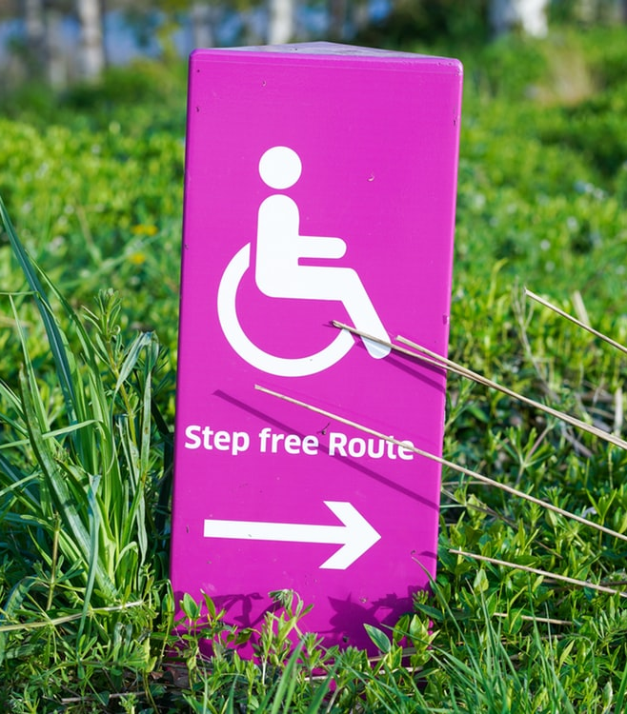
Treatment of the Disability Community

Slide 39
A strong majority of the disability community is concerned about the treatment of people with disabilities in the U.S. People with disabilities, women, Democrats, and African American adults are most likely to be very concerned.
Now for something slightly different. How concerned are you about the treatment of people with disabilities in the United States?
 | Very Concerned | Concerned
People with Disabilities | 59 | 84
People with Connection | 50 | 81
Men | 47 | 80
Women | 57 | 84
Under 50 | 54 | 85
50 + | 50 | 79
Democrat ID | 59 | 89
Independent ID | 47 | 74
Republican ID | 45 | 78
White | 48 | 78
African American | 71 | 92
Latinx | 55 | 89
Noncollege | 53 | 83
College | 50 | 82
Likely Voter | 53 | 83
Not Likely Voter | 43 | 75
Most likely to say very concerned
PWD Democrats (68%)
PWD <50 (66%)
POC PWD (66%)
PWD women (64%)
Mother of child with disability (62%)
HH income below $50k (60%)
 | Somewhat Concerned |  | A little concerned
 | Very Concerned |  | Not concerned at all

Slide 40
A slim majority of the disability community believes that the rights of people with disabilities are under attack or threatened today. People with disabilities, women, people under 50, Democrats, and people of color are most likely to think the rights of this population are under attack.
Do you think the rights of people with disabilities today are under attack or threatened?
 | Yes | No
People with Disabilities | 56 | 27
People with Connection | 51 | 31
Men | 47 | 33
Women | 57 | 27
Under 50 | 56 | 27
50 + | 48 | 33
Democrat ID | 64 | 20
Independent ID | 50 | 28
Republican ID | 40 | 43
White | 49 | 34
African American | 64 | 21
Latinx | 56 | 23
Noncollege | 51 | 29
College | 54 | 32
Likely Voter | 52 | 31
Not Likely Voter | 48 | 26
Most likely to say yes
Mother with disability (72%)
PWD Democrats (69%)
Gen Z (66%)
PWD <50 (63%)
Women with disability (62%)
Most likely to say no
Republicans (43%)
PWD Republicans (42%)
West North Central region (41%)
Age 65+ (37%)

Slide 41
In focus groups, people with disabilities say that when people attack the ACA and ADA, they feel like their rights are threatened because both programs help people with disabilities get healthcare and general protections.
“Trump made a statement about if you don’t truly have a disability, then he was going to make you go up there and work or you just don’t get your disability check and stuff.” – Person of color with disability, Baltimore | “Absolutely. As soon as the ADA got passed. I knew people way back, so the ADA got passed and then people immediately flipped out about it.” – White person with disability, Baltimore “Everybody was like it is going to ruin my business or ruin my life.” – White person with disability, Baltimore “And it was like that’s not the intent for it. Because you have to serve people with disabilities.” – White person with disability, Baltimore | “I asked for special accommodations where I live and housing didn’t back me up, and I have an immune disease and so certain things can make me sick and can really make me die and Baltimore County didn’t protect me.” – Person of color with disability, Baltimore
“To me, just fighting just to get [services]. I mean you could have a medical condition and papers and all that and actually see their specialist as well and they will still deny you regardless of what they are reading.” – Person of color with disability, Baltimore
 | “They told me she basically is not disabled because she gets good grades in school. So, I felt attacked because we still have problems outside of school.” – Parent of child with disability, Baltimore
 |  | “So, basically, you have to jump through a whole bunch of hoops extra loops or hoops to verify your disability. That’s how I was looking at it.” – Person of color with disability, Baltimore
Have you ever felt like your rights, or the rights of people with disabilities, were under attack?

Slide 42
People with disabilities are significantly more likely than people with a family member/friend to say they are part of the disability community. College educated people and people with a friend or family member with a disability split.
Please tell me if you agree or disagree with the following statement: I would consider myself part of the disability community.
 | Strongly Agree | Total Agree | Total Disagree
People with Disabilities | 57 | 80 | 17
People with Connection | 29 | 47 | 47
Parents of Child w/ Disability | 49 | 70 | 25
Men | 38 | 60 | 36
Women | 38 | 56 | 39
PWD Men | 59 | 81 | 16
PWD Women | 56 | 79 | 18
Under 50 | 35 | 55 | 40
50 + | 41 | 61 | 35
PWD Under 50 | 53 | 76 | 21
PWD 50 + | 62 | 83 | 14
White PWD | 56 | 80 | 16
POC PWD | 61 | 80 | 18
Noncollege | 41 | 62 | 34
College | 32 | 50 | 45
Likely Voter | 38 | 58 | 38
Not Likely Voter | 37 | 57 | 36
PWD Likely Voter | 59 | 81 | 16
PWD Not Likely Voter | 49 | 72 | 22
 | Not so strongly agree |  | Not so strongly disagree
 | Strongly Agree |  | Strongly disagree

Slide 43
People with disabilities in the focus groups cite different community groups, both in person and online, that they are members of. They also point to fellow people with disabilities that they help out and attend gatherings with within their community that make them feel like they are a part of a community.
“The Internet is…but thank God for the very specific sites where you go and you learn all about people just like you.” – White person with disability, Baltimore | “So, I turned my disability into a job. I have a mental health issue and I now run a small nonprofit where we work with people with mental health who are also in the LGBTQIA community.” – White person with disability, Baltimore | “I am in a Muscular Dystrophy community because I have Muscular Dystrophy as well.” – Person of color with disability, Baltimore
“The Mighty is the one I mentioned and that is pretty much mental and physical disabilities.” – White person with disability, Baltimore | “We have groups where all of us get together and everybody has their own disabilities, but it feels like family and welcoming.” – Person of color with disability, Baltimore
“I do help out some people or neighbors where I live with disabilities.” – Person of color with disability, Baltimore
In general, have you ever felt like you were part of a community? How so?

Slide 44
Parents talk about how their child’s school can feel like a community and provides a space to bond with other parents in a similar situation. They find connections with other parents who are raising a child with a disability in support groups, schools, and through having a shared experience.
“I think for me it is the understanding that we have between each other because what we fear is the same thing or similar and so we support each other. We are supportive of each other and give each other advice or give each other a hand and enjoy each other’s company like birthdays or whatever.” – Parent of child with disability, Baltimore
“We send our kid to a private school that handles a lot of the learning differences that my son has and that has helped tremendously because most parents are in the same boat, and we laugh about it and we talk about it and we all feel each other’s pain.” – Parent of child with disability, Baltimore
“I just remember when our son was newly diagnosed and feeling like okay it’s the world and us. I don’t even know how I found out about this, they have this autism support group that we meet the first Thursday of the month for the parents and we do a lot of different trips, like we go snow tubing with the kids and restaurant nights...” – Parent of child with disability, Baltimore
“I think it is a comfort level because a lot of our children are kind of quirky in little ways. So, my son goes over to a friend’s house, they understand. They know what their son’s issues are and it is relatable to my son’s issues and so they know how to handle it.” – Parent of child with disability, Baltimore
In general, have you ever felt like you were part of a community? How so?

Slide 45
Some parents point to support groups they or their spouse are a part of related to their child’s disability, but they do not identify as a member of the disability community explicitly.
“My wife is definitely part of a community, a support community.” – Parent of child with disability, Baltimore
“No [I don’t see myself in a community].” – Parent of child with disability, Baltimore
“So, basically, we are not in any kind of groups or anything. I mean other than my church community…like I do have a church family and things like that, but I am just talking about if I walk outside, the neighbors aren’t neighborly. With the autism, he is not in a group or anything with that either.” – Parent of child with disability, Baltimore

Slide 46
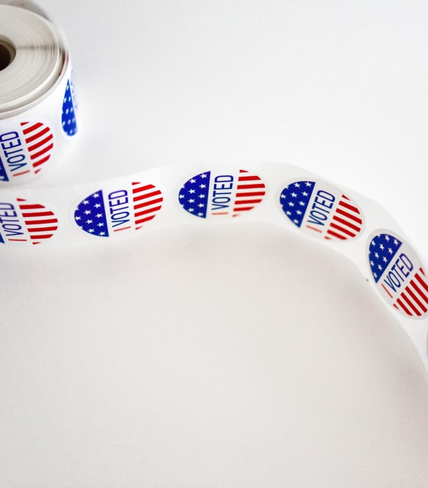
Political Engagement

Slide 47
A plurality of the disability community believes there is a movement among people with disabilities in the United States today, though more than one quarter do not believe there is one and almost one third are unsure. Nearly half of younger and African American people see a movement today, as do a majority of parents of children with a disability. Among people with disabilities, women, younger, and African Americans are more likely than others to see a movement existing.
Would you say there is a movement among people with disabilities in the United States today?
Total Community | Yes | No
People with Disabilities | 43 | 27
People with Connection | 42 | 28
Parent of child w/ disability | 56 | 18
Men | 40 | 28
Women | 45 | 26
Under 50 | 48 | 25
50 + | 35 | 30
Democrat ID | 44 | 28
Independent ID | 36 | 26
Republican ID | 44 | 27
White | 42 | 27
African American | 49 | 24
Latinx | 40 | 30
Noncollege | 44 | 25
College | 40 | 31
Likely Voter | 44 | 27
Not Likely Voter | 36 | 32
Women with disabilities (47%) are more likely than men with disabilities (38%) to say “yes.” Younger people with disabilities (51%) and African Americans with disabilities (50%) are also more likely to say “yes” than their counterparts (35% and 44%, respectively).

Slide 48
Many participants feel like they are part of a movement or that there is a movement among people with disabilities based on their personal experiences advocating for themselves, the larger community, or their child. People with disabilities are most familiar with political activism and disability rights, with some sharing that they have been a part of something like that.
“The protests on the main stage of politics, you know when people were in chairs blocking entrances and getting carried off, I felt like that was a little bit new. I felt like that was getting more attention than before.” – White person with disability, Baltimore | “I work for Baltimore City Public Schools and I have led a school of kids that were autistic and had some behavioral issues, and the one thing that I found is that people make an assumption that they can’t do instead of saying they can. You just give them the opportunity to do and you will be surprised and amazed at what kids can do. And so, the only thing that I did different was I made sure that they had access to everything else that everyone else should have access to. And you just give them opportunities, and they will perform. And so, I just gave hope.” – Parent of child with disability, Baltimore | “Yeah, there is an organization, Disability Maryland, and it is a group of people and they are really active like in politics and trying to get things changed, the laws changed.” – White person with disability, Baltimore
“I was big about children’s rights and different things like that and fighting local governments and all that.” – Parent of child with disability, Baltimore |  | “The movement is Transformation Nation and I am growing with the company and I’m growing with the movement. They hold like resource fairs and different little stuff to put the word out in the community because a lot of people…well some people with disabilities from mental or whatever the disability is. Some people are afraid to talk about it and you know some people feel ashamed. Because I used to be that way.” – Person of color with disability, Baltimore
“There is definitely this sort of discontent within disabled communities that I’ve seen.” – White person with disability, Baltimore
Have you ever felt like you were part of a movement? How so?

Slide 49
Candidates treating people with disabilities with dignity and respect is a core value for the disability community. While it is very important to a strong majority across all demographic and attitudinal subgroups, women, those over 50, and Democrats are more likely than their counterparts to say it is very important.
How important is it to you personally that candidates treat people with disabilities with dignity and respect?
Total Community | Very Important | Total Important
People with Disabilities | 80 | 93
People with Connection | 81 | 95
Parent of child w/ disability | 82 | 97
Men | 74 | 92
Women | 87 | 96
Under 50 | 78 | 93
50 + | 84 | 95
Democrat ID | 86 | 98
Independent ID | 81 | 91
Republican ID | 75 | 93
White | 81 | 94
African American | 82 | 96
Latinx | 82 | 98
Noncollege | 81 | 94
College | 80 | 94
Likely Voter | 82 | 96
Not Likely Voter | 70 | 82
Most likely to say very important
Women 50+ (91%)
Democratic women (91%)
Independent women (90%)
Latinx 50+ (89%)
Women likely voters (89%)
Women with family member/friend (88%)
Women with disabilities (86%) are more likely than men with disabilities (74%) to think it is very important. Older people with disabilities (85%) are also more likely to think it is very important compared to younger people (75%).
Darker colors indicate intensity

Slide 50
People with a disability and parents of children with a disability want to be understood, empathized with, and treated like everyone else. They highlight that it is okay to ask questions to understand them better.
“Ask to understand.” – Person of color with disability, Baltimore | “Making sure that you still treat them as if you would still treat anyone else but have those exceptions. You know like if my other children have chores in the house, you are having chores too. Or if they are having punishment, you are going to have a punishment, you know within reason.” – Parent of child with disability, Baltimore | “I don’t want your sympathy. Give me empathy.” – Person of color with disability, Baltimore
“But don’t be that person who sees me refuse help and then does it anyway.” – White person with disability, Baltimore |  | “Don’t feel guilty about whatever it is that you are feeling because you are still human too, and even though we may have children who have similar abilities or disabilities doesn’t mean that my feelings aren’t valid or hers or better or whatever.” – Parent of child with disability, Baltimore
 | “It’s like I have been in pain since my early 30’s, and the back operations or just keeping me out of a wheelchair. And it’s like I am in pain every day and it’s like they won’t give me anything for the pain to really help it.” – White person with disability, Baltimore
“And so, just realize that just because I look like nothing is wrong, don’t mean I am not.” – Person of color with disability, Baltimore
What advice would you give to other people to talk to you about disability in a way that makes you feel most comfortable?

Slide 51
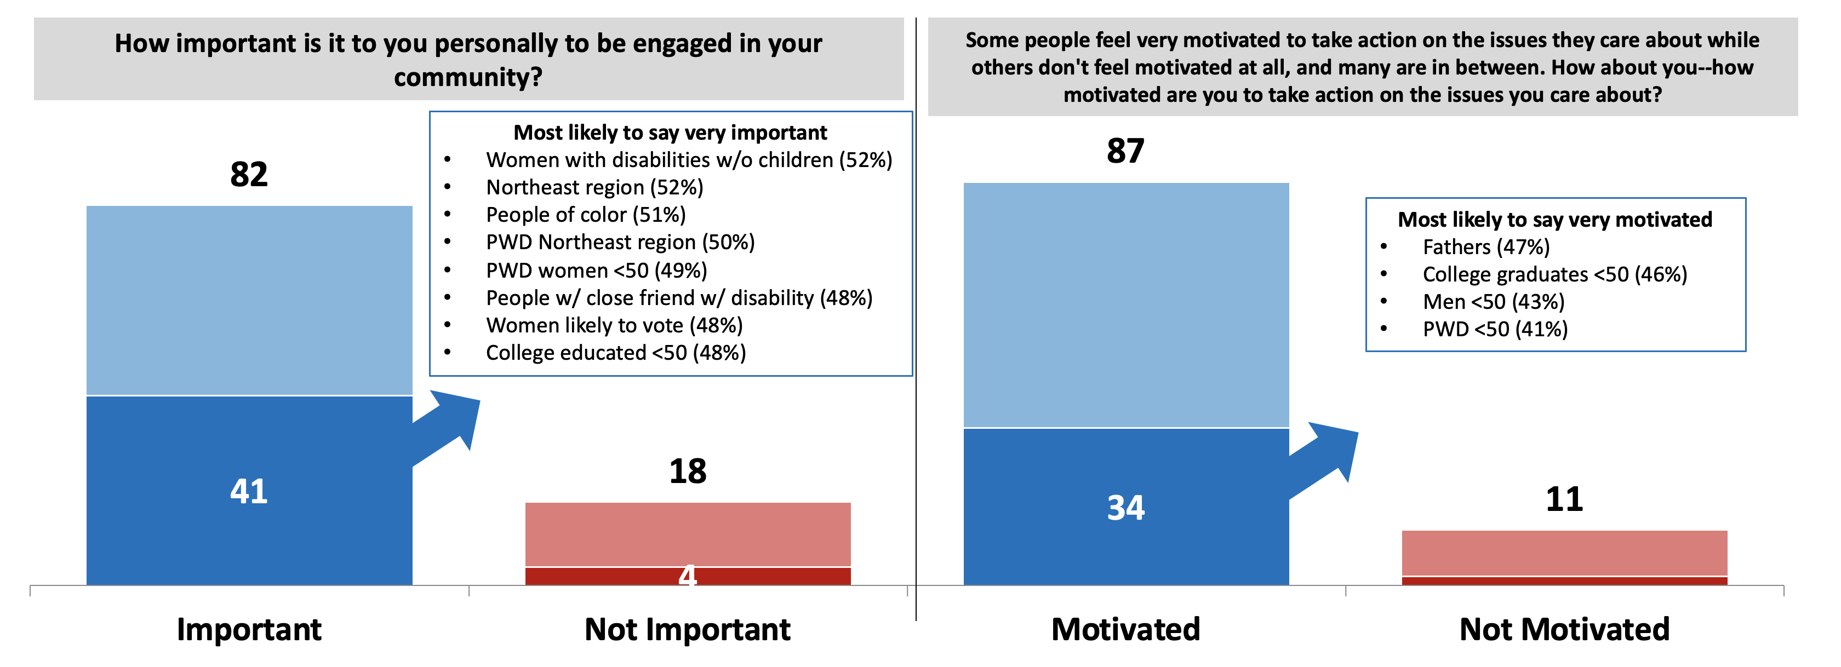
People in the disability community say it is important to be engaged in their community and are motivated to take action on the issues they care about. However, intensity is on the side of being personally engaged and demographic subgroups respond with more intensity to being personally engaged than being motivated to take action.
Darker colors indicate intensity.
Split Sampled Question

Slide 52
Over the course of the survey, the disability community becomes slightly more likely to say it is important to be engaged in their communities driven by those with a family member or friend with a disability. The disability community overall increases 4-points in their intensity and those with a family member or friend with a disability increases 6-points.
How important is it to you personally to be engaged in your community?

Slide 53
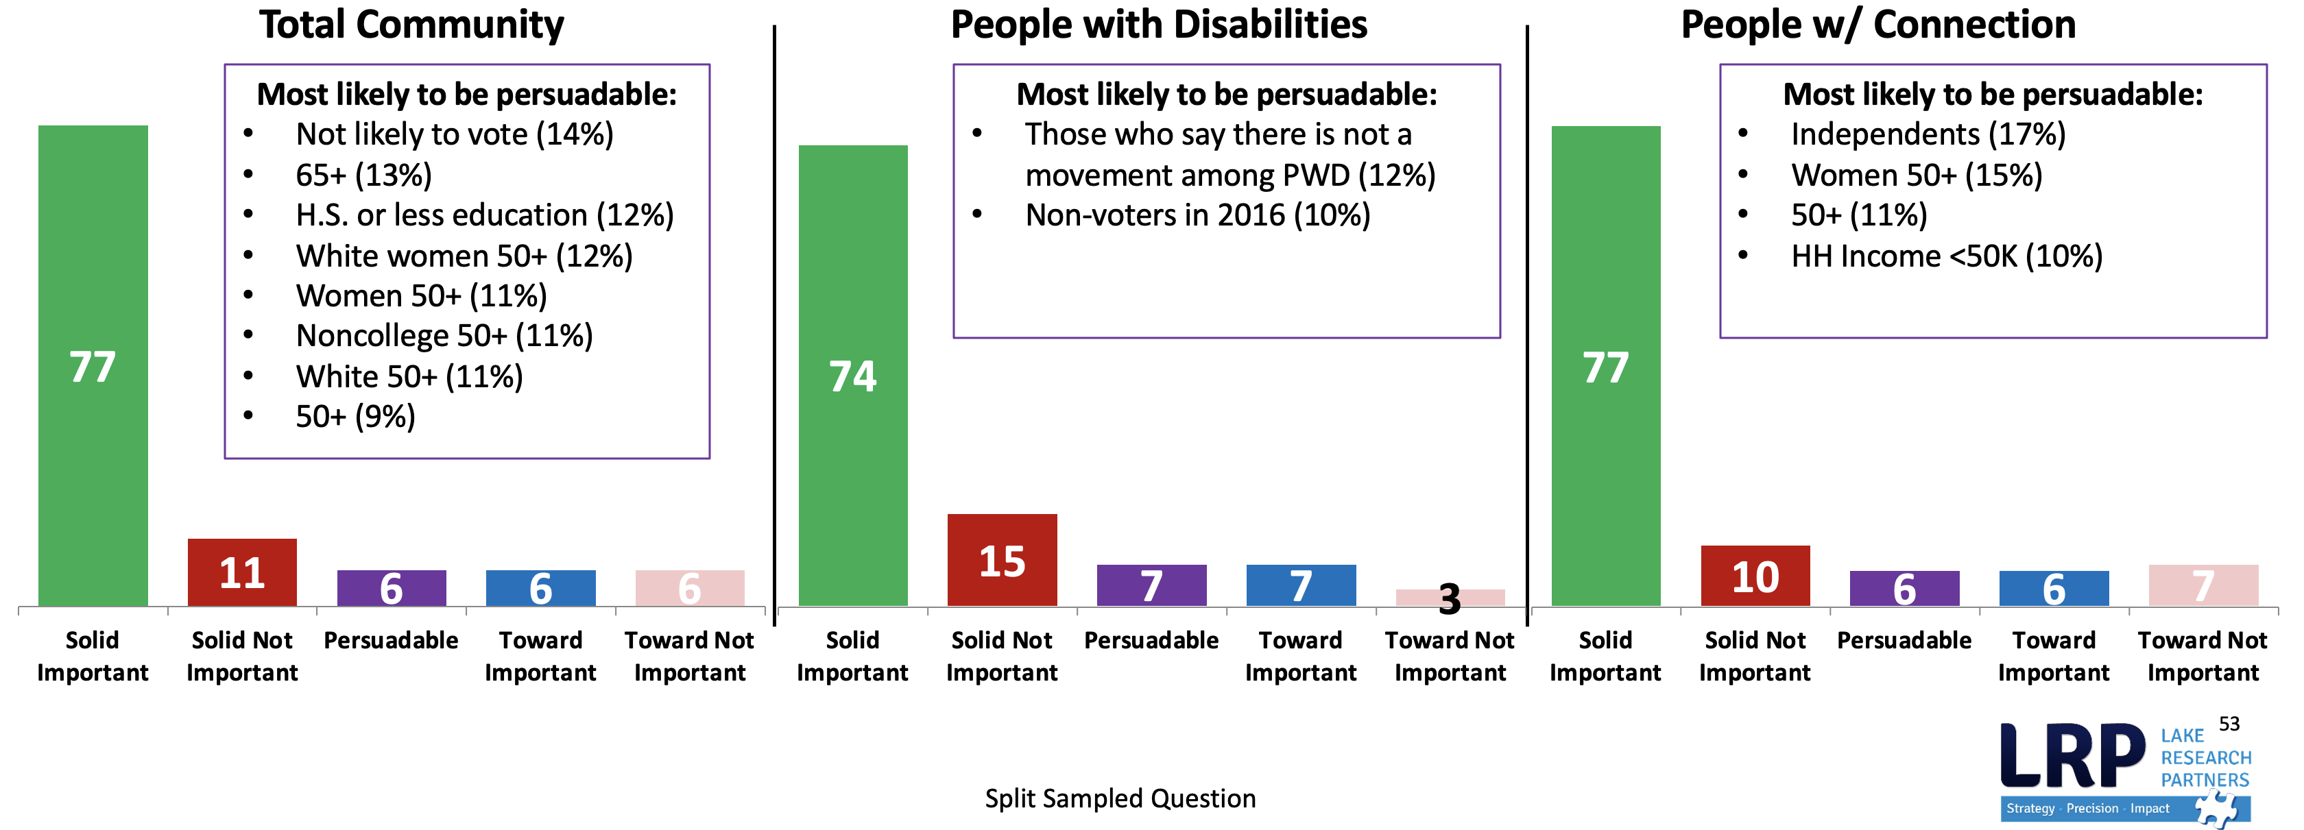
A strong majority of the disability community believes it is important to be engaged in their communities both before and after hearing messaging. About 6% are persuadable, meaning they shift toward believing it is important to be engaged after hearing messaging, or they remained undecided throughout the survey.
How important is it to you personally to be engaged in your community? [Initial to Final Shift]

Slide 54
Throughout the survey, the disability community becomes about 5-points more likely to say they feel very motivated to take action on the issues they care about, again driven by those with a family member or friend with a disability. Levels of motivation to engage are high from the start, resulting in little room for movement overall.
Some people feel very motivated to take action on the issues they care about while others don't feel motivated at all, and many are in between. How about you--how motivated are you to take action on the issues you care about -- are you VERY motivated, SOMEWHAT motivated, NOT too motivated, or NOT at all motivated?

Slide 55
A strong majority of the disability community also feels motivated to take action on the issues they care about both before and after hearing messaging as 6% are persuadable in their motivation. Levels of motivation to engage are high from the start, with at least 8 in 10 across the community being solidly motivated.
Some people feel very motivated to take action on the issues they care about while others don't feel motivated at all, and many are in between. How about you--how motivated are you to take action on the issues you care about -- are you VERY motivated, SOMEWHAT motivated, NOT too motivated, or NOT at all motivated?

Slide 56
Over the course of the survey, respondents were asked how important it is to be engaged in their community. A solid majority said it was important on both the initial and final ask.
Solid Important – 77% of disability community
People in the survey who say it is important to them to be engaged on both the initial and the final ask.
Solid Not Important – 11% of disability community
People in the survey who say it is not important to them to be engaged on both the initial and the final ask.
Toward Important – 6% of disability community
People who say initially that it is not important but who say it is important in the final ask.
Toward Not Important – 6% of disability community
People who say initially that it is important but who say it is not important in the final ask.
Persuadables – 6% of disability community
People who move toward important plus people who say they don’t know in both the initial and final asks.
Notes:
Note – talk to cate / look at final national report to see if this slide is necessary/changes in formatting before filling in

Slide 57
Over the course of the survey, respondents were asked how motivated they are to take action on the issues they care about. A solid majority said they were important on both the initial and final ask.
Solid Motivated – 82% of disability community
People in the survey who say they are motivated to take action on both the initial and the final ask.
Solid Not Motivated – 6% of disability community
People in the survey who say they are not motivated to take action on both the initial and the final ask.
Toward Motivated – 6% of disability community
People who say initially that they are not motivated but who say they are motivated in the final ask.
Toward Not Motivated – 5% of disability community
People who say initially they are motivated but who say they are not motivated in the final ask.
Persuadables – 6% of disability community
People who move toward motivated plus people who say they don’t know in both the initial and final asks.
Notes:
Note – talk to cate / look at final national report to see if this slide is necessary/changes in formatting before filling in

Slide 58
Focus group participants are motivated to take action because of their desire for change based on personal experiences with healthcare, finances, housing, and other personal issues. Some are motivated by specific bills they see being passed. One participant noted that they feel people would be more motivated if there were a clear message that shows how people with disabilities are discriminated against politically, like being unable to own property.
“A need for change or at least the want.” – Parent of child with disability, Baltimore
“So, House Resolution #1, which is making voting more accessible and easier and less corrupt across the country, and the Equality Act, which would actually finally make it so that gay and lesbian and bisexual and transgender people can’t be fired in the states… that is a bill that I am excited about seeing.” – White person with disability, Baltimore
“I feel like part of the issues might be that like when you are a woman or a person of color or something the issues that you face are generally so similar, but someone who has like you know a mental disability is going to need different accommodations than someone with a physical disability and even between the same you know condition there is so much variation than just saying… accessibility.”– White person with disability, Baltimore
“I would want to find out more because it is something that I feel is like…say you can’t own a house and be disabled. You can’t own property without having to sell it and pay the government back. Things like that. I am going to need somewhere to live and I don’t want to keep living in people’s basements anymore. You know what I mean? Like I want to feel like I have a home.” – Person of color with disability, Baltimore
“As far as healthcare, you don’t get on Medicare when you are on disability until you have been on disability for two years.” – White person with disability, Baltimore
What motivates you to take action on issues that you care about? Do you think that people with disabilities may have different issue
priorities than people without disabilities, politically speaking?

Slide 59
Politicians delivering on their promises is the top aspect that would make the full disability community, people with disabilities, and people with a family member with a disability more interested in voting. People with a close friend with a disability split between politicians delivering on their promises and candidates focused on issues they cared about. People with disabilities are slightly more likely than the full disability community and people with a close friend or family member to say that if candidates focused on issues facing people with disabilities they would be more interested in voting.
What would make you more interested in voting? [Select all that apply]
 | Disability Community
 | People with Disabilities
 | Family Member
 | Close Friend

Slide 60
Across age and gender, women with disabilities and people with disabilities under age 50 are more likely to be interested in voting if candidates focused on issues they care about. Younger people with disabilities would also be more interested in voting if candidates focused on issues facing people with disabilities at higher levels.
What would make you more interested in voting? [Select all that apply]
 | PWD Men
 | PWD Women
 | PWD <50
 | PWD 50+

Slide 61
People who are most concerned about Social Security and Medicare would be more interested in voting if politicians delivered on their promises, and people who are most concerned about healthcare would be more interested in voting if candidates focused on issues they cared about.
% Top Concern | Total | Top Concern
 |  | Healthcare | Social Security and Medicare
Politicians delivering on their promises | 51 | 47 | 55
Candidates focused on issues I care about | 46 | 52 | 43
Having more information about candidates and public officials | 31 | 33 | 32
Candidates focused on issues facing people with disabilities | 30 | 34 | 39
Hearing directly from candidates | 25 | 27 | 25
Having voting be more accessible or convenient | 17 | 17 | 15
Having more information about elections | 16 | 16 | 13
Knowing where to register to vote | 7 | 8 | 8
Other | 5 | 4 | 6
None of these | 6 | 4 | 8

Slide 62
Focus group participants are motivated to vote because they want change, they feel responsible, they want to vote for the right person and make their voices heard, and set a good example for their children. Others, feel motivated not to vote because they do not like the candidates running or they feel that there will be no change or follow up to politicians’ promises.
“It makes me feel powerful that I at least put my vote down, and whether that person wins or not, at least I had a vote or a voice in that for myself and that makes me feel better.” – Parent of child with disability, Baltimore | “I certainly do it to set an example for my children. Every election where I have ever voted whether it was local or federal, they have always gone with me and they are like in the booth…I have practiced and made up little paper ballots and we read and talk about the things so that they can talk about what it is and they have had an opportunity to practice for voting for little things in school or whatever it is just so that they can see that this is something that you can help control.” – Parent of child with disability, Baltimore | “Change of power.” – Person of color with disability, Baltimore “Being responsible.” – Person of color with disability, Baltimore “Responsible.” – Person of color with disability, Baltimore “Being that I am voting for the right person.” – Person of color with disability, Baltimore
“Yeah, what she said. If you don’t vote, then keep your mouth shut.” – White person with disability, Baltimore
“Now, if it didn’t go your way, that’s how things work. It conflicts. But if you didn’t at least make the effort, then I discount usually someone’s position on stuff.” – White person with disability, Baltimore
 |  | “I felt that I was not going to vote for either one or just for the lesser of the evil because that is not what I wanted. And I stand by it. You know whatever is going on in this country now, I feel that I am not a part of it because I didn’t vote for that.” – Parent of child with disability, Baltimore
 | “It’s the old Electoral College that dissuades me. Maryland is a democratic state and it has always swung democratic, so no matter how I vote, it doesn’t matter.” – Parent of child with disability, Baltimore
“I mean after a while it seems like…I mean all the promises that they make at times and they tell you this, that and the other, and still no change.” – Person of color with disability, Baltimore
What motivates you to vote? Or motivates you not to vote?

Slide 63
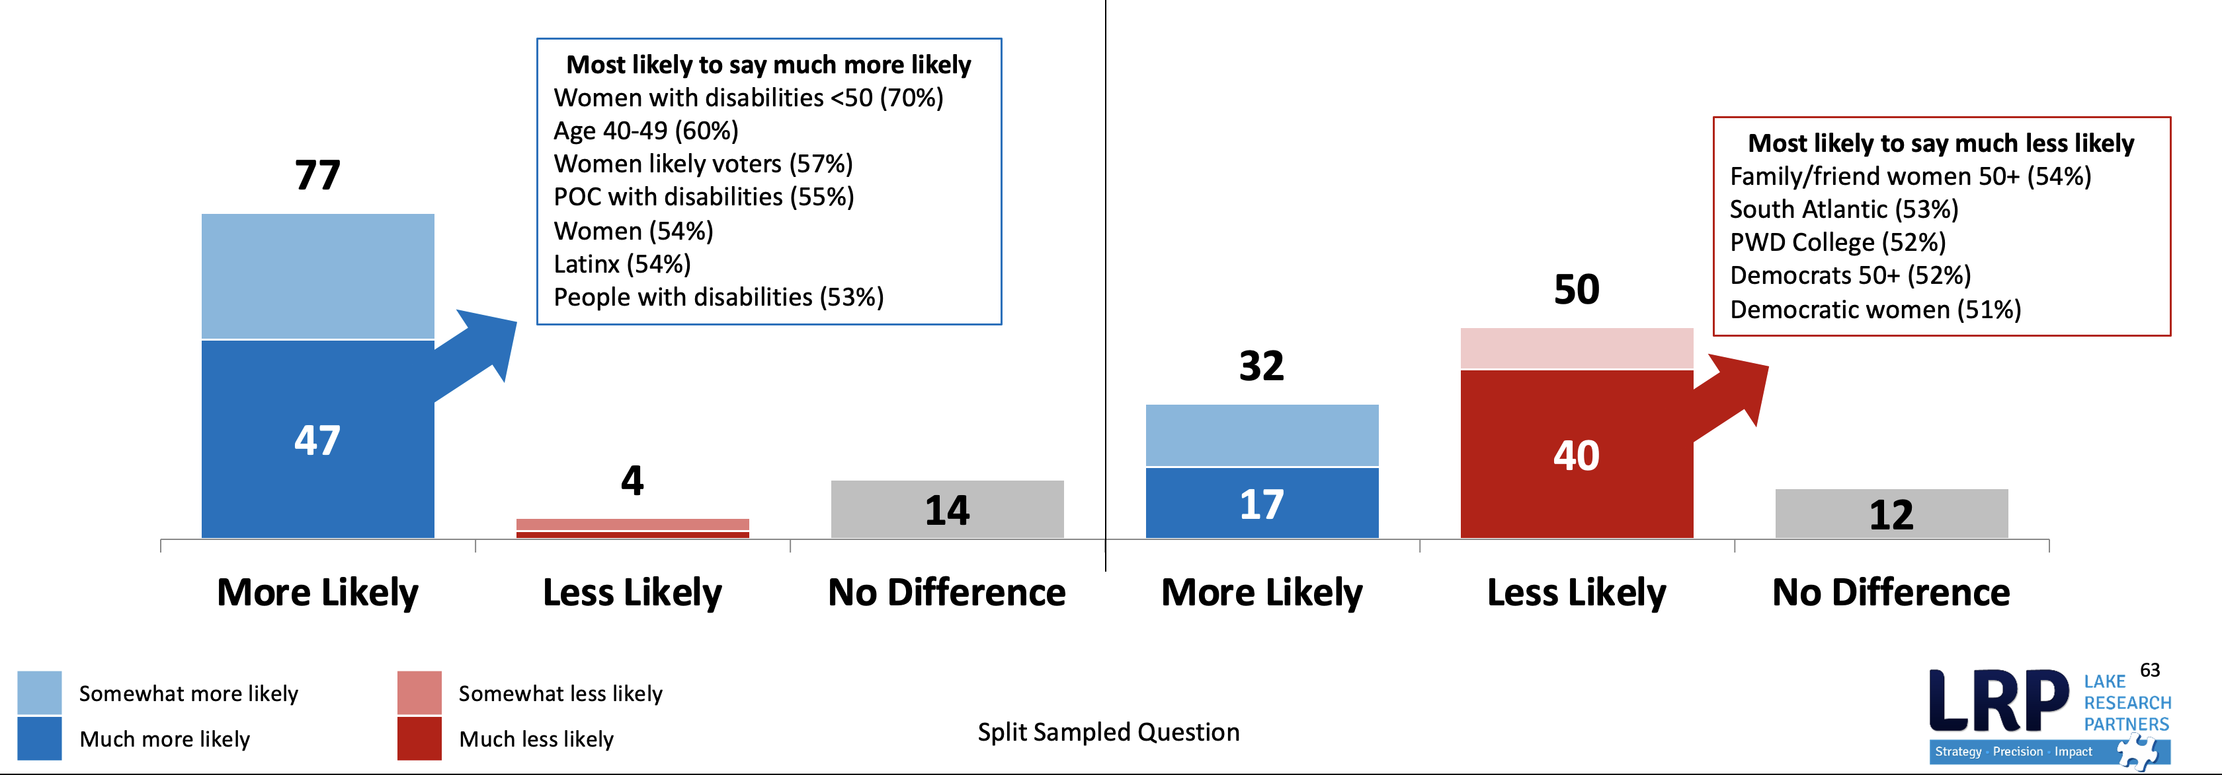
The disability community is more likely to vote for a candidate that votes for legislation that supports people with disabilities. They are less likely to vote against a candidate that votes against legislation that supports people with disabilities. Intensity in support is strongest when framed in the positive. The disability community WILL vote these issues. They want to reward more than punish.
Would you be more or less likely to vote for a candidate that votes for legislation that supports people with disabilities, or does it make no difference?
Would you be more or less likely to vote for a candidate that votes against legislation that supports people with disabilities, or does it make no difference?

Slide 64
It is very important to focus group participants to have elected officials and a government that will listen to them and address issues that directly affect them, such as healthcare.
“It is not just your governor or your mayor or your president. It has a lot to do with the smaller House of Representatives just as much as it is the Senate.” – Person of color with disability, Baltimore
“I care about it no matter who the president was, but certain presidents are a lot worse on issues than others, and I would definitely put this one in that category. And just politics in general, I think, is heavily linked to healthcare because the governments are the ones that are taking care of it.” – White person with disability, Baltimore
“One of the first things the president did when he got in office was to get rid of the President’s Advisory Council on HIV/AIDS and to shut down the Office of HIV/AIDS and make it go away and then to start cutting budgets. So, specifically in that way, it affects my health and my potential to survive as well then as the political aspects around healthcare.” – White person with disability, Baltimore
“And it has a lot to do with who is going to listen to you and how much impact you can have like making them listen to you.” – Person of color with disability, Baltimore
“I am going to vote for whoever is going to take away the regulations on me and whatever. I want to be able to do what I want to do and I don’t want you telling me what I can do.” – Parent of child with disability, Baltimore

Slide 65
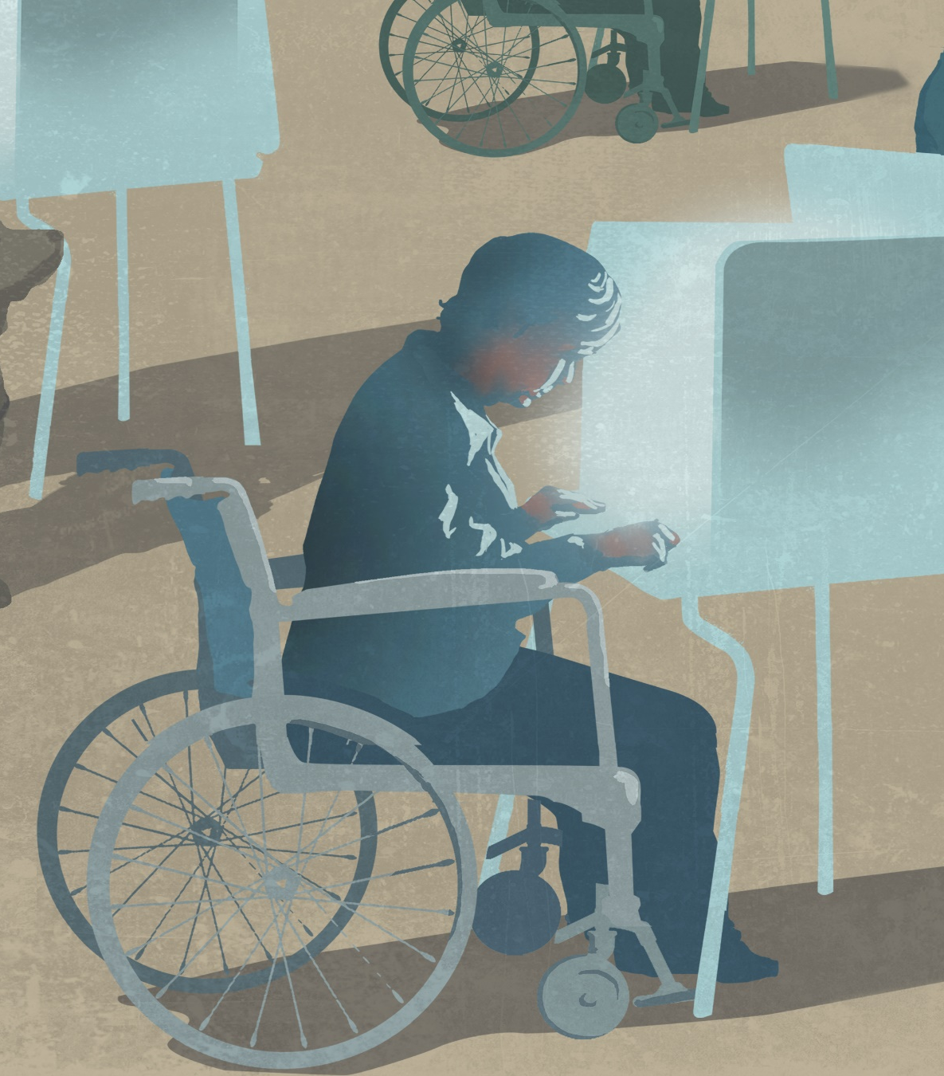
Voting and Values

Slide 66
The disability community’s connection to voting is strong. The top statements around voting making voices heard, being more important now than ever, and being powerful emerge as core values. Additionally, a strong majority also agrees that it takes too long to see political change happen.
Now you will hear a series of statements around being politically engaged and active. For each, please tell me if you agree or disagree.
 | Total Agree
 | Strongly agree
All statements split-sampled

Slide 67
The top tier statements are strong across demographics. People with a family member or friend with a disability are more likely than people with disabilities to say that voting is power. Latinx people in the disability community and non-likely voters are most likely to strongly agree that it takes too long to see political change happen.
Shown Among Disability Community
% Strongly Agree | Total | PWD | Family/ Friend | M | W | Mill. | Gen X | Boo-mer | <50 | 50+ | Father | Mother | Parent of child with disability | No child | Dem | Ind | Rep | White | AA | Lat | Coll | NC | Likely Voter | Not LV | HH <$50k | HH $50k +
Voting is necessary to make our voices heard. | 78 | 78 | 77 | 76 | 80 | 68 | 84 | 83 | 74 | 83 | 79 | 74 | 76 | 79 | 80 | 67 | 80 | 81 | 71 | 76 | 76 | 79 | 83 | 45 | 79 | 78
With the way things are going, voting is more important now than ever. | 72 | 71 | 71 | 72 | 72 | 61 | 74 | 79 | 65 | 80 | 83 | 66 | 82 | 71 | 75 | 60 | 74 | 74 | 69 | 72 | 81 | 67 | 78 | 31 | 71 | 77
Voting is power. | 63 | 56 | 65 | 66 | 59 | 52 | 65 | 74 | 53 | 74 | 76 | 57 | 74 | 61 | 67 | 48 | 64 | 64 | 62 | 63 | 64 | 61 | 69 | 20 | 60 | 66
It takes too long to see political change happen. | 55 | 54 | 57 | 56 | 55 | 48 | 59 | 55 | 55 | 57 | 51 | 49 | 54 | 58 | 60 | 53 | 51 | 53 | 54 | 70 | 48 | 60 | 54 | 61 | 58 | 53
All statements split-sampled

Slide 68
People with disabilities over age 50 are more likely to strongly agree with all three statements about voting. People of color with disabilities are less enthusiastic about the voting statements than white people with disabilities, and people with disabilities over age 50 are more likely to agree with voting is power than younger people with disabilities.
 |  | Shown among People with Disabilities Only
% Strongly Agree | Total | PWD | Family/ Friend | M | W | <50 | 50+ | Parent^ | No child | Dem | Ind^ | Rep | White | POC | Coll | NC | Likely Voter | Not LV^ | HH <$50k | HH $50k +
Voting is necessary to make our voices heard. | 78 | 78 | 80 | 76 | 80 | 73 | 83 | 75 | 79 | 82 | 62 | 83 | 84 | 71 | 80 | 79 | 83 | 50 | 81 | 74
With the way things are going, voting is more important now than ever. | 72 | 71 | 74 | 74 | 69 | 60 | 81 | 76 | 70 | 73 | 59 | 79 | 75 | 61 | 81 | 68 | 78 | 35 | 75 | 70
Voting is power. | 63 | 56 | 57 | 62 | 51 | 43 | 69 | 66 | 53 | 54 | 44 | 66 | 62 | 45 | 51 | 58 | 64 | 18 | 59 | 55
It takes too long to see political change happen. | 55 | 54 | 52 | 52 | 57 | 55 | 54 | 45 | 57 | 59 | 56 | 51 | 56 | 53 | 39 | 60 | 53 | 58 | 58 | 47
^Note small N size
All statements split-sampled

Slide 69
Among those with a family member or friend with a disability, fathers are more enthusiastic about the statements about voting than mothers. White adults are more likely than people of color to agree that voting is necessary to make our voices heard and voting is more important now than ever.
 |  | Shown among People with Disability Connection Only (Have Family Member/Friend with Disability)
% Strongly Agree | Total | Family | Friend | M | W | <50 | 50+ | Father | Mother | No child | Dem | Ind | Rep | White | POC | C | NC | Likely Voter | Not LV | HH <$50k | HH $50k +
Voting is necessary to make our voices heard. | 78 | 77 | 78 | 76 | 78 | 74 | 80 | 83 | 69 | 78 | 78 | 68 | 80 | 79 | 73 | 76 | 79 | 82 | 37 | 77 | 78
With the way things are going, voting is more important now than ever. | 72 | 73 | 65 | 69 | 72 | 67 | 76 | 82 | 67 | 69 | 75 | 60 | 70 | 73 | 66 | 79 | 66 | 77 | 26 | 65 | 77
Voting is power. | 63 | 65 | 60 | 68 | 63 | 57 | 75 | 73 | 61 | 64 | 72 | 50 | 62 | 66 | 65 | 67 | 63 | 71 | 22 | 61 | 69
It takes too long to see political change happen. | 55 | 58 | 54 | 57 | 57 | 55 | 60 | 54 | 49 | 60 | 62 | 51 | 54 | 54 | 62 | 51 | 62 | 56 | 64 | 59 | 57
All statements split-sampled

Slide 70
A majority of people in the disability community agree with the second tier statements that focus on disability issues and candidates, however intensity is much lower. At least one quarter disagree with these statements.
Now you will hear a series of statements around being politically engaged and active. For each, please tell me if you agree or disagree.
 | Total agree
 | Strongly agree
 | Total disagree
 | Strongly disagree
All statements split-sampled

Slide 71
People with disabilities, mothers, parents of children with disabilities, and African Americans are most likely to say that issues around disability influence their vote motivation. Latinx and those with a household income under $50k are most likely to agree that candidates stance on issues around disability influence who they vote for. Agreement around politicians not focusing on issues important to me and political engagement being more difficult for people with disabilities is driven by household income.
Shown Among Disability Community
% Strongly Agree | Total | PWD | Family /Friend | M | W | Mill. | Gen X | Boo-mer | <50 | 50+ | Father | Mother | Parent of child disability | No child | Dem | Ind | Rep | White | AA | Latinx | C | NC | Likely Voter | Not LV | HH <$50k | HH $50k +
Issues around disability influence how motivated I feel to vote. | 36 | 40 | 34 | 35 | 37 | 35 | 35 | 34 | 37 | 34 | 38 | 41 | 54 | 34 | 39 | 37 | 31 | 35 | 47 | 36 | 32 | 38 | 37 | 30 | 38 | 34
Candidates' stance on issues around disability influence who I vote for. | 35 | 34 | 34 | 32 | 37 | 37 | 27 | 34 | 35 | 34 | 29 | 40 | 42 | 34 | 38 | 36 | 29 | 31 | 35 | 45 | 33 | 36 | 35 | 35 | 43 | 25
Politicians do not focus on the issues that are important to me. | 35 | 34 | 35 | 37 | 32 | 32 | 36 | 35 | 33 | 35 | 38 | 30 | 45 | 35 | 36 | 36 | 30 | 34 | 34 | 36 | 31 | 36 | 35 | 33 | 39 | 29
Doing things like attending town halls, rallies, or contacting legislators are less accessible to people with disabilities. | 32 | 34 | 30 | 32 | 32 | 33 | 26 | 30 | 33 | 30 | 23 | 32 | 34 | 34 | 38 | 27 | 26 | 31 | 29 | 36 | 30 | 33 | 32 | 28 | 37 | 26
All statements split-sampled

Slide 72
People with disabilities, especially those under 50 and people of color, are most likely to say that issues around disability influence their vote motivation. Those with a household income below $50k are more likely to agree that candidates’ stance on issues around disability influence who they vote for, and that some types of political engagement can be less accessible to people with disabilities.
 |  | Shown among People with Disabilities Only
% Strongly Agree | Total | PWD | Have Family/ Friend | M | W | <50 | 50+ | Parent^ | No child | Dem | Ind^ | Rep | White | POC | C | NC | Likely Voter | Not LV^ | HH <$50k | HH $50k +
Issues around disability influence how motivated I feel to vote. | 36 | 40 | 39 | 38 | 41 | 43 | 37 | 48 | 37 | 43 | 49 | 34 | 37 | 45 | 38 | 41 | 43 | 23 | 39 | 41
Candidates' stance on issues around disability influence who I vote for. | 35 | 34 | 35 | 33 | 36 | 37 | 32 | 35 | 34 | 38 | 31 | 32 | 37 | 34 | 27 | 37 | 36 | 18 | 43 | 14
Politicians do not focus on the issues that are important to me. | 35 | 34 | 35 | 37 | 31 | 29 | 39 | 29 | 36 | 35 | 32 | 30 | 36 | 28 | 34 | 34 | 36 | 24 | 35 | 33
Doing things like attending town halls, rallies, or contacting legislators are less accessible to people with disabilities. | 32 | 34 | 36 | 31 | 36 | 38 | 30 | 32 | 34 | 41 | 27 | 29 | 37 | 30 | 33 | 34 | 35 | 19 | 40 | 20
^Note small sample size
All statements split-sampled

Slide 73
Those with a family member or friend with a disability agree with the second tier statements at a similar level as the disability community as a whole, but slightly less than people with disabilities. People of color, unlikely voters, and those with a household income below $50k are most likely to say candidates’ stance on issues around disability influence whom they vote for.
 |  | Shown among People with Disability Connection Only (Have Family Member/Friend with Disability)
% Strongly Agree | Total | Family | Friend | M | W | <50 | 50+ | Father | Mother | No child | Dem | Ind | Rep | White | POC | C | NC | Likely Voter | Not LV^ | HH <$50k | HH $50k +
Issues around disability influence how motivated I feel to vote. | 36 | 35 | 35 | 33 | 35 | 34 | 35 | 32 | 39 | 34 | 39 | 34 | 28 | 34 | 37 | 30 | 37 | 34 | 34 | 40 | 31
Candidates' stance on issues around disability influence who I vote for. | 35 | 33 | 38 | 32 | 36 | 34 | 35 | 31 | 37 | 34 | 38 | 34 | 29 | 29 | 46 | 34 | 35 | 34 | 44 | 44 | 27
Politicians do not focus on the issues that are important to me. | 35 | 36 | 30 | 34 | 35 | 36 | 32 | 38 | 34 | 34 | 37 | 39 | 27 | 34 | 36 | 29 | 38 | 33 | 42 | 44 | 27
Doing things like attending town halls, rallies, or contacting legislators are less accessible to people with disabilities. | 32 | 31 | 30 | 31 | 29 | 30 | 29 | 26 | 28 | 31 | 35 | 24 | 24 | 26 | 36 | 29 | 31 | 30 | 32 | 33 | 27
^Note small sample size
All statements split-sampled

Slide 74
In a third tier of statements, agreement is more mixed toward claims of lack of information and the process. About a quarter of the disability community strongly agrees that there is a lack of information about local elections which makes it difficult to participate. A slim majority disagree with me or people that I know have skipped voting because it is an inconvenient or difficult process and being politically active is not one of my priorities.
Now you will hear a series of statements around being politically engaged and active. For each, please tell me if you agree or disagree.
 | Total agree
 | Strongly agree
 | Total disagree
 | Strongly disagree
All statements split-sampled

Slide 75
The bottom tier statements are less salient to all key demographic and attitudinal subgroups. Latinx and those who are younger, noncollege educated, and unlikely voters are more likely to say they lack information about elections and do not know enough to vote in them. Millennials and African Americans are more likely to say they do not know when elections are going to happen.
Shown Among Disability Community
% Strongly Agree | Total | PWD | Family /Friend | Men | Women | Mill. | Gen X | Boo-mer | <50 | 50+ | Father | Mother | Parent of child with disability | No child | Dem | Ind | Rep | White | AA | Lat | C | NC | Likely Voter | Not LV | HH <$50k | HH $50k +
There is a lack of information about local elections and I don't know enough information to vote in them. | 26 | 27 | 25 | 24 | 28 | 30 | 25 | 20 | 30 | 21 | 22 | 27 | 26 | 26 | 27 | 31 | 22 | 24 | 23 | 37 | 19 | 30 | 25 | 32 | 29 | 21
There is a lack of information about local elections and I don't know when they are going to happen. | 24 | 21 | 25 | 22 | 26 | 33 | 18 | 21 | 28 | 19 | 30 | 24 | 28 | 23 | 28 | 20 | 22 | 20 | 32 | 29 | 23 | 24 | 25 | 19 | 23 | 25
Me or people that I know have skipped voting because it is an inconvenient or difficult process. | 20 | 22 | 19 | 22 | 18 | 31 | 15 | 13 | 26 | 13 | 19 | 21 | 24 | 19 | 22 | 19 | 17 | 18 | 22 | 25 | 18 | 21 | 19 | 26 | 23 | 17
Being politically active is not one of my priorities. | 18 | 22 | 16 | 22 | 15 | 24 | 13 | 16 | 21 | 15 | 30 | 14 | 23 | 17 | 17 | 23 | 18 | 16 | 22 | 23 | 17 | 19 | 17 | 28 | 18 | 17
All statements split-sampled

Slide 76
Among people with disabilities, women, parents, people of color, Democrats, Independents, and those without a college degree are more likely to say they strongly agree that there is lack of information about local elections and they don’t know enough to vote in them. People of color and younger adults with disabilities are also more likely to strongly agree that they or people they know have skipped elections because it is an inconvenient or difficult process.
 |  | Shown among People with Disabilities Only
% Strongly Agree | Total | PWD | Family/ Friend | M | W | <50 | 50+ | Parent^ | No child | Dem | Ind^ | Rep | White | POC | Coll | NC | Likely Voter | Not LV^ | HH <$50k | HH $50k +
There is a lack of information about local elections and I don't know enough information to vote in them. | 26 | 27 | 27 | 22 | 32 | 37 | 18 | 34 | 25 | 31 | 32 | 21 | 26 | 32 | 9 | 33 | 26 | 30 | 32 | 15
There is a lack of information about local elections and I don't know when they are going to happen. | 24 | 21 | 22 | 20 | 22 | 24 | 18 | 29 | 19 | 22 | 19 | 22 | 21 | 22 | 23 | 20 | 22 | 16 | 22 | 19
Me or people that I know have skipped voting because it is an inconvenient or difficult process. | 20 | 22 | 22 | 24 | 20 | 31 | 14 | 25 | 21 | 22 | 22 | 19 | 19 | 30 | 14 | 25 | 22 | 23 | 25 | 16
Being politically active is not one of my priorities. | 18 | 22 | 23 | 25 | 18 | 25 | 19 | 27 | 20 | 18 | 19 | 25 | 20 | 26 | 17 | 23 | 22 | 21 | 21 | 22
^Note small sample size
All statements split-sampled

Slide 77
Among people with a family or friend with a disability, unlikely voters, and people of color are more likely to say that they lack enough information to vote in local elections. People of color and Democrats are more likely to say that they lack information and don’t know when local elections are going to happen.
 |  | Shown among People with Disability Connection Only (Have Family Member/Friend with Disability)
% Strongly Agree | Total | Family | Friend | M | W | <50 | 50+ | Father | Mother | No child | Dem | Ind | Rep | White | POC | C | NC | Likely Voter | Not LV^ | HH <$50k | HH $50k +
There is a lack of information about local elections and I don't know enough information to vote in them. | 26 | 27 | 23 | 24 | 26 | 26 | 24 | 20 | 23 | 27 | 25 | 28 | 24 | 23 | 31 | 22 | 28 | 23 | 40 | 28 | 22
There is a lack of information about local elections and I don't know when they are going to happen. | 24 | 24 | 20 | 21 | 28 | 30 | 17 | 26 | 23 | 25 | 31 | 21 | 20 | 19 | 36 | 22 | 26 | 25 | 24 | 23 | 25
Me or people that I know have skipped voting because it is an inconvenient or difficult process. | 20 | 20 | 20 | 20 | 17 | 23 | 13 | 17 | 18 | 19 | 22 | 15 | 16 | 17 | 22 | 19 | 19 | 17 | 31 | 22 | 16
Being politically active is not one of my priorities. | 18 | 16 | 16 | 18 | 14 | 18 | 13 | 27 | 10 | 15 | 17 | 22 | 12 | 13 | 23 | 15 | 16 | 14 | 31 | 16 | 15
^Note small sample size
All statements split-sampled

Slide 78
In focus groups, participants say they are politically involved. They are contacting their representatives to make their voices heard and believe voting is a fundamental right and a core way to make your voice heard. Some say the internet is a more immediate way to get people’s attention.
“I think you do have to vote. You do have to have a voice. Nothing changes unless you vote.” – Parent of child with disability, Baltimore | “Get involved politically.” – White person with disability, Baltimore “Calling your representatives. Calling Washington.” – White person with disability, Baltimore “Getting involved.” – White person with disability, Baltimore | “I think staying involved. If you want to feel powerful politically, you change it from within. A lot of people complain that their vote doesn’t count. It’s because they are voting for these select people and nobody is opposing these select people.” – Parent of child with disability, Baltimore
“[The internet] sometimes seems like the only way to get people’s attention.” – White person with disability, Baltimore
 | “When there is a vote for a bill or something coming up I write or call my representative and say this is how I would like you to vote, and obviously, I am not going to vote for you if you don’t vote the way I want you to vote. And I get a candid response, but I feel like maybe I did something if it actually passes, if it goes the way I want it.” – White person with disability, Baltimore
 |  | “You mean in the realm of voting or just politics? Oh, I have a lot of politicians on email, and when I have issues, I email everybody, like 50 some odd people at one time and that makes me feel really good.” – Person of color with disability, Baltimore
“If you don’t vote, regardless if there is change, you can’t elect change if you don’t become a part of it.” – Parent of child with disability, Baltimore
What makes you feel like your voice is being heard? What makes you feel powerful, politically?

Slide 79
Parents of children with disabilities see a bigger impact when they vote in state and local elections, and feel that federal elections have less of a direct impact. They also believe politicians struggle to deliver on their promises, and it takes a long time to see political change happen.
“I do think local politics and state politics have to be more accountable to their constituents than on a federal level simply because I mean the everyday Congress and Senate are making laws that you probably wouldn’t even hear about unless you look it up.” – Parent of child with disability, Baltimore
“Paramount to my voice being heard, because I want to make sure that whoever I am picking I would think has my interests underlined.” – Parent of child with disability, Baltimore
“When it comes to state elections, I would say essential.” – Parent of child with disability, Baltimore
“And at the federal level, a lot of these decisions made at the federal level…I mean there have been periods of time through multiple presidents where people’s lives haven’t really changed much at all.” – Parent of child with disability, Baltimore

Slide 80
While white people with disabilities respond more positively to seeing a connection between voting and being politically active and their lives, the people of color are much more skeptical. The people of color with disabilities in the focus group highlight how long it takes to see change happen and their doubts that individual votes actually make a difference.
“The word that comes to mind is essential. Like the voting is influenced by who I am 100%.”– White person with disability, Baltimore
“It is hard to be patient when you like to watch the changes happen. Like you will hear things and you hear them as like when they campaigning, but you won’t see that change or that promise fulfilled.” – Person of color with disability, Baltimore
“It is hard to stay motivated to want to vote when it takes so long to see the results of your voting.” – Person of color with disability, Baltimore
“At least I voted. I don’t think it makes a difference whether or not…”– Person of color with disability, Baltimore

Slide 81
Voter suppression is a real issue for focus group participants. They see barriers to voting ranging from accessibility to racism.
“I was just reading about an occasion where it was changed so that the only polling place you could go to was 50 miles away.” – White person with disability, Baltimore | “No.” – Parent of child with disability, Baltimore “I mean there are a lot of restrictions.” – Parent of child with disability, Baltimore “I don’t think so.” – Parent of child with disability, Baltimore | “No, I have heard a lot about like voter suppression, and I get what you are saying. Like in your district, there may be five voting places or whatever, but let’s just say you are in my district. There are eight, but only one is working and then the line is long and then we have the paper ballot and then we don’t and then we have the computer. So, it all really depends on location.” – Parent of child with disability, Baltimore
“And especially since it was the majority African-American, there was a big racial component, and that’s why I don’t think that it can you know be very fairly counted when so many people…especially for a group like us with a bunch of disabilities. Imagine taking the day off to you know go and vote.” – White person with disability, Baltimore
 |  | ”I remember watching a whole bus full of people who came from a church to vote and I think it was in Georgia, but I am not 100% sure and the whole bus was turned away. And they went to all that trouble to rent a bus so that they could pick people up and make sure that they get to vote and they were turned away.” – White person with disability, Baltimore
 | “Since this administration, it has gotten worse.” – White person with disability, Baltimore
Do you think everyone is able to vote if they want to? What are the barriers to voting?

Slide 82
A strong majority of the disability community agrees that voting on the issues that matter to the disability community can make change. Strong partisans react with more intensity to language about voting on these issues while those in the Northeast region, people of color, and women with disabilities react with more intensity to voting in their own self-interest.
Please tell me if you agree or disagree:
Some people have said if the disability community, including those with disabilities as well as family members and friends of people with disabilities, voted on the issues that mattered to them and voted in their own self-interest, then we could make changes on big issues that impact us.
Some people have said if the disability community, including those with disabilities as well as family members and friends of people with disabilities, voted on the issues that matter to them and voted on these issues, then we could make changes on big issues that impact us.
Most likely to say strongly agree
Northeast region (65%)
People of color (63%)
Women with disabilities (61%)
PWD likely voters (60%)
Most likely to say strongly agree
Strong Democrats (67%)
Strong Republicans (63%)
PWD Democrats (63%)
Democratic women (61%)
Income below $50k
Men <50 (60%)
Gen X (60%)
 | Not so strongly agree |  | Not so strongly disagree
 | Strongly Agree |  | Strongly disagree
Split Sampled Question

Slide 83
In the groups, participants are mixed on if the disability community voted in their own-self interest it would make a change on big issues. Some say that is true, but others feel that they haven’t seen change happen so it is hard to believe.
“It is increasing. And we are being listened to.” – Parent of child with disability, Baltimore | “I think any group that lobbies enough…and I think lobbying is more powerful than voting because that’s where all the changes happen and that’s where all the deals are made. If you lobby Congress and you throw enough money and energy at a problem, they will eventually.” – Parent of child with disability, Baltimore | “I think what she was saying you do have a voice when everyone comes together because I had a friend that worked for me, and he was a paraplegic and he…with his help……a side curb accessible for wheelchairs. He made that happen.” – Person of color with disability, Baltimore
“I think that that would be the goal, but it really just depends on the person that is elected and if they are saying that to get my vote and how long are they going to follow through with…I don’t want them to say yeah, I am championing for you know whatever it is, but I am going to carry it out in my second term. You know after they are already elected, and at that point they are like I don’t give a damn.” – Parent of child with disability, Baltimore
 |  | “As opposed to like the AARP, because I think that they have a lot in common with people with disabilities, I haven’t seen all those things go into place.”– White person with disability, Baltimore
 | “Because if it was just people with disabilities voting on certain issues, I believe it would be a stronger effect.” – Person of color with disability, Baltimore
Some people have said if the disability community voted on the issues that matter to them and voted in their own self-interest,
then we could make changes on big issues that impact us. What do you think about this?

Slide 84
Reactions are mixed among focus group participants in their views of elected officials. Some say key issues are not being addressed, while others have written to their representatives and gotten a response. One participant noted that filling out forms in order to contact their representatives is less accessible to them because of their disability. Another noted that changes in local policing behavior to be more sensitive to children with disabilities has made a positive impact in their family’s life.
“There are new issues being brought up that don’t need to be.” – White person with disability, Baltimore | “And I feel that it has been better because now there are laws that protect children with disabilities. Now the police send out forms if you have had an incident or something saying that you know you identify your child and they become aware of that there is a child with a disability in your home. And therefore, they approach your home and they are going to come in your home knowing that they have to treat them differently and that they don’t have to see them as a threat. And I think that that has been a big help and that has been a wonderful change. Because before, you would hear something like a child with autism has been tasered or they have passed away because they were beaten, etc., etc., because the police or the law enforcement did not understand maybe what was happening.” – Parent of child w/ disability, Baltimore | “Maybe not once they find out about the disability stuff that we all want parking spaces, but…[laughter]” – White person with disability, Baltimore
 |  | “Because when you write to certain delegates and senators, they tend to respond. The only thing that I say is…because my vision is bad and with writing, they want you to fill out a form and that’s where my complication comes in.” – Person of color with disability, Baltimore
“Human rights and civil rights and racial issues in this country are not being addressed.” – White person with disability, Baltimore
Do you feel like the issues you care about are being addressed by your elected officials?
Do you feel like politicians and elected officials care about people like you?

Slide 85
Messaging

Slide 86
Full Text of Messages Tested
[EDUCATION] The future of our nation rests on education today. All children, including children with disabilities, must have access to the best education we can offer. This means our schools must be equipped with the correct resources and the most capable and carefully trained teachers. For this to be possible, we must vote for representatives who will allocate the proper funding to our schools to best serve all students and give special needs students a fair shot at a great education.
[FUNDAMENTAL RIGHT] Voting is a fundamental right. It’s our way to contribute to the future of the country, but just 56% of voting-age Americans voted in 2016. That means for every friend of yours that voted, another one didn’t. Voting gives everyone the opportunity to amplify the voices of those who desperately want and need to be heard. Often, those in the disability community need social change even more. As members of the disability community, we should strive to beat that statistic – ALL of us should vote.
[HEALTHCARE] Healthcare should be one of the top reasons you vote in every election. You never know when an injury or illness will occur for you or a loved one, and your future health may be impacted by how people vote on this issue today. With the future of the Affordable Care Act and coverage for people with pre-existing conditions in doubt, and the cost of insurance and prescription drugs on the rise, we need to vote today.
[WHAT'S AT STAKE] Elected officials in Washington and across the country have the power to affect our daily lives. In the last two years, Senators have proposed gutting the Affordable Care Act, cutting Medicaid, and eliminating other critical protections for people with disabilities. That is why it is so important to vote in every election with our personal interests in mind. Even if it won't affect us personally, we all have a responsibility to each other and our futures.
[IMPACT OF VOTING] The importance of voting extends beyond simply choosing who our next President or Governor will be. Critical issues that impact our community, like healthcare, education and access to special education, the environment, LGBTQ and disability rights are all impacted by elections. If you care about your future and want the best things for your family, your children, your community and the broader disability community, you need to vote in every election.
[HISTORY] We have a ways to go until people with disabilities have the same opportunities and accommodations that able-bodied people have. We need to join together with people from all walks of life to fight for our future, just like we did in the past when people with disabilities won the right to accessible public and commercial spaces and freedom from discrimination in public life, including the workplace through the Americans with Disabilities Act. By joining together, we can elect new leaders to build on the progress we have made.
Sorted by % Very Convincing
All statements split-sampled

Slide 87
We consider a strong message to be one that is very convincing to 40% and convincing overall to 60% of survey participants. All of our messages exceed this expectation, with the messages focused on education, voting as a fundamental right, and healthcare testing the strongest among the disability community. Focusing on critical protections for people with disabilities that are at stake, the impact of voting, and the gains this community has made over history fall into a second tier but are still very strong.
Now you will hear some statements encouraging people with disabilities, as well as family members and friends of people with disabilities, to be politically involved and vote in ways that can make a positive difference in their lives. For each, please tell me if you believe it is a very convincing, somewhat convincing, a little convincing, or not at all convincing reason to be politically involved and vote.
 | Total Convincing
 | Very Convincing
All statements split-sampled

Slide 88
The top message, Education, is strongest among African Americans, Democrats, mothers, those with a lower household income, women, and millennials. Fundamental Right is strongest among fathers. The Healthcare message also pops among fathers, Latinx, and Democrats. The Impact of Voting message is notably strong among those over 50, Democrats, and Latinx.
Shown Among Disability Community
% Very Convincing | Total | PWD | Family/ Friend | M | W | Mill. | Gen X | Boo-mer | <50 | 50+ | Father | Mother | Parent of child with disability | No child | Dem | Ind | Rep | White | AA | Lat | Coll | NC | LV | Not LV | HH <$50k | HH $50k +
EDUCATION | 61 | 65 | 60 | 55 | 67 | 65 | 55 | 62 | 61 | 61 | 51 | 70 | 61 | 60 | 70 | 66 | 51 | 57 | 76 | 62 | 57 | 62 | 62 | 55 | 67 | 56
FUNDAMENTAL RIGHT | 57 | 56 | 57 | 58 | 56 | 54 | 52 | 63 | 52 | 62 | 66 | 52 | 61 | 57 | 59 | 52 | 61 | 58 | 54 | 61 | 55 | 58 | 60 | 37 | 57 | 58
HEALTHCARE | 57 | 58 | 55 | 57 | 56 | 52 | 56 | 62 | 54 | 60 | 65 | 53 | 60 | 56 | 64 | 61 | 50 | 55 | 60 | 64 | 48 | 61 | 58 | 48 | 61 | 54
WHAT'S AT STAKE | 54 | 59 | 52 | 51 | 57 | 45 | 56 | 59 | 49 | 60 | 51 | 48 | 49 | 56 | 66 | 47 | 45 | 51 | 64 | 68 | 52 | 55 | 55 | 43 | 59 | 51
IMPACT OF VOTING | 51 | 55 | 51 | 48 | 54 | 37 | 54 | 58 | 42 | 61 | 48 | 44 | 46 | 54 | 61 | 48 | 41 | 51 | 48 | 64 | 44 | 55 | 54 | 29 | 56 | 46
HISTORY | 49 | 51 | 47 | 48 | 49 | 45 | 45 | 49 | 44 | 53 | 52 | 42 | 50 | 49 | 54 | 42 | 45 | 47 | 60 | 52 | 44 | 51 | 50 | 38 | 53 | 44
All statements split-sampled

Slide 89
Among people with disabilities, the messages work best among women, older people with disabilities, and those with lower household incomes. Education tends to work best across groups. Fundamental Right is strongest among Republicans and likely voters.
 |  | Shown among People with Disabilities Only
% Very Convincing | Total | PWD | Family/ Friend | M | W | <50 | 50+ | Parent^ | No child | Dem | Ind^ | Rep | White | POC | Coll | NC | LV | Not LV^ | HH <$50k | HH $50k +
EDUCATION | 61 | 65 | 64 | 57 | 71 | 60 | 69 | 68 | 64 | 69 | 71 | 62 | 63 | 67 | 61 | 66 | 65 | 57 | 70 | 54
FUNDAMENTAL RIGHT | 57 | 56 | 57 | 55 | 56 | 45 | 64 | 47 | 58 | 52 | 56 | 65 | 58 | 50 | 56 | 55 | 62 | 16 | 57 | 51
HEALTHCARE | 57 | 58 | 60 | 55 | 61 | 51 | 64 | 54 | 59 | 63 | 69 | 53 | 58 | 57 | 47 | 61 | 60 | 42 | 62 | 49
WHAT'S AT STAKE | 54 | 59 | 57 | 57 | 61 | 50 | 68 | 54 | 60 | 68 | 51 | 57 | 56 | 68 | 61 | 58 | 62 | 44 | 65 | 54
IMPACT OF VOTING | 51 | 55 | 52 | 51 | 59 | 42 | 69 | 49 | 57 | 65 | 52 | 50 | 53 | 61 | 46 | 58 | 61 | 27 | 62 | 48
HISTORY | 49 | 51 | 53 | 50 | 51 | 44 | 57 | 50 | 51 | 54 | 45 | 52 | 45 | 64 | 39 | 54 | 52 | 43 | 57 | 42
^Note small sample size
All statements split-sampled

Slide 90
Among those with a family member or friend with a disability, the Education message is strongest among women, younger adults, mothers, Democrats and Independents, people of color, and those with lower household incomes. Fundamental Right is strongest among fathers, non-college, and Republicans. Healthcare is also strong among fathers.
 |  | Shown among People with Disability Connection Only (Have Family Member/Friend with Disability)
% Very Convincing | Total | Family | Friend | M | W | <50 | 50+ | Father | Mother | No child | Dem | Ind^ | Rep | White | POC | C | NC | Likely Voter | Not LV^ | HH <$50k | HH $50k +
EDUCATION | 61 | 62 | 56 | 53 | 66 | 63 | 54 | 53 | 67 | 59 | 70 | 66 | 44 | 54 | 70 | 58 | 61 | 61 | 53 | 65 | 56
FUNDAMENTAL RIGHT | 57 | 59 | 53 | 59 | 56 | 56 | 58 | 67 | 54 | 55 | 61 | 51 | 57 | 55 | 62 | 52 | 59 | 59 | 49 | 56 | 58
HEALTHCARE | 57 | 59 | 48 | 57 | 54 | 54 | 56 | 69 | 53 | 53 | 65 | 57 | 45 | 53 | 61 | 46 | 60 | 57 | 48 | 57 | 54
WHAT'S AT STAKE | 54 | 51 | 56 | 48 | 56 | 51 | 55 | 54 | 47 | 53 | 64 | 49 | 39 | 51 | 58 | 49 | 56 | 52 | 49 | 55 | 51
IMPACT OF VOTING | 51 | 53 | 47 | 49 | 52 | 45 | 58 | 51 | 43 | 54 | 60 | 46 | 40 | 52 | 50 | 43 | 57 | 53 | 35 | 52 | 48
HISTORY | 49 | 48 | 42 | 46 | 47 | 42 | 51 | 49 | 41 | 47 | 53 | 44 | 38 | 48 | 46 | 43 | 49 | 48 | 34 | 50 | 44
^Note small sample size
All statements split-sampled

Slide 91
Reactions to messages from focus group participants provided valuable insights.
FUNDAMENTAL RIGHT | HEALTHCARE FOCUS | WHAT’S AT STAKE | IMPACT OF VOTING | SCHOOLS
“It doesn’t matter how smart you are, you can understand it. Or every person that voted, one of them voted and one did not.” – Person of color with disability, Baltimore | “Like I said before, it is a little ominous. It is sort of like you need to vote or something could happen to you.” – White person with disability, Baltimore | “I mean because they are talking about oh, where your personal interests. That starts to sound selfish.” – White person with disability, Baltimore | “I don’t like putting people in categories because I believe that when you name certain groups, it is people that really don’t like certain groups. And I believe just from them hearing this, they might dislike it just because of certain groups. I don’t like pointing fingers at certain groups if it doesn’t matter.” – Person of color with disability, Baltimore | “I really like the fact that they were talking about increasing the education funding. A lot of times maybe the security guards or the teachers are getting pretty much stressed out because they are not being paid enough to deal with anything that comes with being a teacher or counselor or whatever the position may be in the school system.” – Parent of child with disability, Baltimore
 | “I think the fact that it talks about the future and reminds you that you may not be of concern today, but there is a future.” – Parent of child with disability, Baltimore | “The importance of voting every election. Because like [he] said, it is a privilege that we have and we should always go out and vote.” – Person of color with disability, Baltimore
“Just add disability on there. If you want me to acknowledge it as something with disability, put disability on there.” – Person of color with disability, Baltimore | “I also found it very convincing because you never know what can happen to you in the future. Tomorrow is not promised.” – Parent of child with disability, Baltimore | “Well it does bring up recent things with not very much details. Just the names – The Affordable Care Act and Medicaid.” – White person with disability, Baltimore | “It doesn’t say anything about healthcare. Healthcare could be cut. There is nothing inspiring about this paragraph. There is nothing motivating. There are no motivating statements.” – Person of color with disability, Baltimore | “I always think that education needs more funding and resources.” – Parent of child with disability, Baltimore
“I don’t think voices are really heard with voting because they don’t never really put a platform for people with disabilities or saying what they are going to do for people with disabilities, so what is there to vote for? You are not amplifying anything because it is not anything that is pertaining to you.” – Person of color with disability, Baltimore | “Along the same lines as what [she] was saying, people who don’t deal with any kind of disability often don’t think about what could happen.” – White person with disability, Baltimore | “But there has got to be a better way to connect to saying the issues we care most about are the things that make us the most motivated. You know there has got to be some way to better do that last part.” – White person with disability, Baltimore | “It is okay with everybody else. Don’t left me with everybody else. disability issues need to be as disability issues. Politicians are not focusing on people with disabilities at all. We are lumped in with everybody else and then we don’t get the resources that we need. So, once you lump us, it is over.” – Person of color with disability, Baltimore | “You know I was just completely turned off. We were able to put them in a private school, and we put my son in a school that can really work with him and works at his grade level and doesn’t push him through. They don’t move on to a concept until he has got it.” – Parent of child with disability, Baltimore

Slide 92
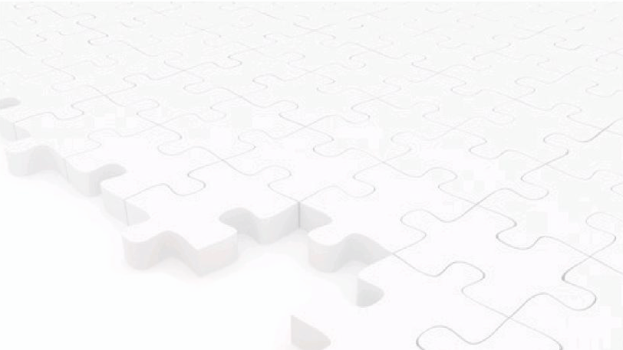
Washington, DC | Berkeley, CA | New York, NY
LakeResearch.com
202.776.9066
Celinda Lake
clake@lakeresearch.com
Alysia Snell
asnell@lakeresearch.com
Jesse Kline
jkline@lakeresearch.com
Emily Caramelli
ecaramelli@lakeresearch.com

