Slide 1
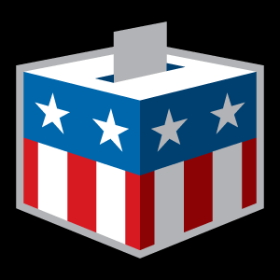
Election Omnibus Findings January 2021

Slide 2
Methodology
Lake Research Partners and The Tarrance Group designed and administered this pre-election and election night survey which was conducted using professional interviewers from October 31 – November 3, 2020. The questions about voting and the demographics reached a total of 2,400 voters nationwide who voted in the 2020 elections or who were planning to vote later on Tuesday – 1,335 interviews among voters who were reached on cell phones, including 600 interviews completed by text-to-online, and 1,065 interviews among voters who were reached on landlines (margin of error +/- 2.0%). Issue questions reached a total of 1,200 voters nationwide who voted in the 2020 elections or who were planning to vote later on Tuesday (margin of error of +/-2.8%).
Telephone numbers were drawn from the TargetSmart voter file. The sample was stratified geographically based on the proportion of likely voters in each region. The data were weighted to reflect the aggregated Presidential vote as reported in the 2020 exit polls, as well as by gender, age, race, party identification, education, marital status, union household, and census region to reflect the actual proportions of the electorate.
Due to rounding some of the numbers in the presentation will not always add to 100%.

Slide 3
More than 2 in 5 voters report having a disability and/or having a family member or a close friend with a disability. Throughout this webinar deck, we use either the phrase “voters with disabilities/family/friends” or “P/F/F” to refer to the total sample of voters who say they either personally have a disability, have a family member with a disability, or a close friend with a disability.
Do you, a family member, or a close friend have a disability, such as a physical, mental health, sensory, learning, cognitive or other disability that impacts daily living? If yes, then please let me know which applies.

Slide 4
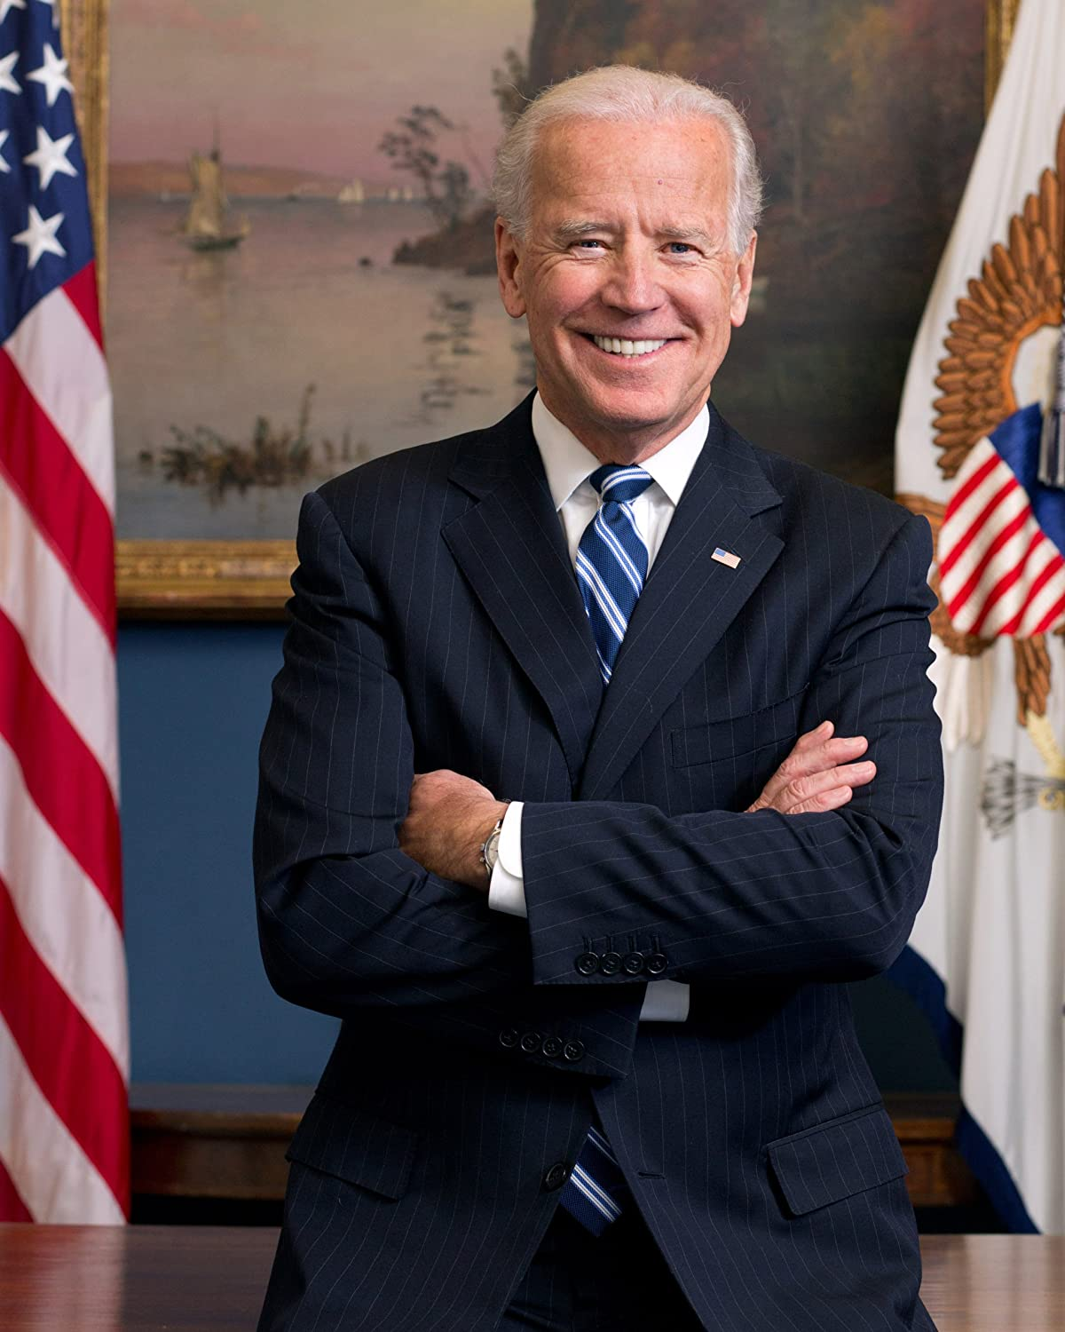
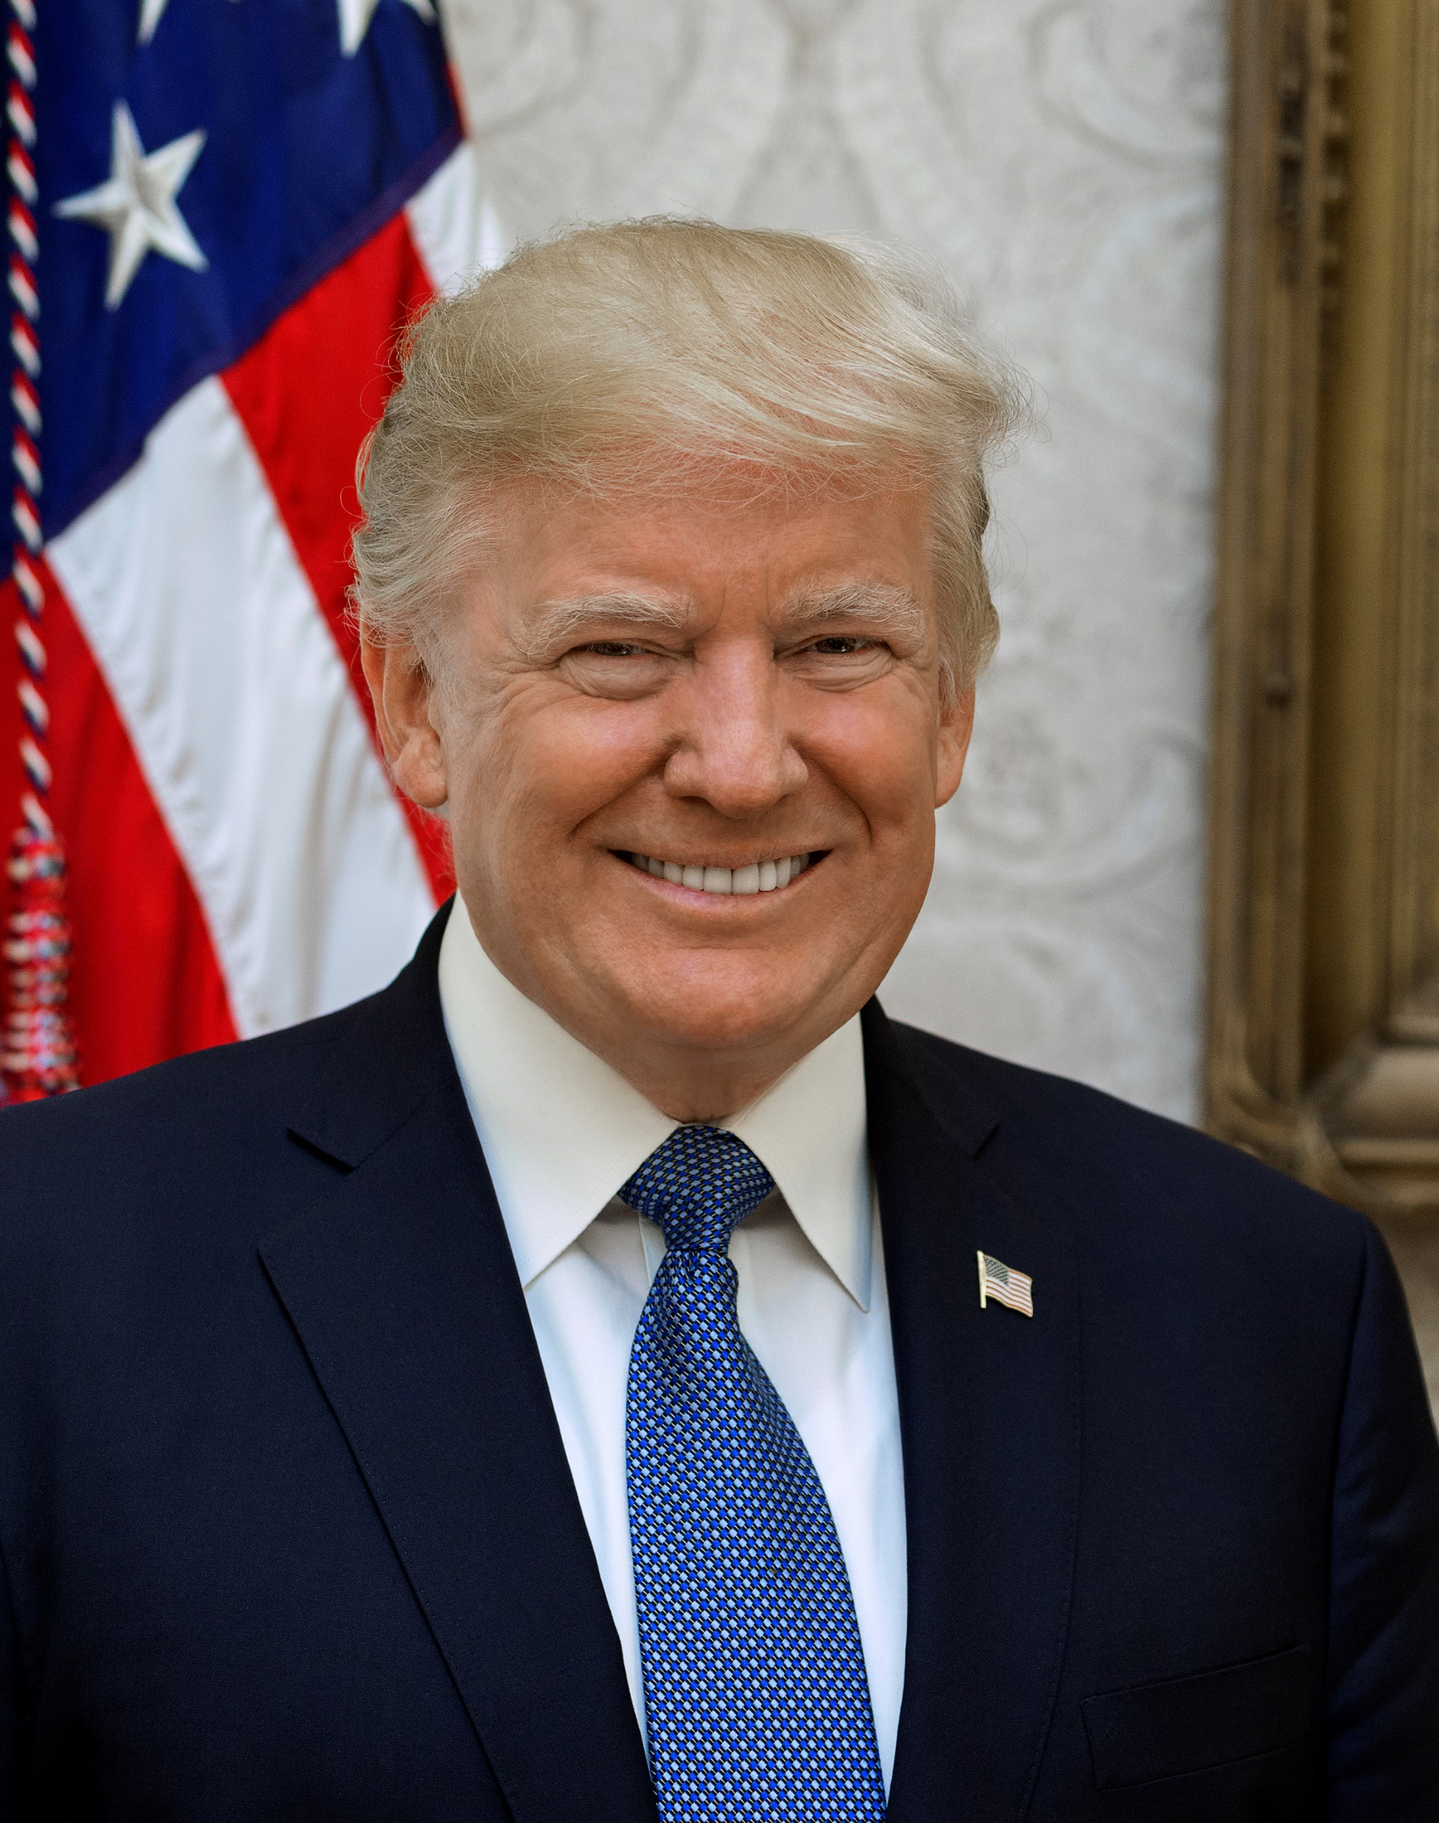
Presidential Vote
Image Description: An official photo of President-Elect Joe Biden and President Donald Trump.

Slide 5
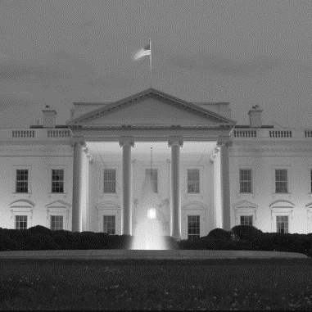
In a closely contested race, Joe Biden defeated Donald Trump in both the electoral college and the popular vote. Our election survey had the national vote at 51% for Biden to 48% for Trump.
If the election for President were held today, and the candidates were [ROTATE BIDEN AND TRUMP] _ Democrat Joe Biden _Republican Donald Trump, _Libertarian Jo Jorgensen, [AND] _Green Party Candidate Howie Hawkins, for whom would you vote?
 | Trump | Biden | Third Party
Men | 50 | 48 | 2
Women | 45 | 53 | 1
Under 30 | 40 | 58 | 2
30 to 39 | 43 | 55 | 1
40 to 49 | 51 | 47 | 1
50 to 64 | 50 | 49 | 0
Over 65 | 51 | 47 | 1
Northeast | 38 | 61 | 0
Midwest | 51 | 48 | 1
South | 51 | 47 | 2
West | 47 | 52 | 1
White | 54 | 45 | 1
African American | 11 | 87 | 1
Latinx | 40 | 59 | 1
API | 36 | 62 | 3
Democrat (ID) | 7 | 92 | 0
Independent (ID) | 44 | 54 | 2
Republican (ID) | 93 | 6 | 1
Notes:
Democrats and Republicans consolidated their respective bases (92% of Democrats voted for Biden and 93% of Republicans voted for Trump), while Independents broke in favor of Biden (54% Biden to 44% for Trump).
The gender gap played an important role, overcoming men’s support for Trump. Women broke for Biden by 8 points—53% for Biden and 45% for Trump, compared to men who broke for Trump by 2 points— 50% percent for Trump and 48% percent for Biden. Several groups of women supported Biden at higher levels.

Slide 6
A majority of voters with disabilities overall, including 55% of voters with disabilities in battleground states, voted for Donald Trump. A majority of the voters with disabilities/family/friends voted for Biden – 51% to 48%. In 2016, a plurality of voters with disabilities (49%) voted for Clinton.
If the election for President were held today, and the candidates were [ROTATE BIDEN AND TRUMP] _ Democrat Joe Biden _Republican Donald Trump, _Libertarian Jo Jorgensen, [AND] _Green Party Candidate Howie Hawkins, for whom would you vote?
2016 Vote | Trump | Clinton
Voters w/ a disability | 46 | 49
PWD/family/friends | 48 | 47
Not PWD/family/friends | 47 | 46
 | Democrat Joe Biden
 | Republican Donald Trump
Notes:
In 2016, a plurality of voters with disabilities (49%) voted for Clinton (46% voted Trump). Forty-eight (48) percent of voters with disabilities/family/friends voted for Trump in 2016 while 47% voted for Clinton.

Slide 7
Majorities of voters who are college educated, unmarried, female, younger, and voters of color who identify as a person with a disability and/or as a voter with a family member or close friend with a disability voted for Biden. Conversely, a solid majority of non-college, married, male, white, and older voters with disabilities voted for Trump.
If the election for President were held today, and the candidates were [ROTATE BIDEN AND TRUMP] _ Democrat Joe Biden _Republican Donald Trump, _Libertarian Jo Jorgensen, [AND] _Green Party Candidate Howie Hawkins, for whom would you vote?
 | Trump | Biden | Third Party
Total Voters | 48 | 51 | 1
Total Voters with a Disability | 51 | 47 | 3
Total PWD/family/friends | 48 | 51 | 2
College PWD | 39 | 57 | 4
College PWD/family/friends | 38 | 59 | 2
Non-college PWD | 57 | 42 | 0
Non-college PWD/family/friends | 50 | 48 | 0
Married PWD | 64 | 34 | 1
Married PWD/family/friends | 52 | 46 | 2
Unmarried PWD | 40 | 58 | 3
Unmarried PWD/family/friends | 35 | 63 | 2
Men PWD | 55 | 43 | 2
Women PWD | 48 | 50 | 3
PWD under 50 | 40 | 56 | 3
PWD over 50 | 59 | 40 | 0
White PWD | 57 | 41 | 2
POC PWD | 40 | 58 | 2

Slide 8
In the Congressional ballot, the Democratic candidate beat the Republican candidate 51% to 48%. The gender gap showed up in the Congressional ballot as well, with men voting for the Republican candidate by 3 points and women voting for the Democratic candidate by 9 points. Independent voters favored the Democratic candidate by 6 points.
In the election for Congress, will you vote for [ROTATE: _the Republican candidate or _the Democratic candidate? [IF “UNDECIDED,” ASK]: Which candidate do you lean toward at this time?
 | Rep | Dem | Other
Men | 51 | 48 | 1
Women | 45 | 54 | 1
Under 30 | 39 | 59 | 2
30 to 39 | 43 | 56 | 1
40 to 49 | 53 | 46 | 1
50 to 64 | 51 | 48 | 1
Over 65 | 50 | 48 | 2
Northeast | 38 | 61 | 1
Midwest | 50 | 48 | 2
South | 52 | 46 | 2
West | 48 | 51 | 1
White | 54 | 45 | 1
African American | 11 | 87 | 2
Latino | 39 | 58 | 3
AAPI | 43 | 57 | 1
Democrat (ID) | 6 | 94 | 0
Independent (ID) | 45 | 51 | 4
Republican (ID) | 95 | 5 | 0
Notes:
The gender gap among voters overall showed up in the Congressional ballot as well, with men voting for the Republican candidate by 3 points (51% for the Republican to 48% for the Democrat), and women voting for the Democratic candidate by 9 points (54% for the Democrat to 45% for the Republican). Independent voters favored the Democratic candidate by 6 points (51% for the Democrat to 45% for the Republican).
While white voters voted for the Republican by 9 points, Black, Latinx, and Asian American/Pacific Islander voters voted for the Democratic candidate by significant margins.

Slide 9
Voters with disabilities nationwide split their votes evenly between the Democratic and Republican candidate. Among voters with disabilities in battleground states, 52% voted for the Republican candidate. Half of all voters with disabilities/family/friends voted for the Democrat.
In the election for Congress, will you vote for [ROTATE: _the Republican candidate or _the Democratic candidate? [IF “UNDECIDED,” ASK]: Which candidate do you lean toward at this time?
2016 Vote | Republican | Democrat
Voters w/ a Disability | 41 | 54
Voters w/ a Disability/Family/Friends | 48 | 50
Not PWD/family/friends | 50 | 48
 | Democrat
 | Republican
Notes:
In 2016, a majority of voters with disabilities (54%) voted for the Democratic candidate as did half (50%) of the voters with disabilities/family/friends.

Slide 10
Like the presidential ballot, majorities of voters who are college- educated, unmarried, female, younger, and voters of color who identify as a person with disabilities voted for Biden. Majorities of non-college, married, male, white, and older voters with disabilities and voters with disabilities/family/friends voted for Trump.
In the election for Congress, will you vote for [ROTATE: _the Republican candidate or _the Democratic candidate? [IF “UNDECIDED,” ASK]: Which candidate do you lean toward at this time?
 | Republican | Democrat | Third Party
Total Voters | 48 | 51 | 1
Total Voters with a Disability | 49 | 49 | 2
Total PWD/family/friends | 48 | 50 | 2
College PWD | 36 | 62 | 2
College PWD/family/friends | 41 | 58 | 2
Non-college PWD | 57 | 41 | 2
Non-college PWD/family/friends | 51 | 48 | 1
Married PWD | 64 | 33 | 3
Married PWD/family/friends | 54 | 44 | 2
Unmarried PWD | 36 | 62 | 2
Unmarried PWD/family/friends | 35 | 64 | 1
Men PWD | 55 | 44 | 1
Women PWD | 45 | 53 | 3
PWD under 50 | 41 | 59 | 1
PWD over 50 | 56 | 41 | 3
White PWD | 57 | 41 | 2
POC PWD | 35 | 62 | 3

Slide 11
The economy and jobs and COVID-19 dominated voters’ issue concerns, with 30% saying the economy and jobs and 28% saying COVID-19 were one of the two most important issues in deciding for whom to vote. While the economy and jobs were paramount among Trump voters, COVID-19 was most important to Biden voters.
I am going to read you a list of issues that may have come up during the election. Please tell me which one or two of these was most important to you in deciding from whom to vote. [TOP TIER]

Slide 12
Among voters with disabilities and those connected to voters with disabilities, COVID-19 and the economy and jobs were the most important issues in deciding for whom to vote. Voters with a family member or close friend were likely to list health care as an important issue and voters with disabilities were more likely than voters overall to list Social Security and Medicare as an important issue, too.
I am going to read you a list of issues that may have come up during the election. Please tell me which one or two of these was most important to you in deciding from whom to vote. [TOP TIER]

Slide 13
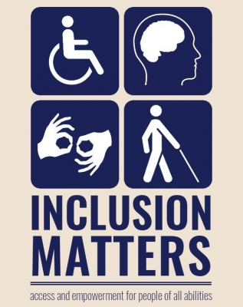
Candidates and Disability Issues
Image Description: A tan and navy poster with four squares of imagery including a wheelchair sign, an outline of a male’s head and his brain, an icon of hands symbolizing sign language, and a walking icon with a cane. Underneath the image is the text “inclusion matters – access and empowerment for people of all abilities”.

Slide 14
Less than one-third of voters overall remember hearing, reading, or seeing anything from congressional or presidential campaigns about issues that are important to people with disabilities. African American voters are most likely to recall hearing something from campaigns. Independents and voters in the Midwest are least likely.
Leading up to the November 2020 General Election, did you hear, read, or see anything from congressional or presidential campaigns about issues that are important to people with disabilities?
 | All Yes | No
Men | 30 | 64
Women | 32 | 62
Under 50 | 32 | 62
Over 50 | 30 | 65
Northeast | 33 | 62
Midwest | 26 | 68
South | 35 | 61
West | 29 | 64
White | 30 | 65
African American | 38 | 57
Latino | 29 | 66
API | 29 | 64
Democrat (ID) | 34 | 61
Independent (ID) | 26 | 69
Republican (ID) | 32 | 61
31% Yes
Among those who heard, read, or saw something, 53% voted for Biden and 46% voted for Trump. Those who heard, read, or saw something voted 53% for the Democratic candidate and 46% for the Republican candidate on the congressional ballot.

Slide 15
Voters with disabilities, particularly women with disabilities, and voters with a close friend with disabilities are most likely to have heard, read, or seen something.
Leading up to the November 2020 General Election, did you hear, read, or see anything from congressional or presidential campaigns about issues that are important to people with disabilities?
 | All | PWD | Family | Friends | PWD/Family/Friends | PWD Men | PWD Women | PWD <50 | PWD 50+ | PWD BG States | P/F/F in BG States | Voted Trump | Voted Biden
Yes, heard | 19 | 25 | 22 | 23 | 23 | 26 | 24 | 25 | 26 | 22 | 22 | 18 | 20
Yes, read | 14 | 15 | 19 | 31 | 18 | 14 | 16 | 22 | 9 | 7 | 13 | 13 | 16
Yes, saw | 14 | 17 | 13 | 28 | 16 | 11 | 22 | 21 | 13 | 13 | 17 | 14 | 14
All yes, combined | 31 | 41 | 36 | 47 | 38 | 36 | 46 | 41 | 42 | 33 | 33 | 31 | 33
No | 63 | 55 | 59 | 51 | 58 | 61 | 50 | 55 | 55 | 61 | 62 | 63 | 63

Slide 16
A solid majority of voters believe it is very important that candidates treat people with disabilities with dignity and respect – a core value among all voters, voters with disabilities, and voters with disabilities/family/friends since 2016. The simple act of treating disabled people with respect is powerful and in an election season where hundreds of races are going to be decided by 5-points or less, courting these groups is good politics and good policy.
How important is it to you personally that candidates treat people with disabilities with dignity and respect?
^Lake Research Partners and The Tarrance Group a pre-election and election night omnibus survey November 6 through November 8, 2016, that included issue questions on behalf of RespectAbility. A total of 1,200 likely voters nationwide who voted in the 2016 elections (margin of error of +/-2.8%) were reached.
^^Lake Research Partners conducted a mixed mode survey for NDRN from August 12 – August 20th, 2019 among 1,000 adults nationwide with a disability, or who have an immediate family member or close friend with a disability.
 | Somewhat important |  | A little important
 | Very important |  | Not important at all

Slide 17
Voters across demographic subgroups believe it is very important that candidates treat people with disabilities with dignity and respect. We see the greatest intensity of support among the voters with disabilities/family/friends, older voters, whites, African Americans, and Democrats. There is a 13-point gap in intensity between Biden and Trump voters.
How important is it to you personally that candidates treat people with disabilities with dignity and respect?
 |  | PWD | Fam | Friend | PWD/Family/Friends | M | W | <30 | 30-39 | 40-49 | 50-64 | 65+ | White | AA | Latinx | API | Dem | Ind | Rep | Voted Trump | Voted Biden
Very important | 83 | 90 | 89 | 87 | 88 | 82 | 84 | 80 | 79 | 82 | 85 | 87 | 85 | 86 | 77 | 67 | 89 | 83 | 77 | 77 | 90
Somewhat important | 9 | 5 | 8 | 5 | 7 | 10 | 8 | 11 | 14 | 8 | 10 | 5 | 8 | 8 | 12 | 21 | 6 | 10 | 12 | 13 | 5
A little important | 3 | 2 | 1 | 3 | 2 | 3 | 2 | 3 | 3 | 2 | 2 | 3 | 2 | 3 | 3 | 9 | 2 | 2 | 4 | 4 | 1
Not important at all | 2 | 1 | 1 | 6 | 2 | 2 | 2 | 1 | 2 | 5 | 2 | 1 | 2 | 1 | 4 | 1 | 1 | 1 | 4 | 3 | 1
Important | 93 | 96 | 97 | 91 | 95 | 92 | 93 | 91 | 93 | 90 | 95 | 92 | 93 | 94 | 89 | 87 | 95 | 94 | 90 | 90 | 95
Not important | 5 | 3 | 3 | 9 | 4 | 5 | 4 | 4 | 5 | 7 | 4 | 5 | 5 | 4 | 7 | 10 | 3 | 3 | 7 | 8 | 2
Within the battleground states, 95% of voters with disabilities and voters with disabilities/family/friends say candidates treating people with disabilities with dignity and respect is important. 90% of voters with disabilities and 88% of the voters with disabilities/family/friends in battleground states think it is very important.

Slide 18
Across demographic subgroups, a solid majority of voters believe it is very important that congressional and presidential campaigns address issues that are important to people with disabilities. African American voters are especially likely to say it is very important.
How important is it to you that congressional and presidential campaigns address issues that are important to people with disabilities?
 | Very Important | Not Important
Men | 59 | 13
Women | 60 | 10
Under 50 | 57 | 11
Over 50 | 62 | 11
Northeast | 59 | 11
Midwest | 60 | 11
South | 61 | 11
West | 57 | 12
White | 59 | 12
African American | 77 | 7
Latino | 56 | 13
API | 34 | 17
Democrat (ID) | 68 | 8
Independent (ID) | 59 | 8
Republican (ID) | 52 | 17
Trump | 51 | 15
Biden | 68 | 7
 | Somewhat important |  | A little important
 | Very important |  | Not important at all

Slide 19
We see the greatest rating of importance for issues for people with disabilities among voters with disabilities, especially those in battleground states, men with disabilities, older people with disabilities, and Biden voters who heard something around disabilities during the election.
How important is it to you that congressional and presidential campaigns address issues that are important to people with disabilities?
 | All Voters | PWD | Fam | Friend | PWD/Family/Friends | PWD Men | PWD Women | PWD <50 | PWD 50+ | Heard Issues Biden | Heard Issues Trump | Didn’t Hear Biden | Didn’t Hear Trump | PWD BG States | P/F/F BG States
Very important | 60 | 81 | 66 | 60 | 69 | 84 | 78 | 76 | 86 | 82 | 62 | 62 | 48 | 79 | 62
Somewhat important | 26 | 12 | 24 | 30 | 21 | 8 | 16 | 16 | 10 | 17 | 27 | 25 | 32 | 11 | 25
A little important | 8 | 4 | 6 | 5 | 6 | 6 | 3 | 7 | 2 | 1 | 9 | 8 | 11 | 6 | 8
Not important at all | 4 | 1 | 3 | 5 | 3 | 1 | 2 | 1 | 1 | 0 | 2 | 2 | 6 | 2 | 3
Important | 86 | 94 | 90 | 90 | 90 | 93 | 95 | 92 | 95 | 99 | 88 | 86 | 80 | 91 | 88
Not important | 11 | 6 | 9 | 10 | 9 | 7 | 4 | 8 | 4 | 1 | 11 | 10 | 17 | 8 | 10

Slide 20
At least 9 in 10 voters agree that our communities are at their best when all people, including people with disabilities, have opportunities, and that people with disabilities should be at decision making tables just like everyone else. Voters also strongly agree with statements that call for disability issues to be included in national policies and for candidates and their campaigns to include this constituency in their efforts and fight against stigmas and bias.
Now let me read you some statements and please tell me if you agree or disagree with each statement. [TIER ONE]
All Voters
 | Not so strongly agree
 | Strongly agree

Slide 21
At least two-thirds of voters also strongly agree with statements that center people with disabilities and highlight their contributions to the workplace, underscore the historical biases they have faced, and talk about how voting on issues important to this community can bring about change. Statements focused on the individual around the issues and motivation to vote fall into a second tier. Voters are more likely to strongly agree that issues around disability and healthcare influence their motivation to vote rather than disability issues alone.
Now let me read you some statements and please tell me if you agree or disagree with each statement. [TIER TWO]
All Voters
 | Not so strongly agree
 | Strongly agree
*split sampled question

Slide 22
The top tier of statements is also strong, especially among voters with disabilities. More than 9 in 10 older voters with disabilities and voters with disabilities in battleground states strongly agree our communities are at their best when all people, including people with disabilities, have the opportunity to get skills, jobs, and succeed.
Tell me if you agree or disagree with each statement. [TOP TIER]
% Strongly Agree | All Voters | PWD | Fam | Friend | PWD/Family/Friends | PWD Men | PWD Women | PWD <50 | PWD 50+ | Heard Issues Biden | Heard Issues Trump | Didn’t Hear Biden | Didn’t Hear Trump | PWD BG States | P/F/F BG States
Our communities are at their best when all people, including people with disabilities, have the opportunity … | 80 | 91 | 85 | 84 | 87 | 91 | 91 | 86 | 95 | 88 | 81 | 83 | 73 | 92 | 87
People with disabilities should be at decision making tables, just like anyone else | 76 | 85 | 78 | 77 | 80 | 87 | 83 | 83 | 86 | 85 | 69 | 82 | 70 | 85 | 80
Disability issues should be included in national policies on health care | 73 | 84 | 80 | 77 | 81 | 86 | 82 | 84 | 84 | 86 | 66 | 83 | 61 | 88 | 84
Candidates and their campaigns should reach out to and include people with disabilities … | 70 | 81 | 77 | 63 | 76 | 83 | 79 | 76 | 85 | 83 | 66 | 77 | 61 | 79 | 75
America's leaders should fight stigmas and bias that limit opportunities for people with disabilities | 70 | 79 | 75 | 68 | 75 | 79 | 78 | 78 | 80 | 82 | 70 | 77 | 57 | 80 | 75

Slide 23
Voters with disabilities strongly agree with all statements at higher rates than overall voters with disabilities/family/friends overall, as do Biden voters who heard about issues around disabilities from campaigns. Younger voters with disabilities are more likely than older voters with disabilities to strongly agree that candidates’ stances on issues around disability influence who they voted for and how motivated they were to vote this election.
Tell me if you agree or disagree with each statement. [SECOND TIER]
% Strongly Agree | All Voters | PWD | Fam | Friend | PWD/Family/Friends | PWD Men | PWD Women | PWD <50 | PWD 50+ | Heard Issues Biden | Heard Issues Trump | Didn’t Hear Biden | Didn’t Hear Trump | PWD BG States | P/F/FBG States
People with disabilities bring unique talents to the workplace that benefit employers and organizations | 69 | 83 | 75 | 60 | 76 | 81 | 85 | 78 | 87 | 80 | 66 | 72 | 62 | 82 | 75
People with disabilities have faced deep inequality, ableism and oppression. They need to be heard | 68 | 84 | 70 | 65 | 73 | 81 | 86 | 83 | 85 | 84 | 54 | 77 | 59 | 84 | 72
Voting on the issues that matter to the disability community can bring about change | 66 | 79 | 71 | 59 | 72 | 81 | 77 | 78 | 80 | 81 | 61 | 72 | 59 | 79 | 69
Issues around disability and health care influence how motivated I am to vote* | 43 | 53 | 49 | 42 | 50 | 51 | 55 | 50 | 55 | 65 | 40 | 47 | 31 | 49 | 48
Candidates' stances on issues around disability influenced who I voted for in the election | 38 | 54 | 40 | 36 | 43 | 57 | 51 | 57 | 52 | 59 | 39 | 42 | 25 | 56 | 47
Issues around disability influence how motivated I am to vote* | 35 | 50 | 35 | 49 | 41 | 52 | 47 | 57 | 44 | 49 | 26 | 42 | 24 | 48 | 40
*split sampled question

Slide 24
There has been a 10-point increase in intensity among people with disabilities and a 5-point increase among the voters with disabilities/family/friends strongly agreeing that issues around disability influence how motivated they are to vote.
Issues around disability influence how motivated I am to vote*
PWD
PWD/Family/Friends
*split sampled question
 | Not so strongly agree
 | Strongly agree
^^Lake Research Partners conducted a mixed mode survey for NDRN from August 12 – August 20th, 2019 among 1,000 adults nationwide with a disability, or who have an immediate family member or close friend with a disability.

Slide 25
Voters are concerned that cuts to health care and the ACA will have a negative impact on people with disabilities, including about 2 in 5 who are very concerned. African Americans, Democrats, voters in the Northeast, and older voters are most likely to be very concerned. A majority of Republicans are not concerned.
How concerned are you that cuts to health care and the ACA will have a negative impact on people with disabilities?
 | Very Concerned | Not Concerned
Men | 39 | 34
Women | 42 | 30
Under 30 | 39 | 32
30 to 39 | 39 | 33
40 to 49 | 36 | 39
50 to 64 | 40 | 34
Over 65 | 47 | 25
Northeast | 49 | 27
Midwest | 41 | 30
South | 39 | 35
West | 36 | 34
White | 37 | 34
African American | 66 | 18
Latino | 44 | 26
API | 33 | 40
Democrat (ID) | 66 | 12
Independent (ID) | 39 | 32
Republican (ID) | 17 | 54
 | Somewhat concerned |  | A little concerned
 | Very concerned |  | Not concerned at all

Slide 26
Voters with disabilities, particularly women with disabilities, are very concerned that cuts to health care and the ACA will have a negative impact on people with disabilities.
How concerned are you that cuts to health care and the ACA will have a negative impact on people with disabilities?
 | All Voters | PWD | Family | Friends | PWD/Family/Friends | PWD Men | PWD Women | PWD <50 | PWD 50+ | PWD BG States | Dis. Comm. BG States
Very concerned | 41 | 52 | 47 | 42 | 46 | 44 | 60 | 54 | 50 | 47 | 46
Somewhat concerned | 22 | 18 | 19 | 18 | 20 | 19 | 17 | 17 | 20 | 14 | 17
A little concerned | 14 | 8 | 12 | 22 | 13 | 8 | 9 | 10 | 7 | 10 | 15
Not concerned at all | 19 | 15 | 20 | 15 | 18 | 21 | 8 | 17 | 12 | 20 | 19
Concerned | 62 | 70 | 65 | 60 | 65 | 63 | 77 | 71 | 70 | 62 | 63
Not concerned | 32 | 23 | 32 | 37 | 31 | 30 | 16 | 28 | 19 | 31 | 33

Slide 27
Washington, DC | Berkeley, CA
LakeResearch.com
202.776.9066

