Slide 1
What do you hope to learn during today’s webinar?
Webinar: The 2020 Census Disability Count Continues
Notes:
White Board Activity

Slide 2
The 2020 Census Disability Count Continues May 5, 2020

Slide 3
Today’s Speakers
Robin Troutman
Deputy Director
NACDD
Julie Ward
Senior Executive Officer, Public Policy
The Arc
Erika Hudson
Public Policy Analyst
NDRN

Slide 4
Have you been counted in the 2020 Census yet?
Notes:
Poll Question
Oh yes!
Not yet.
Not sure.

Slide 5
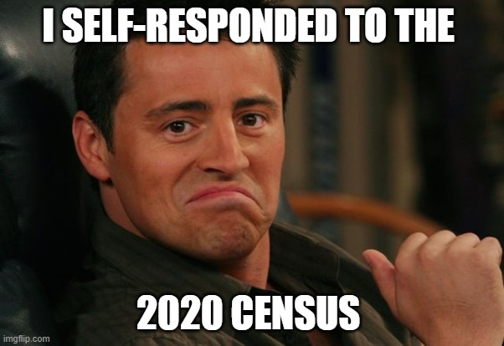

Slide 6
Today’s Agenda
Census 201
Census 2020 and COVID-19
Frequently Asked Questions

Slide 7
Census 201
Why does the 2020 Census matter to the disability community? (not a full list)
Hard-To-Count Population
Federal Funding
Community Resources

Slide 8
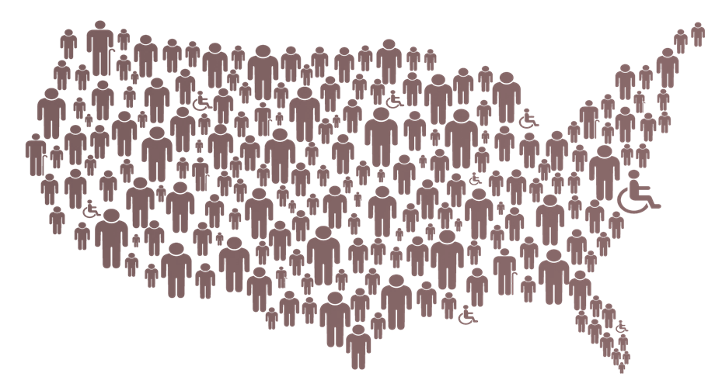
Hard-to-Count Population
Hard to contact
Hard to interview
Hard to persuade
Hard to locate
Nearly 1 in 5 people with disabilities live in areas considered hard-to-count.
Notes:
The 2020 Census aims to count every single person in the United States.
Nearly 1 in 5 People with disabilities live in areas considered hard-to-count.
An area is defined as hard-to-count either if households in the area were counted by the bureau solely through the update/enumerate operation or if its mail return rate for the 2010 Census was 73 percent or less. Figures only refer to the total civilian non-institutionalized population of people with disabilities. Source: Georgetown Center on Poverty and Inequality and National Disability Rights Network, 2019. Authors’ calculations using U.S. Census Bureau, American Community Survey 5-year Estimates 2017, and the CUNY Center for Urban Research, Hard-to-Count map data, 2019.
The reasons according to the bureau are hard locate, persuade, interview and contact
When poorly designed and tested, inaccessible surveys restrict the participation of people with disabilities.
Similarly, insufficient or ineffective outreach efforts may also mean that people with disabilities are not informed of the necessary resources available to support completing the survey.
Anecdotal evidence suggests that people with disabilities may be suspicious of the government or concerned that personal information will be used to determine their eligibility for government programs.
This is why we must come together and say count me in….

Slide 9
Federal Funding
Supplemental Nutrition Assistance Program
Special Education Grants to States
Medical Assistance Program
Notes:
Census data are used to apportion multiple federal funding streams. In fiscal year 2015, census data were used to determine the allocation of $675 billion for 132 programs, including Medicaid, SNAP, the Section 8 Housing Choice Voucher program, Head Start, and Highway Planning and Construction. The top five programs by amount of funds that used census-based population numbers and population characteristics to determine fund distribution in fiscal year 2015 were: Medicaid ($311 billion); the Supplemental Nutrition Assistance Program (SNAP $71 billion); Medicare Part B ($70 billion); Highway Planning and Construction ($38 billion); and the Federal Pell Grant program ($29.9 billion), according to a Census report (for a full listing of programs see page 3 here.)
IDEA program relies on the Census for counts of school-aged children and children in poverty at the state and school district levels. Even though multiple data sources are used to allocate these funds, including the American Community Survey and administrative data, funding relies on annually updated Census population estimates.
Census data are used to calculate the rate at which federal funds match state spending on programs including Medicaid, Temporary Assistance for Needy Families (TANF), and the Children’s Health Insurance Program (CHIP). This rate, known as the Federal Medical Assistance Percentage, depends on a state’s per capita income relative to the national average (CHIP uses an “enhanced FMAP“). For example, the federal share of Medicaid spending ranges from 50 percent in wealthier states to a maximum of 83 percent in poorer states. Annual population estimates derived from decennial census counts are used as the denominator in calculating these per capita amounts, while total personal income data come from a different source, the Bureau of Economic Analysis. If the population estimates are artificially low, the per capita income estimates will be too high – which means some states would not receive the full federal reimbursement to which they are entitled.

Slide 10
Community Resources
Notes:
2020 Census data will provide baseline numbers not only for funding of federal disaster relief, but also preparation, rescue coordination and even locations for new fire stations.

Slide 11
Why does the 2020 Census matter to you?
Notes:
Poll Question
I want to make sure everyone is counted
I want accurate representation in Congress
I want accurate population data when making business decisions
I want to make sure my community receives fair and accurate federal funding
I want to make sure my community receives fair and accurate resources
I want to shape my future

Slide 12
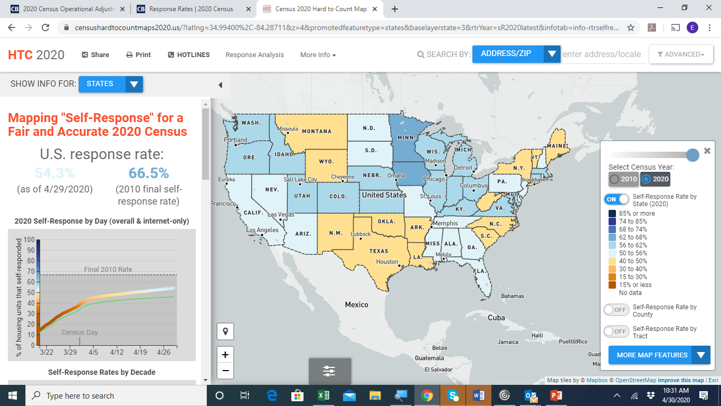
Census 2020 and COVID-19
The Count Continues!
Response Rates
Hard-to-Count Map
Notes:
Screen-share.

Slide 14
The Count Continues!
March 12 – October 31 | Self-Response Phase
April 2 – September 3 | Group Quarters (e-Response and Paper Enumeration) Operation
June 13 – July 9 | Update Leave (except Puerto Rico)
July 1 – September 3 | In-Person Group Quarters Operation
August 11 – October 31 | Nonresponse Follow-up (NRFU)
Notes:
The update leave operation is designed to occur in areas where the majority of housing units either do not have mail delivered to the physical location of the housing unit or the mail delivery information for the housing unit cannot be verified. For example in some rural areas the mail is delivered to a post office box but census forms are not mailed to PO boxes. A census worker will come to the house and note the address and leave a paper form
Nonresponse follow up is when Census takers interview households in person. These are households that have not filled out the census

Slide 15
What FAQs do you get about the 2020 Census?
Webinar: The 2020 Census Disability Count Continues
Notes:
White Board activity

Slide 16
Frequently Asked Questions
Are disability-related questions asked on the 2020 Census?
No, disability-related questions are asked on the American Community Survey (ACS).
Notes:
I think it is important to say that the 2020 Census only asks a few questions that are studied for years and approved by Congress. It has to be short to get people to respond. The more questions the less response. Purpose is to count everyone in the country. ACS goes much deeper into other demographic information and is ongoing to keep data up to date.

Slide 17
American Community Survey (ACS)
Notes:
Talk about the ACS in more detail here.
Questions as they appear on the form
Is this person deaf or does he/she have serious difficulty hearing?
Is this person blind or does he/she have serious difficulty seeing even when wearing glasses?
Because of a physical, mental, emotional condition, does this person have serious difficulty concentrating, remembering, or making decisions?
Does this person have serious difficulty walking or climbing stirs?
Does this person have difficulty dressing or bathing?
Because of a physical, mental or emotional condition, does this person have difficulty doing errands alone such as visiting a doctor’s office or shopping?

Slide 18
Frequently Asked Questions
Is my 2020 Census data safe?
Yes!
Notes:
Show video on next slide to discuss further.

Slide 19
Frequently Asked Questions
Notes:
Play video.

Slide 20
Frequently Asked Questions
How are people living in group quarters, like nursing homes, college dorms and group homes counted in the 2020 Census?
People in group living situations will be counted through a process known as the Group Quarters (GQ) operation.
**Resource Alert: How Are Group Homes Being Counted in the Census?

Slide 21
Frequently Asked Questions
How can I help?
Resource sharing, social media, emails, virtual events, etc.
Notes:
Next slide showcases resources including plain language documents

Slide 22
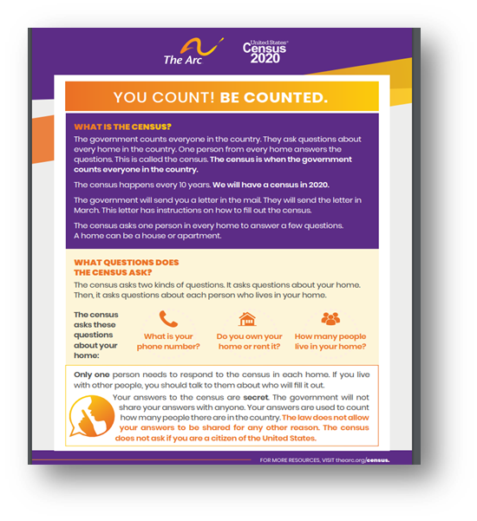
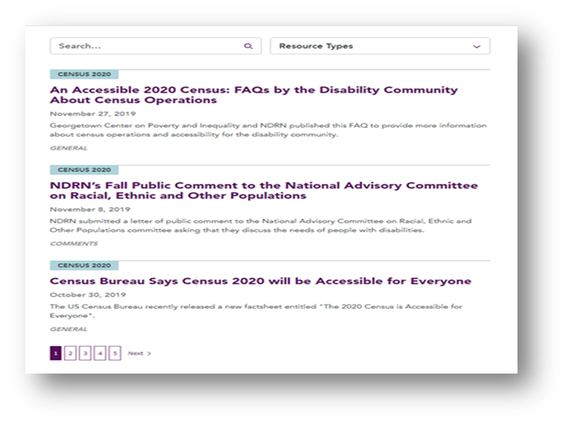
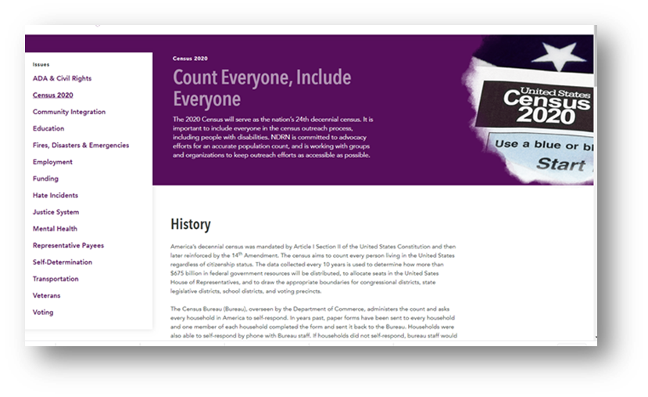
Frequently Asked Questions
Notes:
There are so many resources out there!

Slide 23
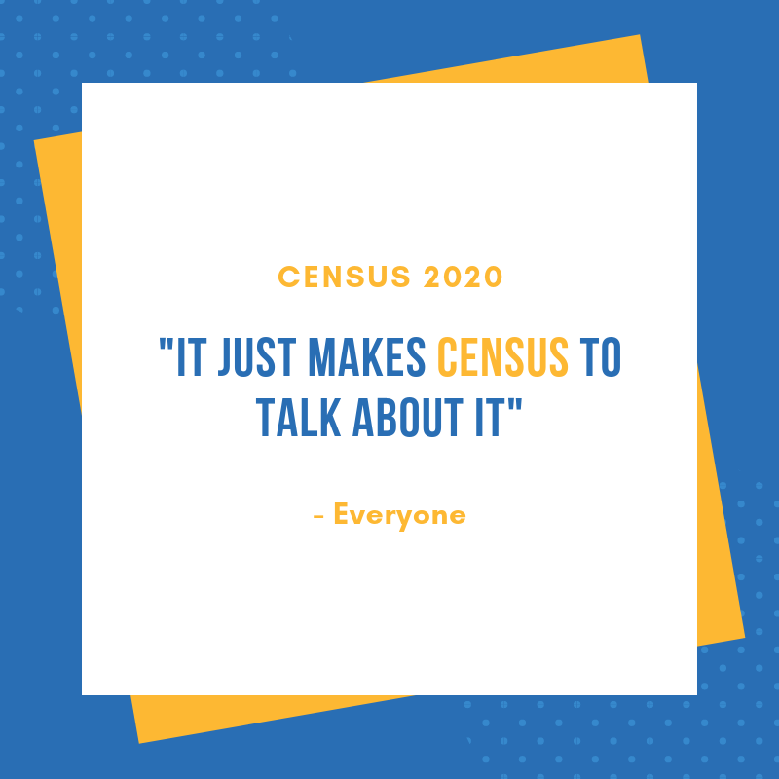

Slide 24
Questions?

Slide 25
Thank You!
The Arc of the United States
National Association of Councils on Developmental Disabilities National Disability Rights Network
National Alliance On Mental Illness
Autistic Self Advocacy Network
American Association of People with Disabilities
Disability Rights Education and Defense Fund
National Council on Independent Living
Self Advocates Becoming Empowered
American Network of Community Options and Resources
National Association of State Directors of Developmental Disabilities Services

