Slide 1
Which states do you think will see an increase in their population after the 2020 Census?

Slide 3
The Census & the Disability Community: Get Ready to Be Counted! Thursday, February 13th

Slide 4
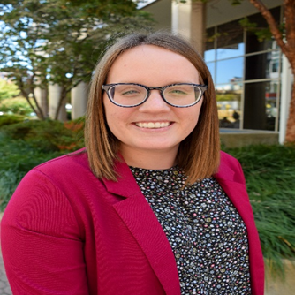
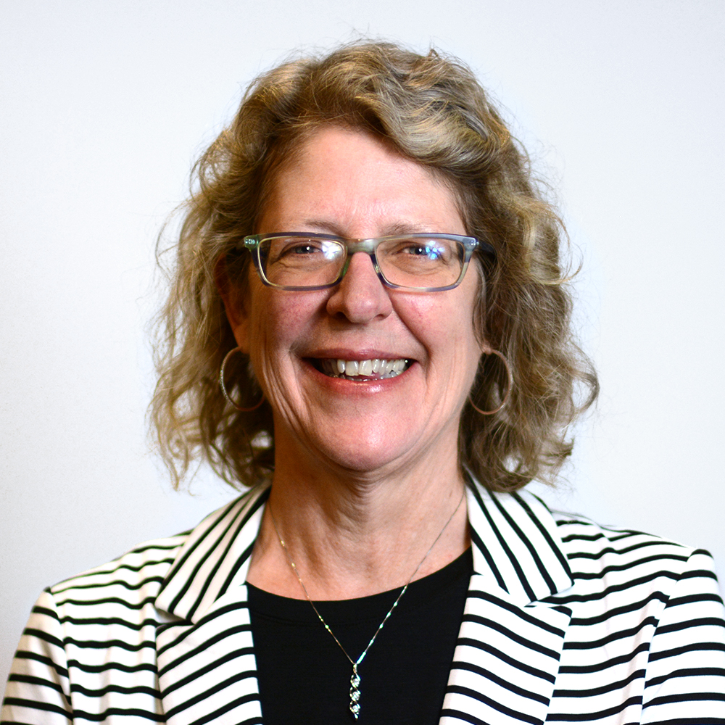
Speakers
Erika Hudson
Public Policy Analyst
National Disability Rights Network
Julie Ward
Senior Executive Officer, Public Policy
The Arc
Notes:
Erika

Slide 5
Agenda
Census 2020
The Disability Community
An Accessible 2020 Census
Key Dates
Resources
Get Ready to Be Counted!
Notes:
Claire

Slide 6
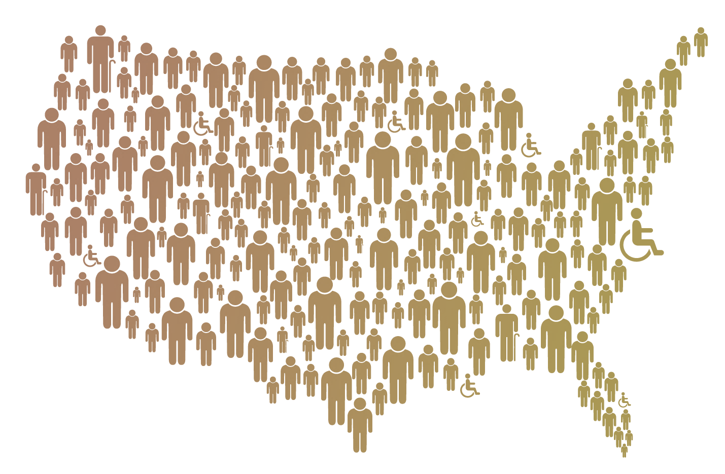
Census 2020
Notes:
Claire

Slide 7
Census 2020 Cont.
Most households will receive an invitation in the mail to self-respond online.
These households can also respond by phone or by mail.
Census enumerators will visit all households that did not self-respond, to collect responses in person.
Notes:
Claire

Slide 8
Will disability-related questions be on the 2020 Census?

Slide 9
Census 2020 Cont. II
The 2020 Census will ask for the following information:
Number of people in household
Homeownership (owner/renter)
Name
Sex
Age
Race and Hispanic Origin
Relationship Status in Household
Telephone Number
Notes:
Claire

Slide 10
Why is the census important for people with disabilities?
Notes:
Claire

Slide 11
The 2020 Census will allow us to know how many people live in the United States and this data will impact:
Federal Funding Guide how $1.5 trillion in federal funds are allocated every year – including programs like Medicaid, housing vouchers, SNAP, etc. and much more!
Congressional Seats determine how many seats in Congress each U.S. state will receive,
District Boundaries influence where the boundaries of legislative, school, and voting districts are drawn.
Notes:
claire

Slide 12
Persons who distrust the government • People of color • Young children
People with disabilities are considered a “hard-to-count” population by the Census Bureau
LGBTQ persons • People experiencing homelessness • Immigrants

Slide 13
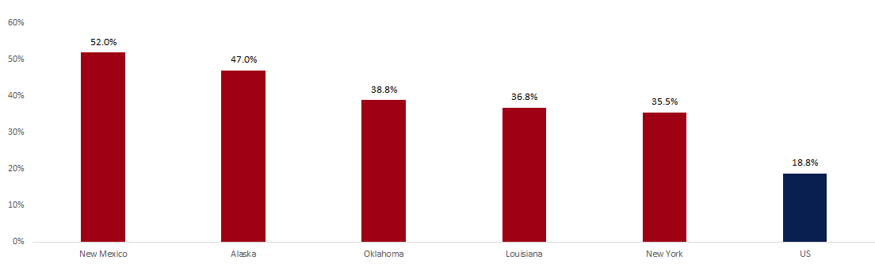
The Disability Community
Nearly One in Five People with Disabilities Live in Areas Considered Hard-to-Count

Slide 14
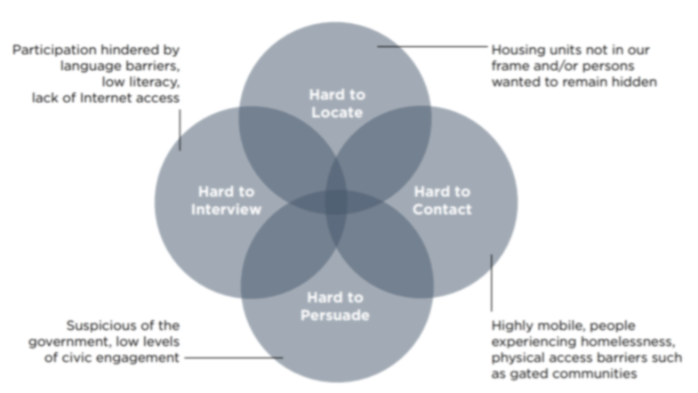
Why Are People with Disabilities Hard-to-Count?
Notes:
When poorly designed and tested, inaccessible surveys restrict the participation of people with disabilities.
Similarly, insufficient or ineffective outreach efforts may also mean that people with disabilities are not informed of the necessary resources available to support completing the survey.
Anecdotal evidence suggests that people with disabilities may be suspicious of the government or concerned that personal information will be used to determine their eligibility for government programs.

Slide 15
An Accessible 2020 Census
“The 2020 Census is accessible for everyone.”- US Census Bureau
Online Section 508 Compliant and a video guide in American Sign Language
By Phone Telephone Device for the Deaf (TDD/TTY) technology.
By Mail Braille and large print language guides (“Sample Ballots”).
Notes:
Claire

Slide 16
Key Dates
March
April
May
June
July
April 1: Census Day
March 1 - July 31: Telephone help is available
March 12 - April 30: People respond online, by phone or mail
April 2 - June 5: Special counting process for people who live in group quarters
May 13 - July 30: Census workers follow up

Slide 17
Frequently Asked Questions
Can we help people?
Yes but…
Where am I counted?
Where you live and sleep most of the time

Slide 18
Frequently Asked Questions Cont.
Will I be asked if I am a citizen?
Is my information shared?
Census information is not shared and is protected by law
The decennial Census does not ask about citizenship

Slide 19
Frequently Asked Questions Cont. II
What are group quarters?
Special counting process for prisons, nursing homes, colleges and some group homes
https://www.georgetownpoverty.org/issues/democracy/census/2020-census-group-quarters-operation/
2020 Census Detailed Operational Plan for Group Quarters Operation (GQ)

Slide 21
What 2020 Census resources are you currently using?

Slide 22
Census Resources
Fact sheets, brochures, and videos
Include Spanish and plain language versions
thearc.org/census
Notes:
Claire
National partner with the census bureau
All materials in English and Spanish

Slide 23
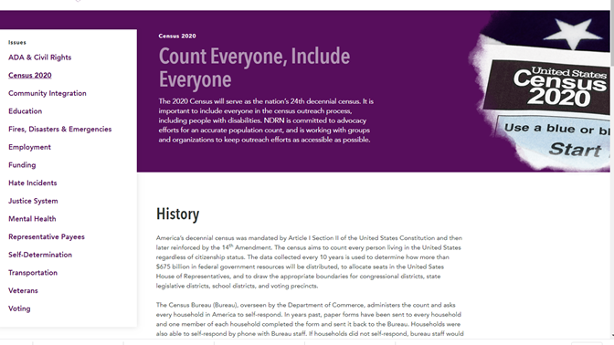
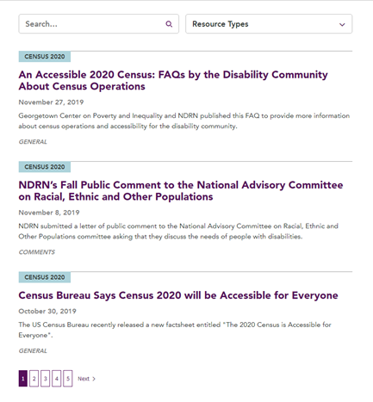
Census 2020 Resources Cont.
ndrn.org/census
Notes:
C

Slide 24
How can you help?
Share information online
Talk about the census at meetings
Work with other organizations
Partner with the Census Bureau
https://www.census.gov/partners.html
Partner with Complete Count
https://census.gov/programs-surveys/decennial-census/2020-census/complete_count.html

Slide 26
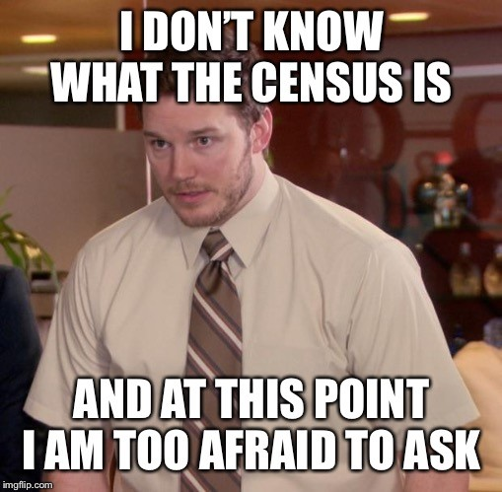

Slide 27
Thank you!

