Slide 1
Creating Accessible Microsoft Word Documents
Notes:
Take a few moments:
What feels uncertain to you in your organization now and over the next two years?
What have you, your team and the organization as a whole done to manage it?

Slide 2
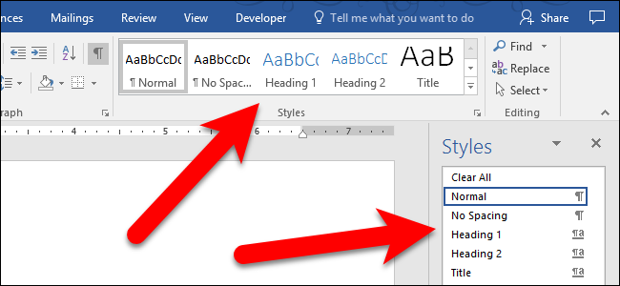
Using Styles to Format Content
Use styles to identify what is a heading, body text, lists, etc. Styles make it easy to control and update the formatting of your document as well as make it easy for screen readers to understand what the content is.
This is especially important for headings in your document. If your document is converted into a PDF document, the heading will automatically become PDF bookmarks.

Slide 3
Use Columns and Tables
Use the columns tool.
If your document has columns, use the columns tool (“Layout” -> “Columns”) in Word.
Use tables tool (“Insert” -> “Tables”) in Word to create tables of information.
Do not use tabs to setup tables. If you have existing tables setup with tabs, Word has a tool to convert the tabbed content into tables (Insert, Table, Convert Text to Table).
Do not Merge cells, or Split Cells

Slide 4
Use Columns and Tables (continued)
Rule: When using a table, specify/designated the row or column (“Design” -> check “Header Row” under “Table Style Options”) that has the “Header” information.

Slide 5
Text Descriptions
Alternative text descriptions for images.
All non-text content has alternative text (Alt Text). Screen readers speak the alternative text to describe images and other-non text content that users can’t see.
For complex images that require an explanation of more than 255 characters, an appendix can be notated and used.
If images are decorative, no alt text needed, add a blank text (“ ”) in the description field.

Slide 6
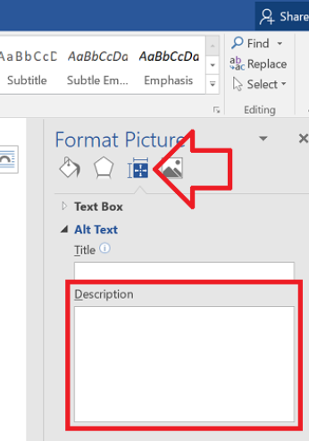
Text Descriptions (continued)
How to add alt text
Right-click on the image in the document and choose ‘Format Picture’
In the settings at the right of the window, click on the 'Layout & Properties' icon.
Expand 'Alt Text'
Enter a description for the image in the 'Description' field.

Slide 7
Hyperlinks
If your document contains links, the links must work
If there is a link on the text, describe the link for printing
For example NDRN (http://www.ndrn.org)

Slide 8
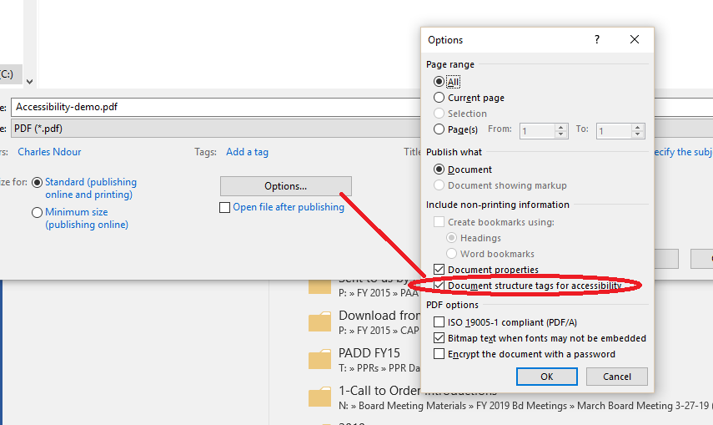
Preserve Accessibility when Converting to PDF
In order for an Adobe PDF document to be accessible, it must be a “tagged” PDF.

Slide 9
Fonts
Sans Serif Fonts are the easiest for people to read. For example:
Arial
Calibri (default)
Tahoma
Verdana

Slide 10
Fonts (continued)
Serif Fonts are difficult. For example:
Times New Roman
Georgia
Cambria
Century Schoolbook

Slide 11
Font Size
The body text in your document should be big enough so that it does not present a problem for individuals with limited vision. Usually this means font sizes between 10 and 14 points
Large Print is 18 point or larger
22 point is the smallest font you should use in a PowerPoint presentation

Slide 12
Contrast
If you use background colors or images, there should be ample contrast between the background and foreground text.
Color Contrast Analyser: https://developer.paciellogroup.com/resources/contrastanalyser/
NDRN
NDRN

Slide 13
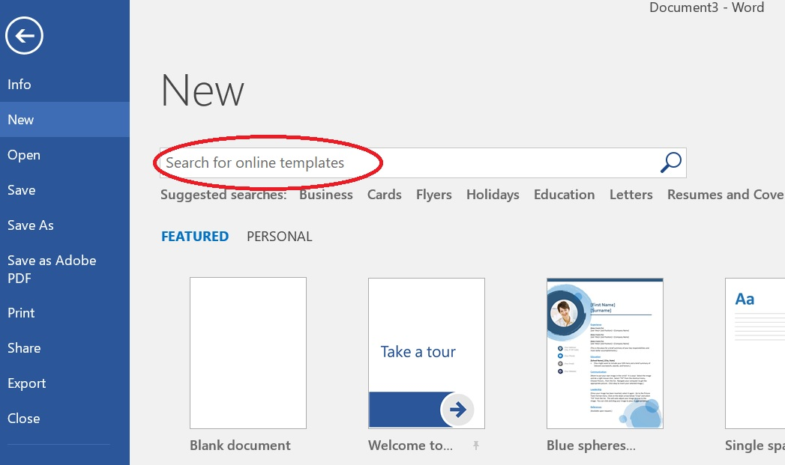
Accessible Templates
Microsoft offers a new tag in its templates library called “Accessible”.

Slide 14
Accessibility Checker
Save your document.
Click the File tab.
Click the Check for Issues button and choose Check Accessibility.
Click to select an individual item.
Scroll the Additional Information item in the Accessibility Checker pane to review the fix.
Continue to review the document; repeat Steps 4 and 5.

Slide 15
National Disability Rights Network Training and Advocacy Support Center
820 First Street NE, Suite 740
Washington, DC 20002
P: 202-408-9514 ◊ TTY: 202-408-9521
www.ndrn.org

